Slide 1
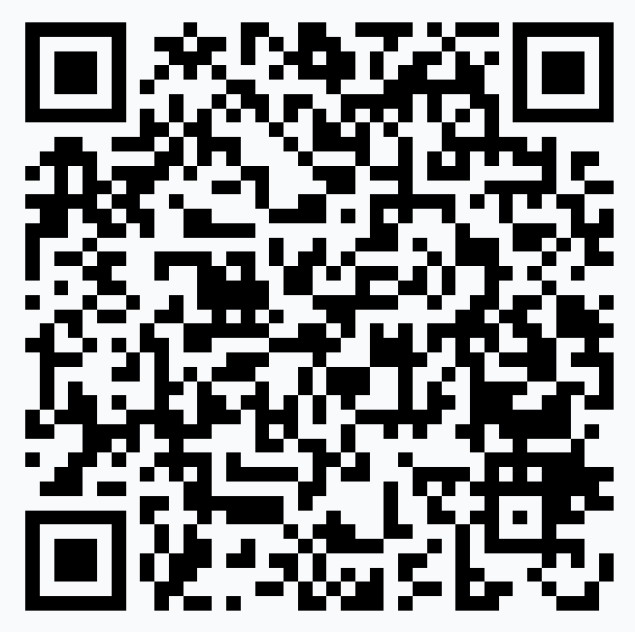
Presenting Your Best Self
Faculty Development Seminar
Emory Department of Psychiatry and Behavioral Sciences
Scan the QR code with your device camera
or
Text vphadke to 37607
or
Go to PollEv.com/vphadke
Varun Phadke MD
Associate Professor of Medicine
Division of Infectious Diseases
Emory University School of Medicine
varun.phadke@emory.edu
David Thylur MD
Assistant Professor of Medicine
Dept. of Psychiatry and Behavioral Sciences
Emory University School of Medicine
dthylur@emory.edu

Slide 2
Disclosures
None

Slide 3


Overview for this session
PART 1:
Presenter as Educator
Do I have to use slides?
How should I use them?
How do I engage the audience?

Slide 4




Overview for this session
PART 1:
Presenter as Educator
PART 2:
Presenter as Designer
Do I have to use slides?
How should I use them?
How do I engage the audience?
Why should I _______?
How do I _______?
Getting creative!

Slide 5
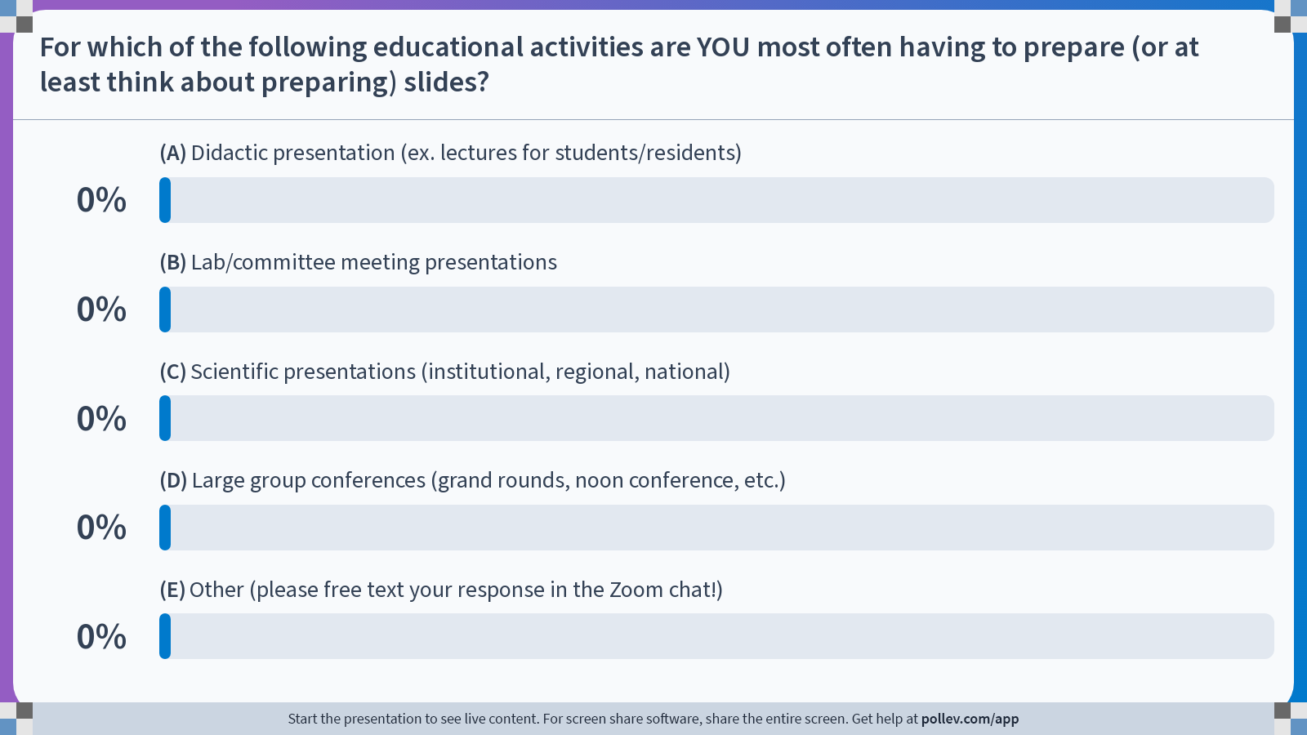
Notes:
Poll Title: Do not modify the notes in this section to avoid tampering with the Poll Everywhere activity.
More info at polleverywhere.com/support
Which of the following educational activities are YOU most often having to prepare (or at least think about preparing) slides?
https://www.polleverywhere.com/multiple_choice_polls/iaaXfYiSsPBMYIAK6qNbs?state=opened&flow=Default&onscreen=persist

Slide 6

May NOT need slides at all
Probably NEED at least some slides
May NOT need slides at all

Slide 7


Overview for this session
PART 1:
Presenter as Educator
PART 2:
Presenter as Designer
Do I have to use slides?
How should I use them?
How do I engage the audience?
Why should I _______?
How do I _______?
Getting creative!

Slide 8


Reorienting ourselves
I need to cover…
I could talk about…
I want to discuss…
My learners need to…
My learners could…
My learners want to…

Slide 9

A lesson from Dwight Schrute
Back
Notes:
Only play the first minute

Slide 10

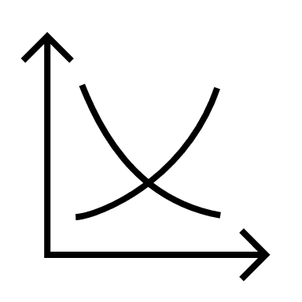



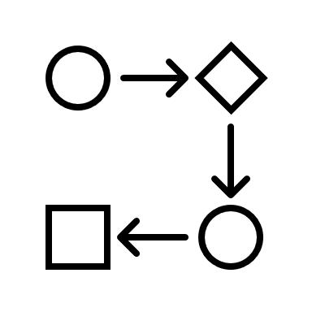


When slides can be helpful
Slides may be LESS effective if…
Information transmission
  Think about: Presenting data, figures, tables
Presenter-driven control of session
  Think about: A large group/remote audience
For asynchronous applications
  Think about: Review sessions, webinars, etc.
You want attendees to apply knowledge
You want a learner-directed session
Participation is part of the learning

Slide 11
Reflect on what session format would be best and what, if anything, slides would ADD
You have been tasked with teaching a group of medical students about trauma-informed communication skills
You are the faculty facilitator for a resident conference that includes a debrief of cases seen in the psychiatric emergency department
You are planning a session at a national meeting to identify strategies to address structural inequities in access to mental health providers

Slide 12


Slide 13
“Big Picture” decisions about presentations
Slide format
Slide number
Slide organization
Audience participation

Slide 14
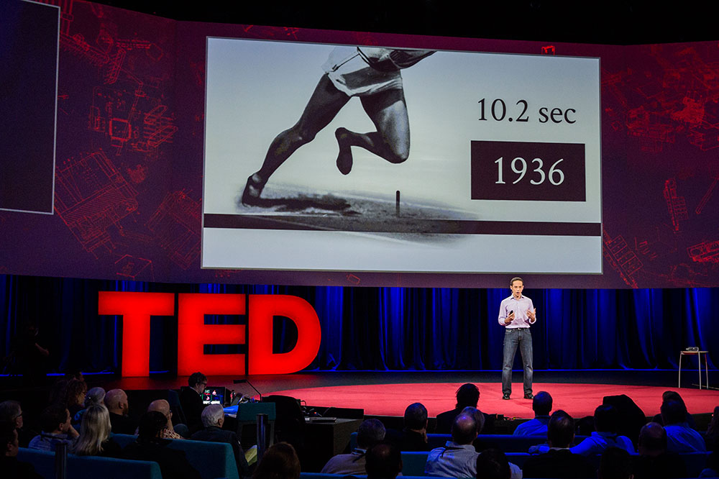
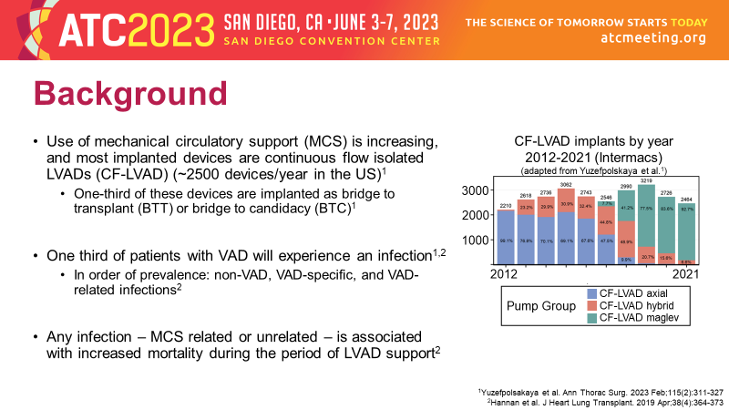
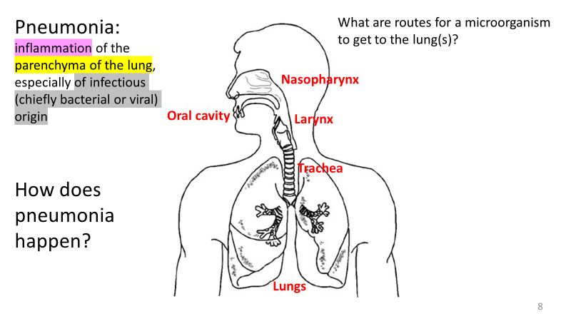
“Big Picture” decisions about presentations
Slide format
Slide number
Slide organization
Audience participation
Expectations
Know your venue/audience

Slide 15



PowerPoint
Everyone has it
Lots of free add-ins
Anchors us to present things in a certain way
Prezi
Free! (web-based)
Easy to create effects
Animations/transitions can be off-putting
Keynote
Free on Macs
Unique visual effects
Must be presented on a Mac to take advantage

Slide 16
“Big Picture” decisions about presentations
Slide format
Slide number
Slide organization
Audience participation
“Plan for one minute per slide”
Know yourself

Slide 17
One minute…to do what?
One minute per slide does NOT mean each slide should contain enough text that would take one minute to read it
When in the Course of human events, it becomes necessary for one people to dissolve the political bands which have connected them with another, and to assume among the powers of the earth, the separate and equal station to which the Laws of Nature and of Nature's God entitle them, a decent respect to the opinions of mankind requires that they should declare the causes which impel them to the separation.
We hold these truths to be self-evident, that all men are created equal, that they are endowed by their Creator with certain unalienable Rights, that among these are Life, Liberty and the pursuit of Happiness.--That to secure these rights, Governments are instituted among Men, deriving their just powers from the consent of the governed, --That whenever any Form of Government becomes destructive of these ends, it is the Right of the People to alter or to abolish it, and to institute new Government, laying its foundation on such principles and organizing its powers in such form, as to them shall seem most likely to effect their Safety and Happiness…

Slide 18
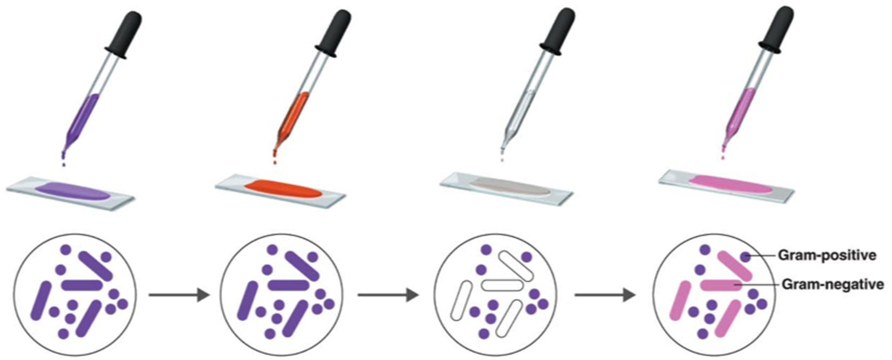
Slides with no text may take MINUTES to explain

Slide 19
The same “one-minute point” may be broken over MULTIPLE slides
Step 1:
Add crystal violet to a slide onto which bacteria have been smeared and heat fixed

Slide 20
The same “one-minute point” may be broken over MULTIPLE slides
Step 2:
Add an iodine solution (Gram’s iodine) to the slide, which will form a water insoluble complex with crystal violet

Slide 21
The same “one-minute point” may be broken over MULTIPLE slides
Step 3:
Add a decolorizer (ethyl alcohol or acetone) which dehydrates the cell wall of certain bacteria and traps crystal violet

Slide 22
The same “one-minute point” may be broken over MULTIPLE slides
Step 4:
Add a counter stain (usually safranin) to stain cells that did not retain crystal violet

Slide 23
“Big Picture” decisions about presentations
Slide format
Slide number
Slide organization
Audience participation
“Tell them what you are going to tell them, tell them, then tell them what you told them.”
-attributed to Aristotle

Slide 24

Presentation organization pearls
Start with learning objectives and/or an overview/outline slide
  These can be merged if the objectives will be tackled in order
Use signpost slides to indicate where you are in the presentation
  A recurring “Outline” slide is one example
End with a “Take home points” or “Summary” slide (that aligns with your objectives) instead of a generic “Questions?” slide

Slide 25



Presentation organization pearls
Start with learning objectives and/or an overview/outline slide
  These can be merged if the objectives will be tackled in order
Use signpost slides to indicate where you are in the presentation
  A recurring “Outline” slide is a simple example
End with a “Take home points” or “Summary” slide (that aligns with your objectives) instead of a generic “Questions?” slide

Slide 26
Signposting Example 1
Introduction
Part 1
Part 2
Part 3

Slide 27
Signposting Example 2
Background
Methods
Results
Conclusions
Next steps

Slide 28


Signposting Example 3
Cell wall
Proteins and sugars
50S
Ribosomes
50S/30S subunits
30S
50S
30S
Cell membrane
lipids
Bacterial chromosome
Circular, dsDNA, no nucleus

Slide 29



Presentation organization pearls
Start with learning objectives and/or an overview/outline slide
  These can be merged if the objectives will be tackled in order
Use signpost slides to indicate where you are in the presentation
  A recurring “Outline” slide is one example
End with a “Take home points” or “Summary” slide (that aligns with your objectives) instead of a generic “Questions?” slide

Slide 30
Reflect on what session format would be best and what, if anything, slides would ADD
You have been tasked with teaching a group of medical students about trauma-informed communication skills
You are the faculty facilitator for a resident conference that includes a debrief of cases seen in the psychiatric emergency department
You are planning a session at a national meeting to identify strategies to address structural inequities in access to mental health providers

Slide 31


“Big Picture” decisions about presentations
Slide format
Slide number
Slide organization
Audience participation
Analog
Digital

Slide 32

Go analog and “Hit Pause”
Insert a “blank” slide and verbally instruct the audience to engage in an activity
Insert a slide with instructions for an interactive exercise
  Think-Pair-Share
  Peer teaching
  Small group work
  Think-Answer-Pair-Answer
Remember to budget time for these pauses!
Disclaimer!
Usually practical only for in-person

Slide 33
Tech Tools – the Why and the How
Technological Tool | Educational Purpose | Available Modalities (not exhaustive)
Audience Response Software | To assess baseline knowledge To promote learning To assess learning | Zoom PollEverywhere Mentimeter Slido

Slide 34
Zoom Polling
Pros: Built into Zoom, requires no extra log in for those attending remotely
Cons: Limited to MCQ, requires you to be host/co-host and set up beforehand

Slide 35
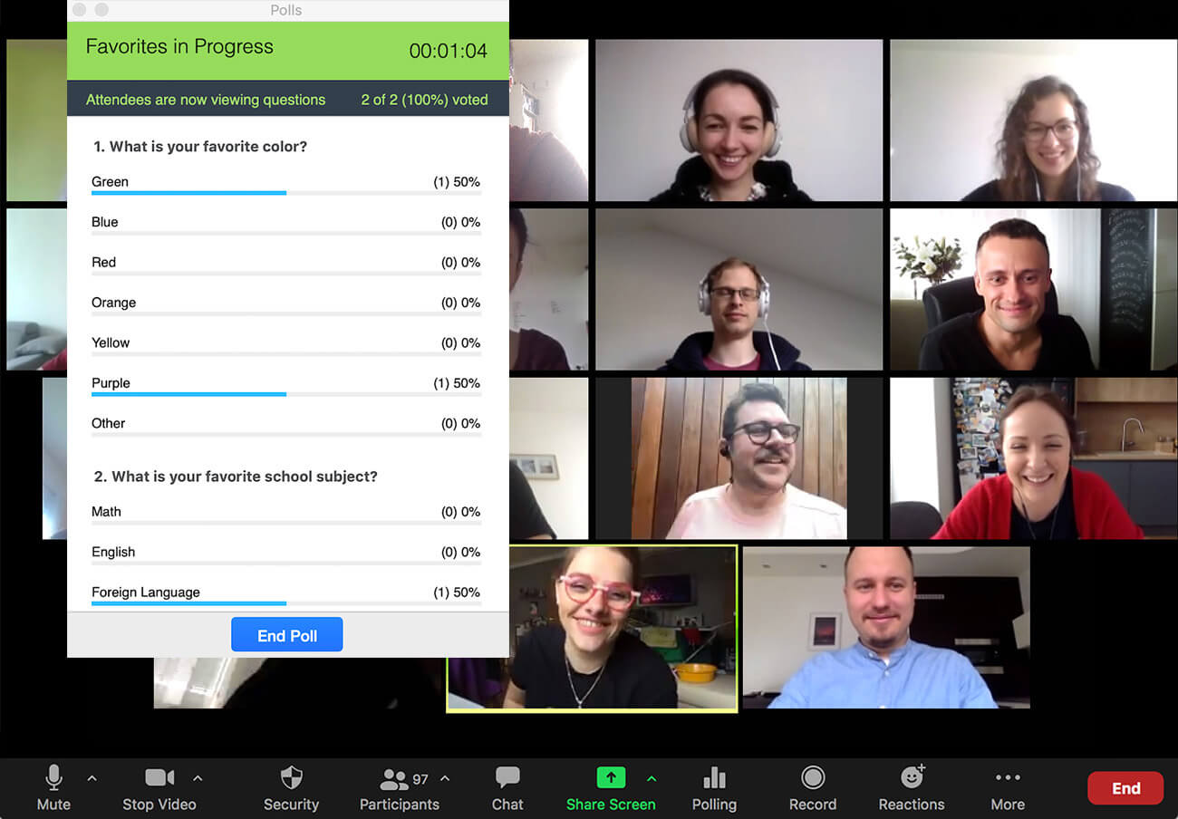

Slide 36
Poll Everywhere
Pros: Emory SOM has an institutional license, LOTS of features, integrates into slide presentation software
Cons: A bit of a learning curve

Slide 37
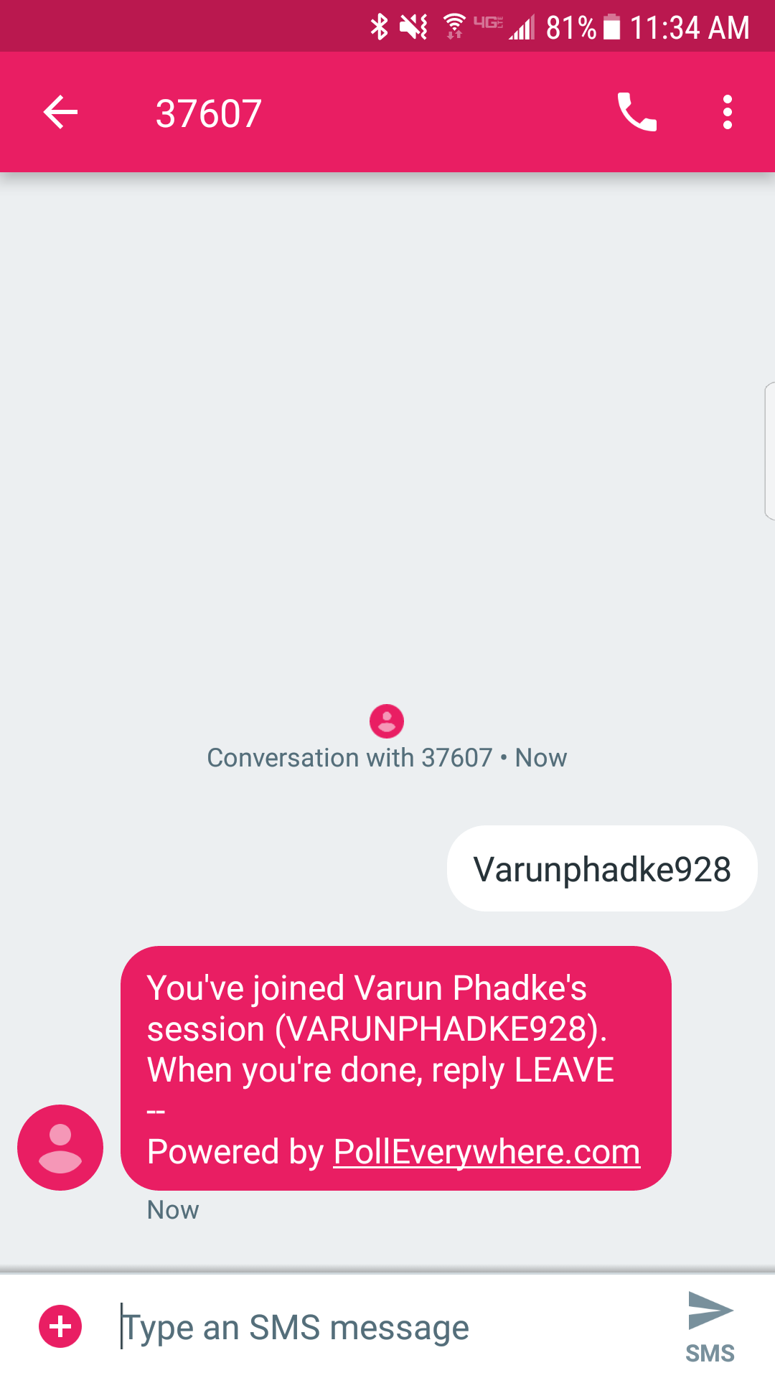
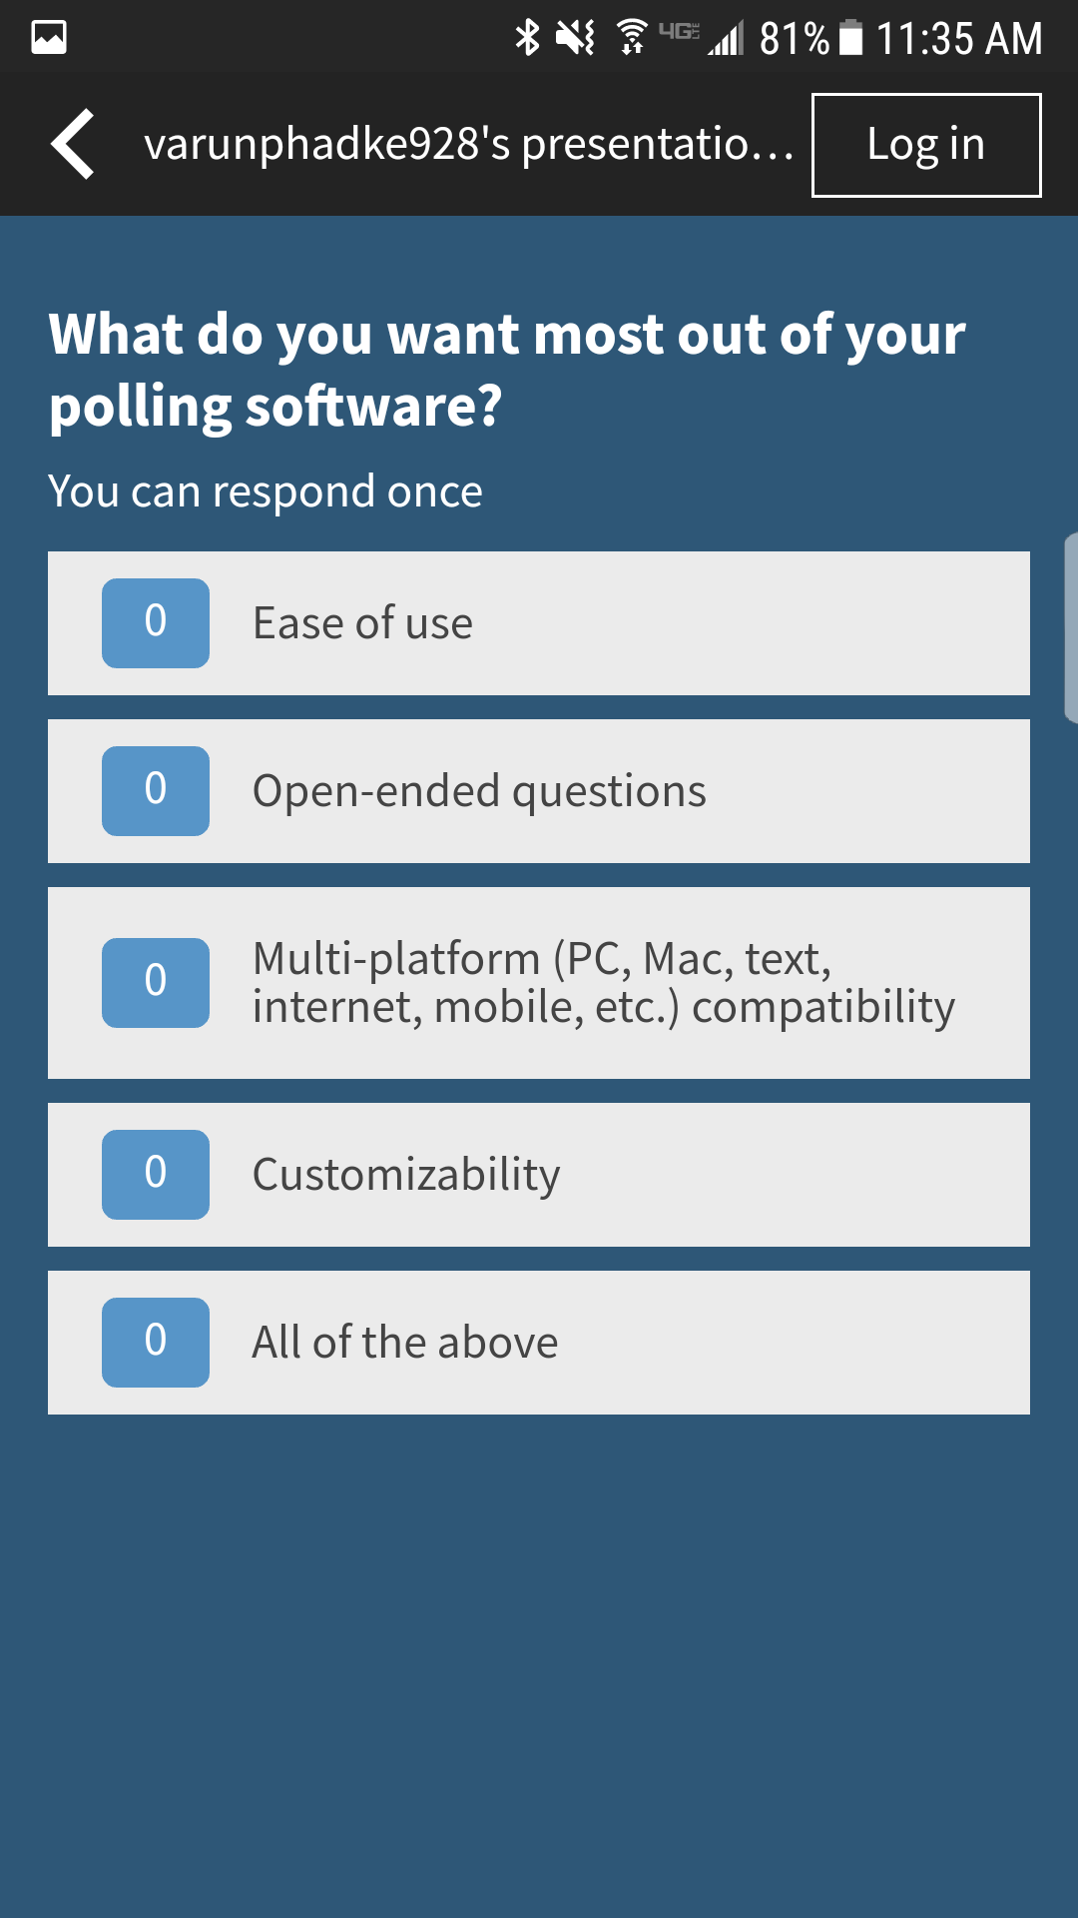
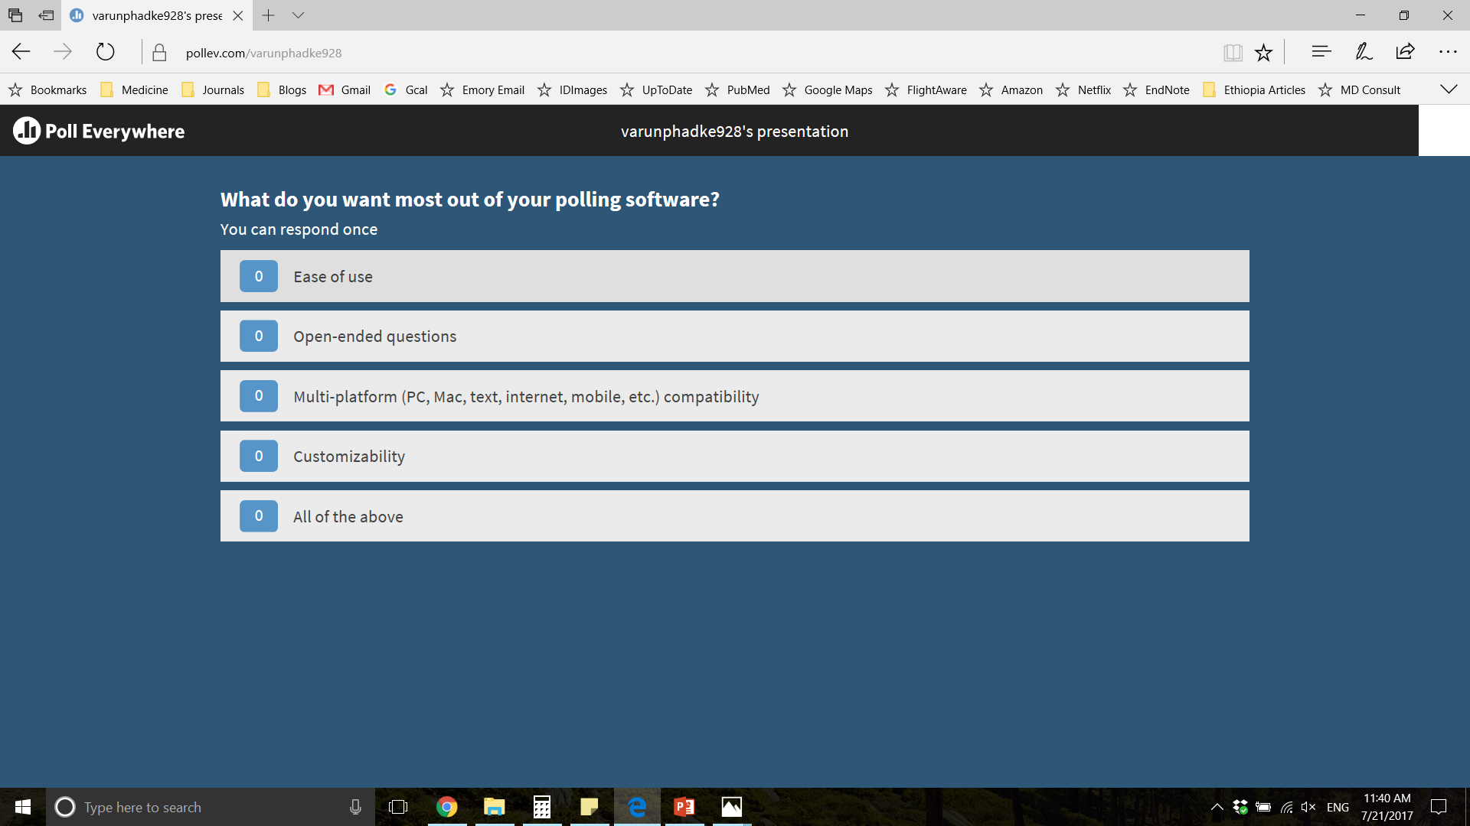
Multiple options for participation
Text
Mobile app
Internet

Slide 38


App available for Mac/iOS and PC/Android

Slide 39
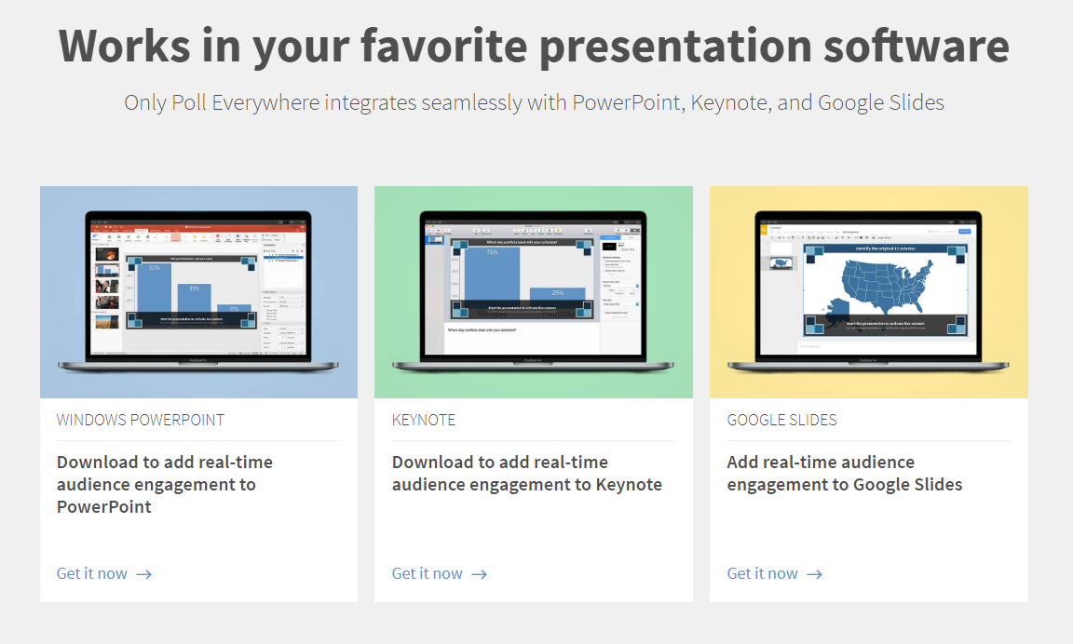

Slide 40
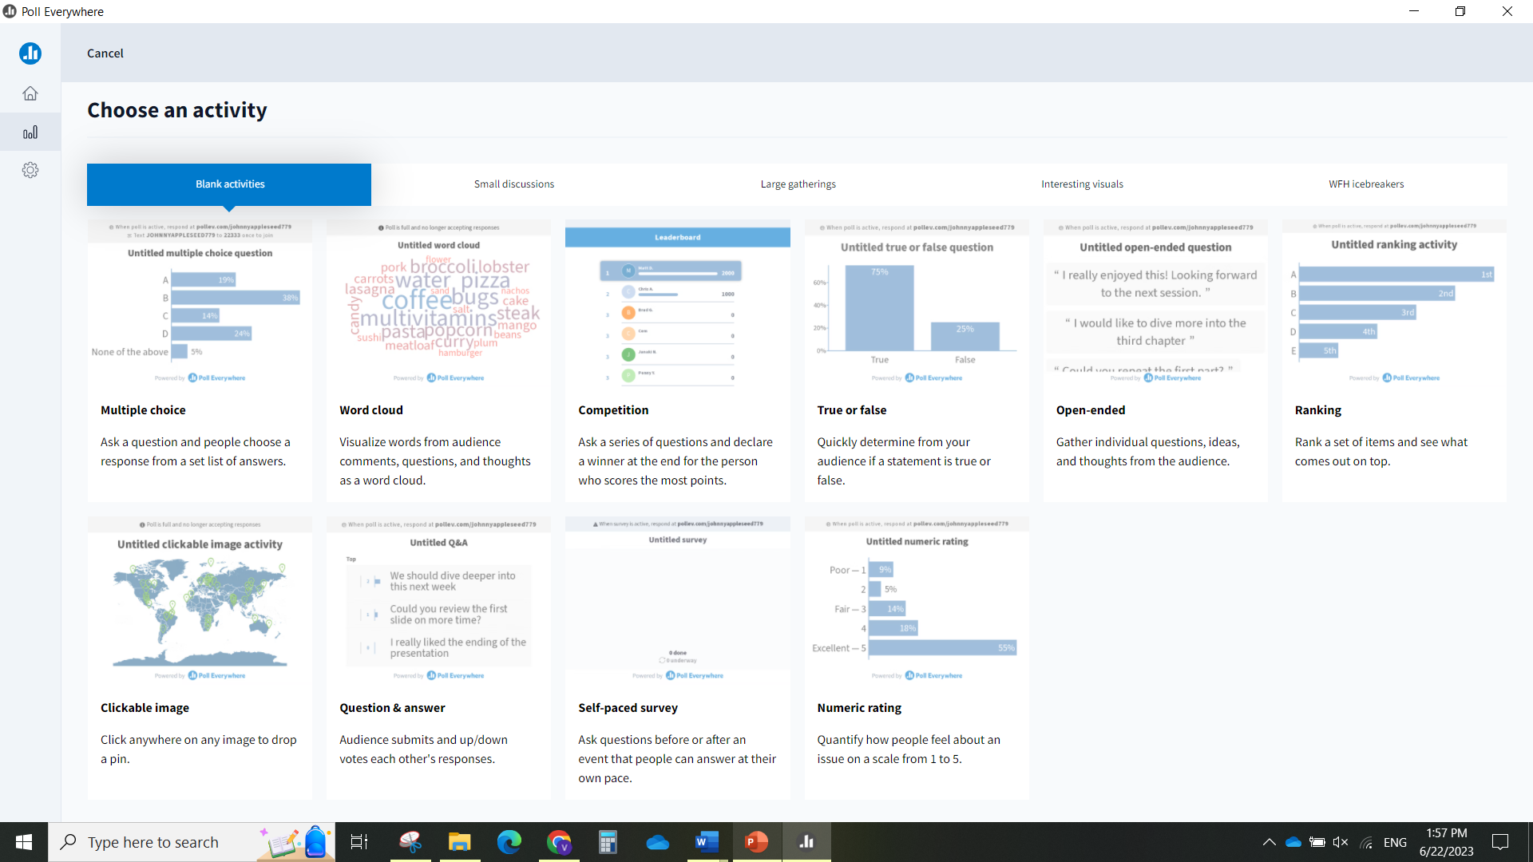

Slide 41
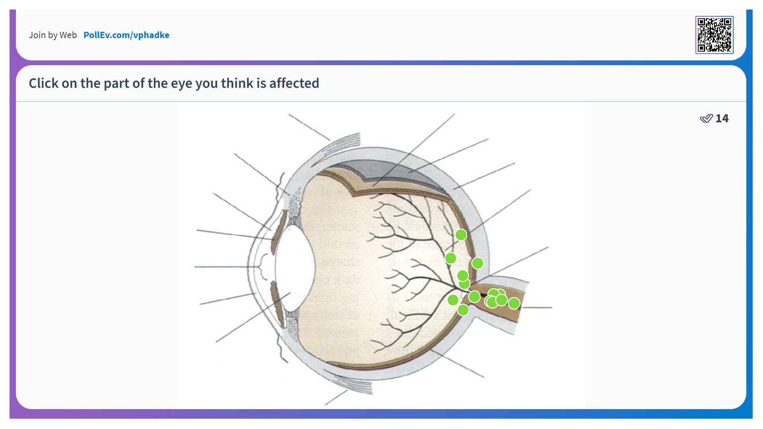

Slide 42
Mentimeter
Pros: Free version available (max 50 participants), stand-alone from slide presentation software, MANY dynamic templates/visual effects
Cons: Requires toggling back-and-forth, less easy for participants to “log in”

Slide 43
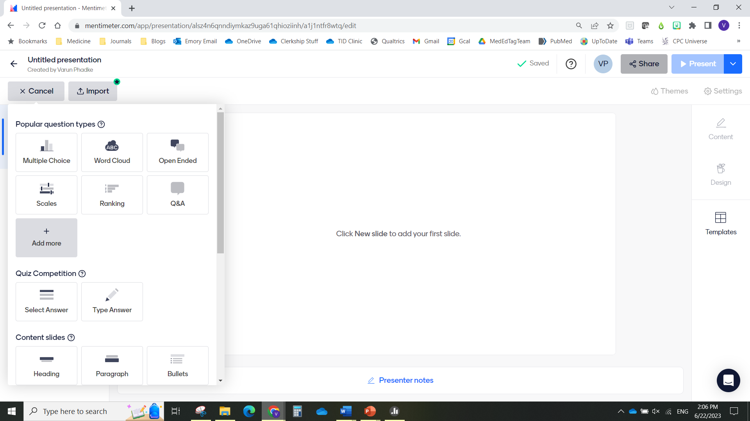

Slide 44
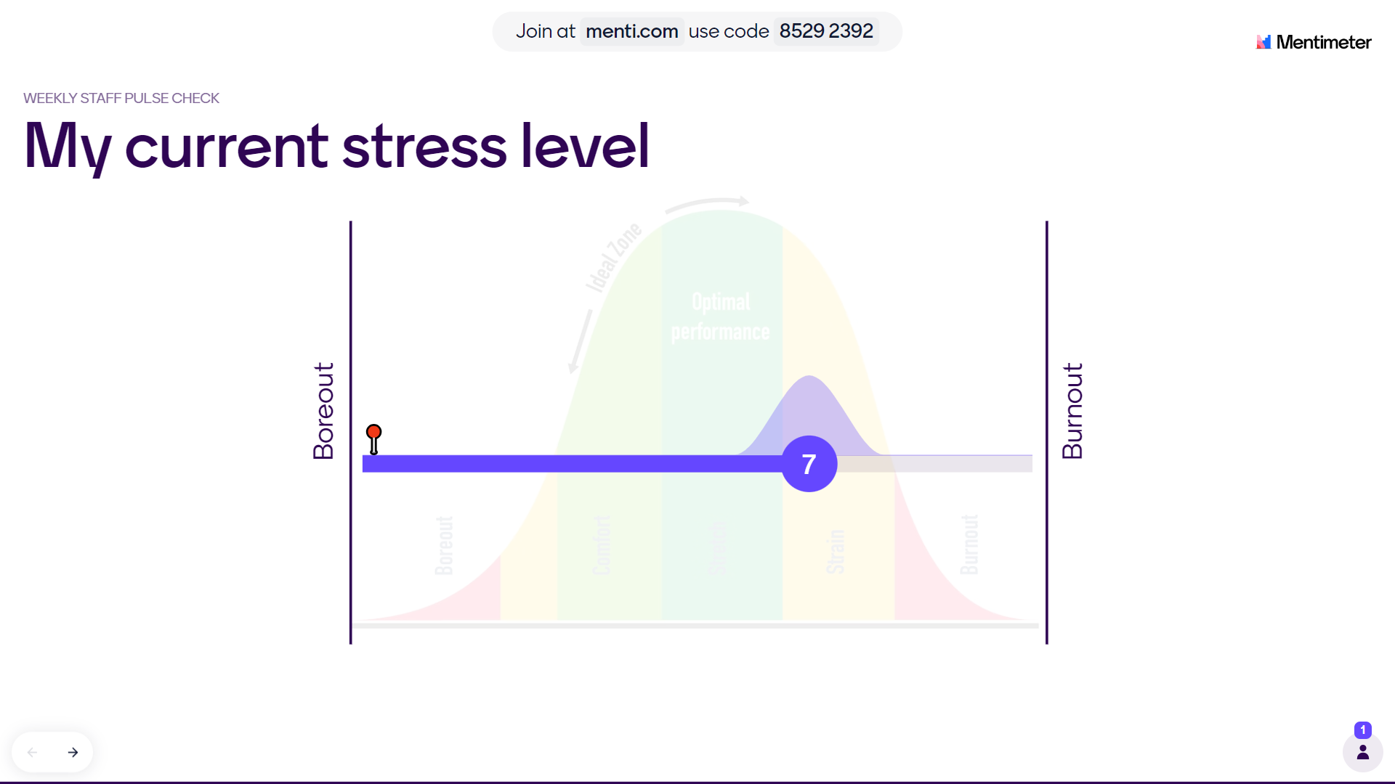

Slide 45
Tech Tools – the Why and the How
Technological Tool | Educational Purpose | Available Modalities (not exhaustive)
Audience Response Software | To assess baseline knowledge To promote learning To assess learning | Zoom PollEverywhere Mentimeter Slido
Gamification | To enhance engagement To build community | Kahoot!

Slide 46
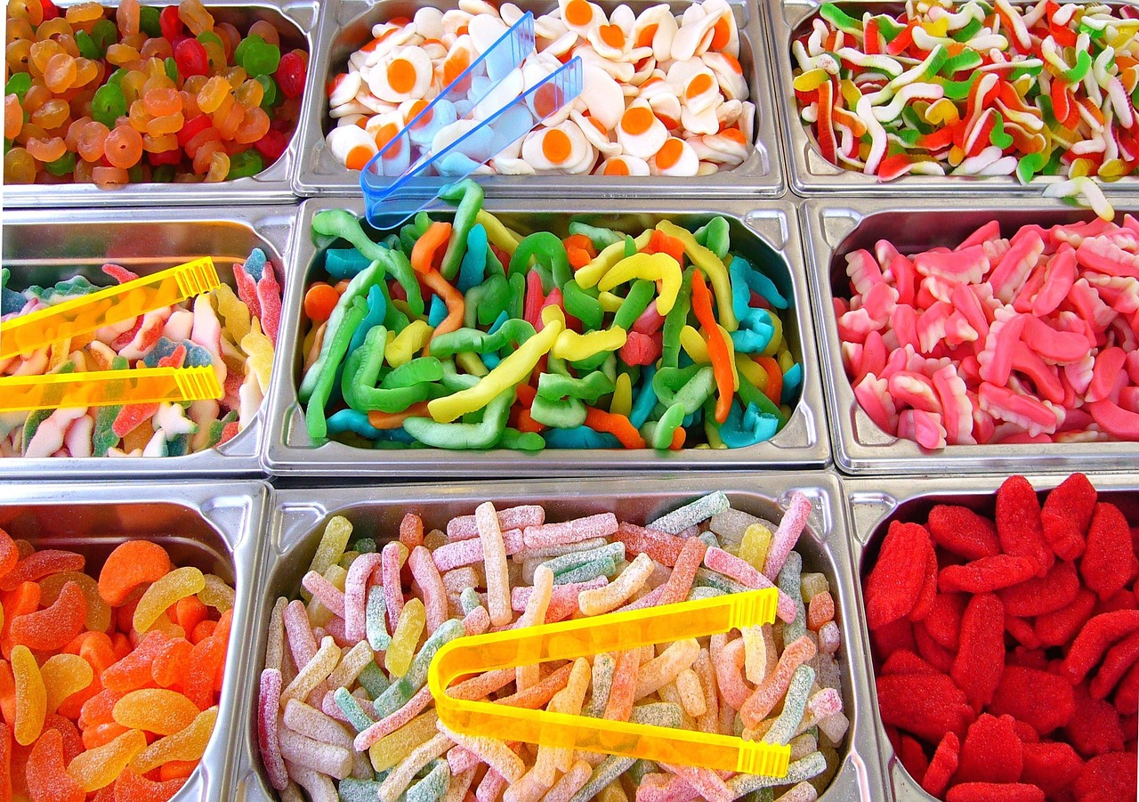
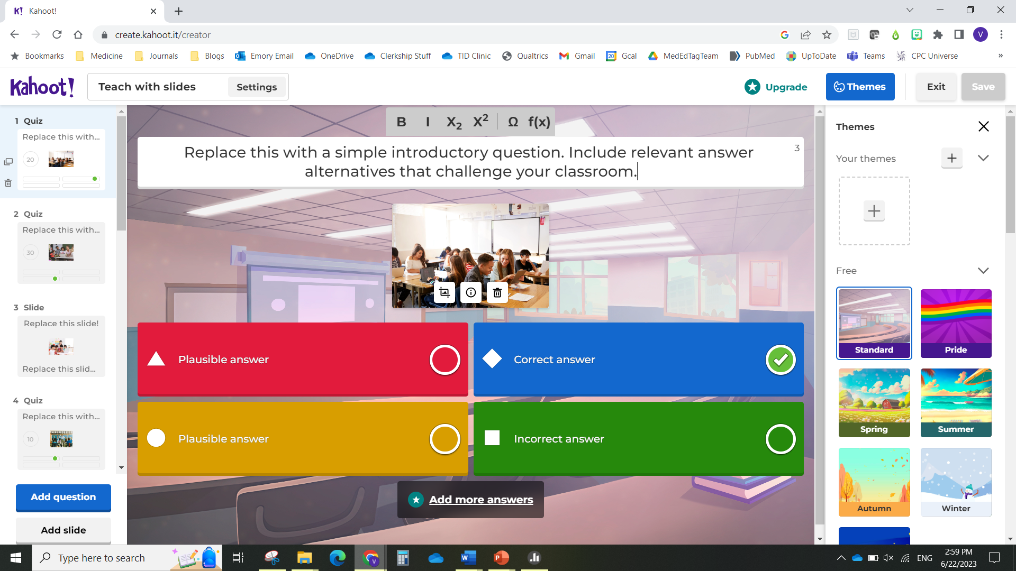
What is “gamification”?
Use of game-playing elements (teams, competition, rewards) to enhance audience engagement

Slide 47
Kahoot!
Pros: Does a lot of the backend logistics needed for gamification/competition
Cons: Free version limited, somewhat of a learning curve

Slide 49
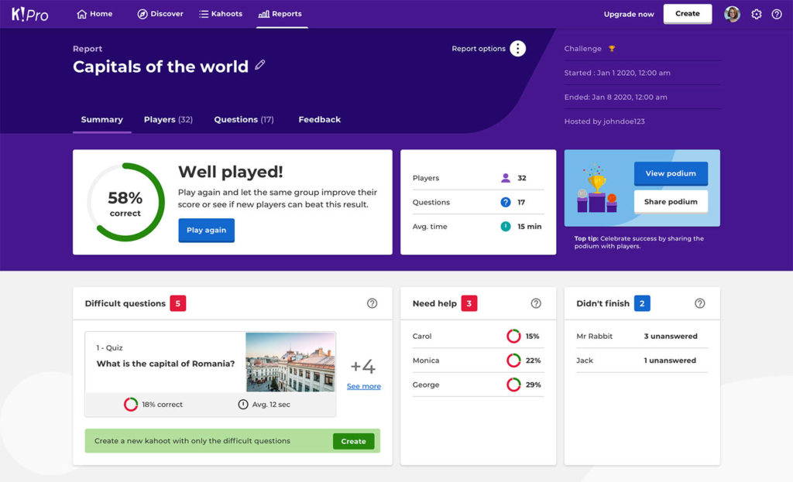

Slide 50
Tech Tools – the Why and the How
Technological Tool | Educational Purpose | Available Modalities (not exhaustive)
Audience Response Software | To assess baseline knowledge To promote learning To assess learning | Zoom PollEverywhere Mentimeter Slido
Gamification | To enhance engagement To build community | Kahoot!
Collaborative Documents | To facilitate participation To “take the pulse” of the class | Google Docs Google Jamboard Padlet

Slide 51
Google Docs
Pros: Everyone has it, no limits to participants
Cons: Limited to basic document templates (text entry)

Slide 52
Google Jamboard
Pros: A free-for-all digital whiteboard (text, images, draw), can be shared afterward
Cons: Can get chaotic and messy

Slide 53
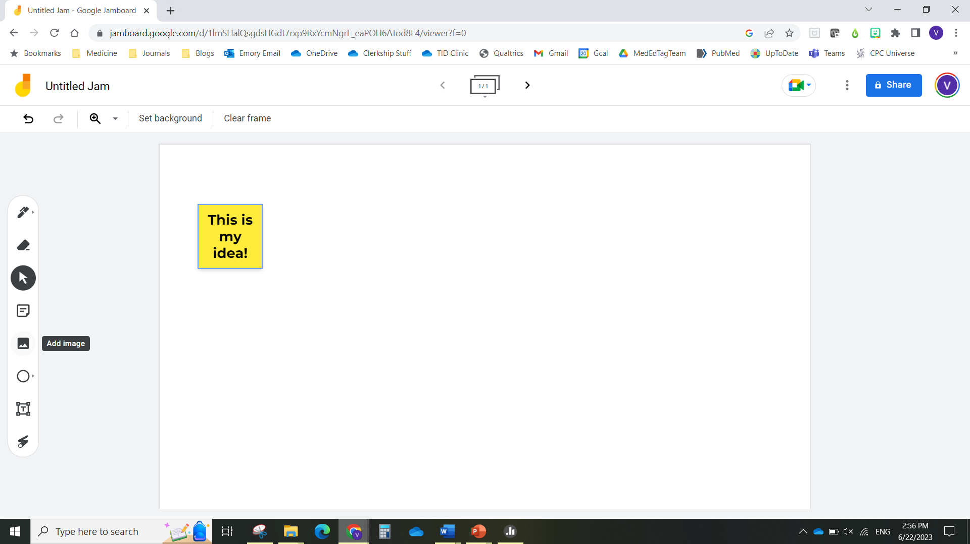

Slide 54
Padlet
Pros: Easy to participate, multiple templates, visually appealing
Cons: Free version limited to 4 active Padlets (but you can “archive” the old ones)

Slide 55
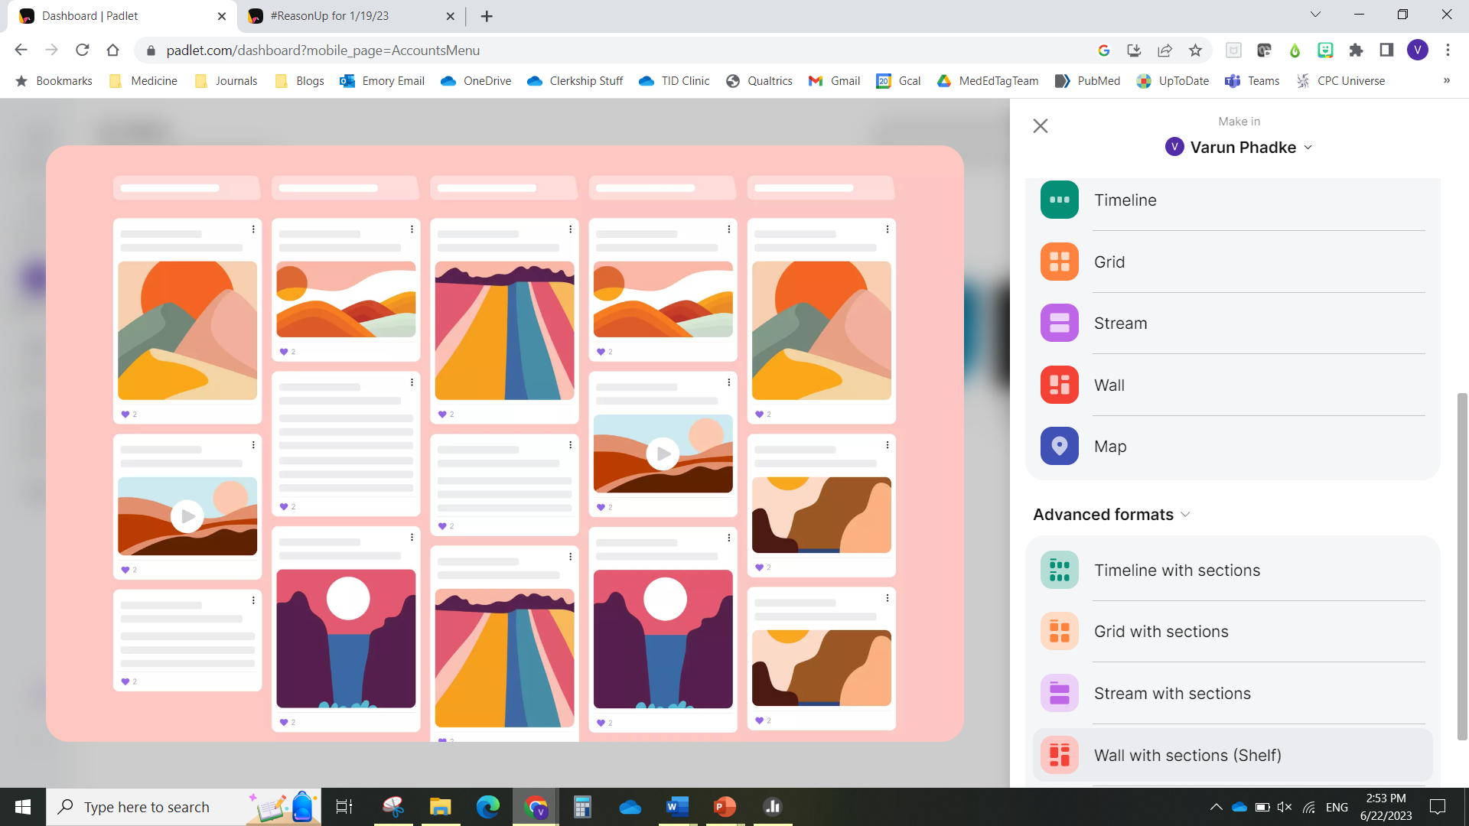

Slide 56

Use the QR code to be able to enter your thoughts in a Padlet as the case evolves!

Slide 57
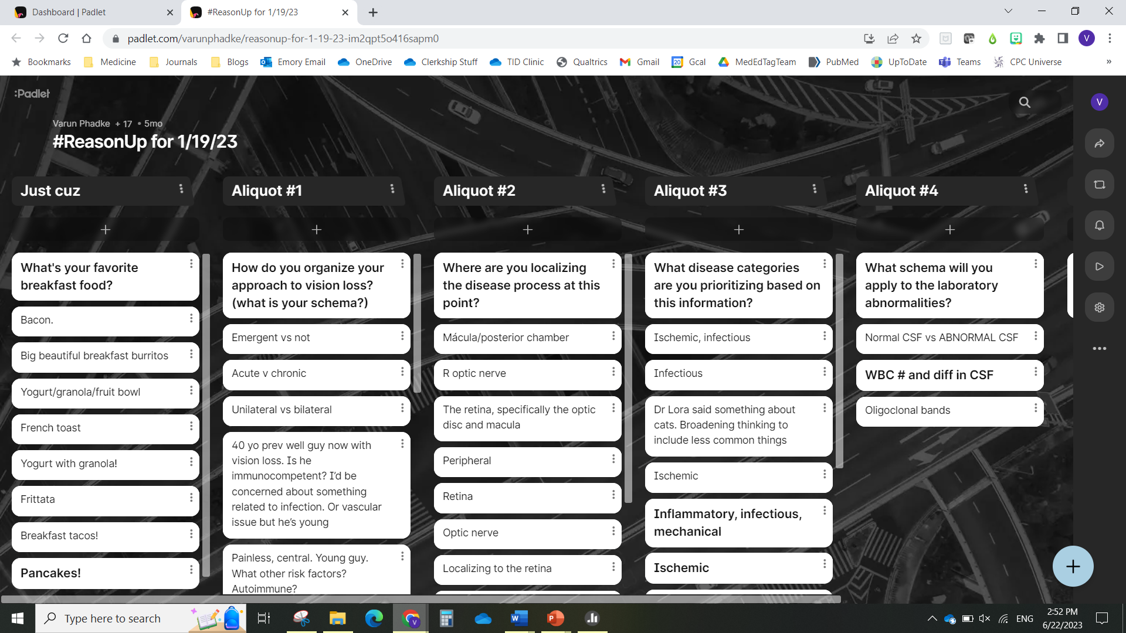

Slide 58
Reflect on what session format would be best and what, if anything, slides would ADD
You have been tasked with teaching a group of medical students about trauma-informed communication skills
You are the faculty facilitator for a resident conference that includes a debrief of cases seen in the psychiatric emergency department
You are planning a session at a national meeting to identify strategies to address structural inequities in access to mental health providers

Slide 59
Part 1 Summary
When planning a session where slides are possible, start by asking if slides are even necessary
If you choose to use slides, start with “Big Picture” considerations
  Slide format
  Slide number
  Slide organization
Multiple ways to engage the audience – tailor to the educational goal

Slide 60
Overview for this session
PART 1:
Presenter as Educator
PART 2:
Presenter as Designer
Do I have to use slides?
How should I use them?
How do I engage the audience?
Why should I _______?
How do I _______?
Getting creative!

Slide 61
Common presentation faux pas
Faux pas | Audience perspective
“I apologize for the busy slide…” | And you were too busy to fix it?

Slide 62
Common presentation faux pas
Faux pas | Audience perspective
“I apologize for the busy slide…” | And you were too busy to fix it?
“I know this is hard to read but…” | Then we’re not reading it…and PLEASE don’t just read it to us

Slide 63
Common presentation faux pas
Faux pas | Audience perspective
“I apologize for the busy slide…” | And you were too busy to fix it?
“I know this is hard to read but…” | Then we’re not reading it…and PLEASE don’t just read it to us
“I’m not sure why this slide is here…” “I’m going to skip these slides…” | But now I’m anxious that I might need to know that information…

Slide 64
Common presentation faux pas
Faux pas | Audience perspective | DDx
“I apologize for the busy slide…” | And you were too busy to fix it? | Trying to cover too much Slides/Slidesets were combined
“I know this is hard to read but…” | Then we’re not reading it…and don’t read it to us | Trying to cover too much Not attentive to/aware of multimedia principles
“I’m not sure why this slide is here…” “I’m going to skip these slides…” | But do I need to know that? | Trying to cover too much Re-purposing a talk without appropriate revision Presenting someone else’s slides

Slide 65
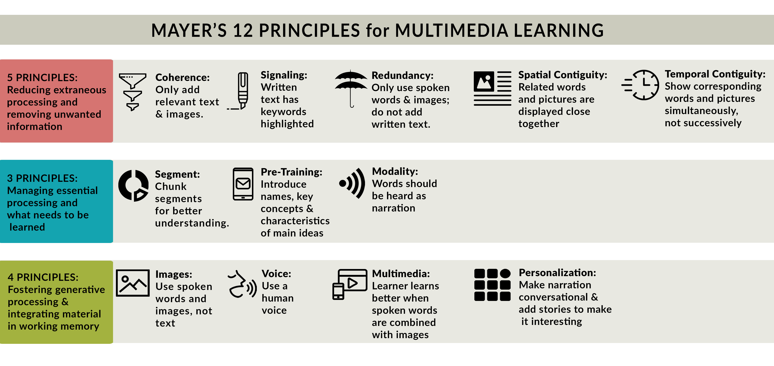
Mayer’s Multimedia Principles and Cognitive Load Theory
Don’t make something harder than it already is to understand
Acknowledge that your material might be hard and plan how you cover it accordingly
Match information delivery with information storage
Notes:
https://lucidea.com/blog/mayers-12-principles-of-multimedia-learning/
https://www.amazon.com/Multimedia-Learning-Richard-Mayer-dp-1316638081/dp/1316638081/ref=dp_ob_title_bk

Slide 66
Slide design considerations
Basics (typeface, font, color palette, templates)
Tables, charts, figures
Adding emphasis
Animations/Transitions
Media (icons, images, video)
Slide navigation (silencing, links)

Slide 67
Slide design considerations
Basics (typeface, font, color palette, templates)
Tables, charts, figures
Adding emphasis
Animations/Transitions
Media (icons, images, video)
Slide navigation (silencing, links)

Slide 68
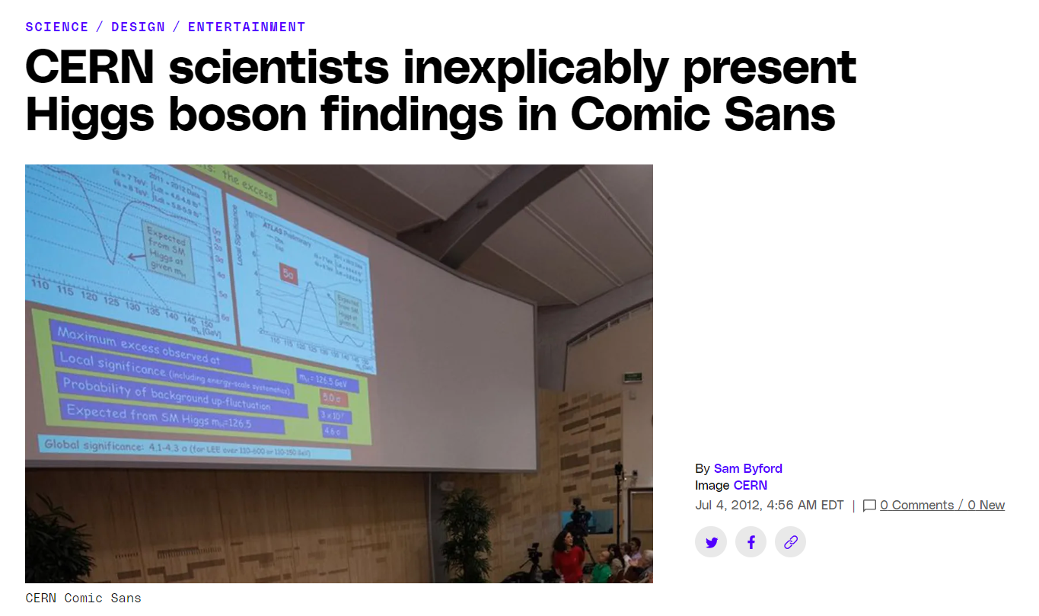
Pick your typeface carefully
Calibri (Microsoft default)
Comic Sans
Georgia
Baskerville Old Face
Arial
Notes:
https://archive.nytimes.com/opinionator.blogs.nytimes.com/2012/08/08/hear-all-ye-people-hearken-o-earth/
https://medium.com/design-ibm/how-fonts-influence-what-users-think-of-your-product-238874c593d7

Slide 69
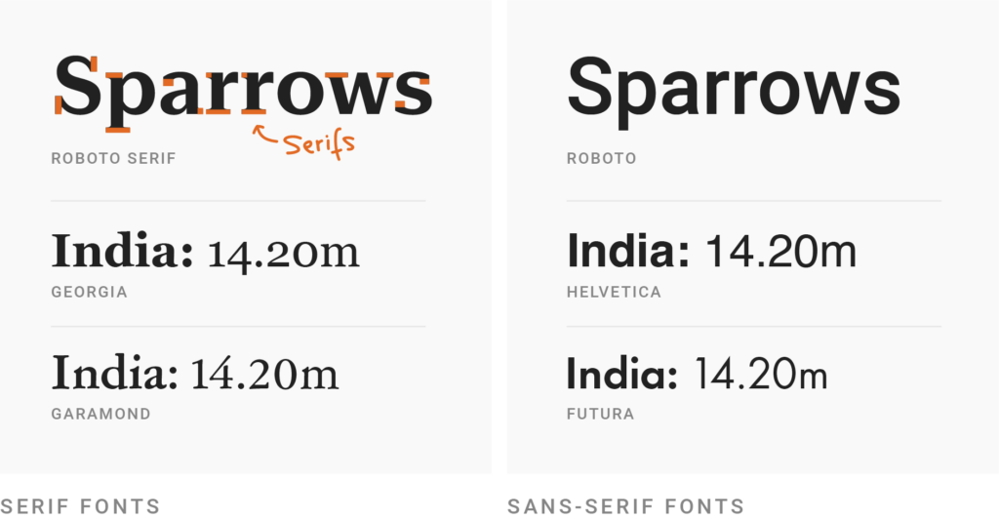
Sans-Serif typefaces are easier to read

Slide 70
Pick your font size carefully
14 point
20 point
28 point (default in PowerPoint)
36 point
48 point

Slide 71
Pick your background and text colors carefully
Low contrast color schemes are painful for you and the audience
Apologies to Microsoft Office 97 holdouts, but…
Yellow text on blue background is no longer acceptable…
…and has been proven to be less readable than B&W!
Notes:
https://www.laurenscharff.com/research/AHNCUR.html

Slide 72
ALMOST ALL POWERPOINT TEMPLATES ARE DISTRACTING…

Slide 73
END OF LIFE CONVERSATIONS
…They can undermine your educational objective…

Slide 74
…and they limit how much of the slide you can use!

Slide 75
Slide design considerations
Basics (typeface, font, color palette, templates)
Tables, charts, figures
Adding emphasis
Animations/Transitions
Media (icons, images, video)
Slide navigation (silencing, links)

Slide 76
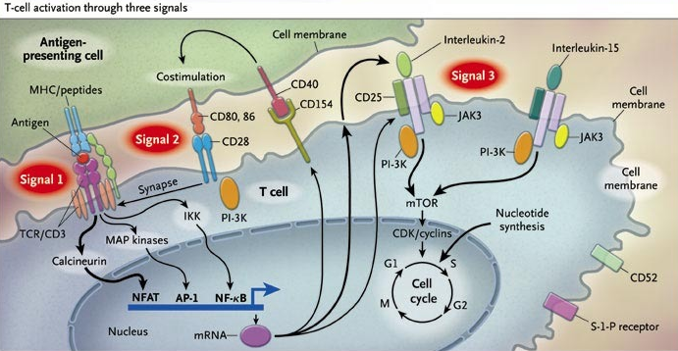
Figures, charts, and tables we find in journals/textbooks make TERRIBLE slides
Notes:
https://blog.datawrapper.de/fonts-for-data-visualization/

Slide 77
Arrows are a double-edged sword
Likelihood of teaching point being retained
# of arrows in a figure

Slide 78


Making it harder than it has to be…
Isn’t it confusing that the Y axis is labeled “survival distribution” when this is a graph of the cumulative incidence of death?
Why is the legend spatially removed from the lines they represent?
Does this axis have to be vertically oriented?
Why are the axes in the SMALLEST font?
Marr et al. Ann Intern Med. 2015 Jan 20;162(2):81-9

Slide 79
You have the power to make it easier!
Cumulative deaths (%)
(lower is better)
voriconazole + placebo
p = 0.086
voriconazole + anidulafungin
0
1
2
3
4
5
6
7
8
9
10
11
12
13
Time to death (weeks)
Marr et al. Ann Intern Med. 2015 Jan 20;162(2):81-9

Slide 80
Slide design considerations
Basics (typeface, font, color palette, templates)
Tables, charts, figures
Adding emphasis
Animations/Transitions
Media (icons, images, video)
Slide navigation (silencing, links)

Slide 81
Adding emphasis to text
Underline is easier for viewer to distinguish than bold or italics
Change in typeface is usually distracting
Color or Size change generally the most effective, but limit the number of color/size changes on any individual slide to ~3

Slide 82
Bold
Bold
Italic
Italic
Underline
Underline
Size
Size
Color
Color

Slide 83
Adding emphasis to tables/figures

Slide 84
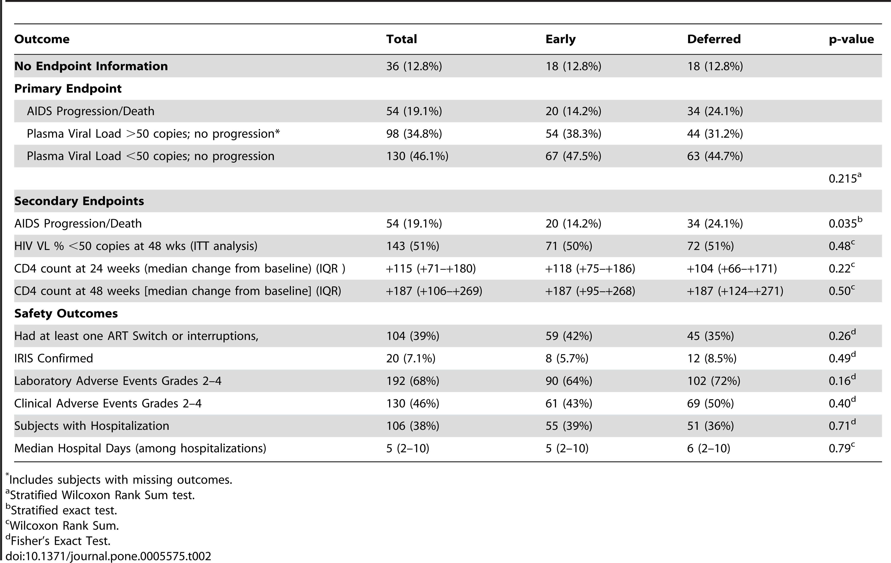
Option 1: Emphasize with color (arrows)
Zolopa et al. PLoS One. 2009;4(5):e5575. doi: 10.1371/journal.pone.0005575

Slide 85
Option 2: Emphasize with color (shape)
Zolopa et al. PLoS One. 2009;4(5):e5575. doi: 10.1371/journal.pone.0005575

Slide 86
Option 3: Emphasize with spotlight
Zolopa et al. PLoS One. 2009;4(5):e5575. doi: 10.1371/journal.pone.0005575

Slide 87
Option 3: Emphasize with spotlight
Emphasize with spotlight
Zolopa et al. PLoS One. 2009;4(5):e5575. doi: 10.1371/journal.pone.0005575

Slide 88
How to make the “spotlight” effect
Select the slide to which you want to add the “spotlight” and duplicate it
  On a PC, right click and choose “Duplicate Slide”

Slide 89
How to make the “spotlight” effect
On the second copy of the slide, insert a “Rectangle” shape
  Drag the corner so that the rectangle is bigger than the slide itself
  For the “Shape Fill” color select black
  For the “Shape Outline” color select “No outline”
At this point the entire slide should be covered by a black rectangle (the content of the slide is not visible)

Slide 90
How to make the “spotlight” effect
Create the “shadow”, i.e. make the rectangle “transparent”
  Select the rectangle and open the “Format Shape” menu
  Under “Fill”, choose “Transparency” of 30%
At this point the entire slide should appear to be under a “shadow” (the content of the slide should be visible)

Slide 91
How to make the “spotlight” effect
Create the “spotlight” shape
  Insert the shape you will want to be “lit up” (rectangles work well for emphasizing rows or columns of a table, circles may work better for figures/radiology)
  Move and resize the shape so it covers the part of the slide that you will want to be “under the spotlight”
  For the “Shape Outline” color select “No outline”
At this point the you should have a large transparent “shadow” rectangle covering the entire slide and a smaller shape covering the part of the slide you will want to “spotlight”

Slide 92
How to make the “spotlight” effect
Create the “spotlight”
  Select both the large “shadow” rectangle and the smaller “spotlight” shape (in that order – this procedure will not work if the shapes are selected in the reverse order)
  Under the “Format” tab in the PowerPoint ribbon, select the button called “Merge Shapes”, then click “Subtract”
At this point the entire slide should appear to be under a “shadow” except for the part you want “under the spotlight”

Slide 93
How to make the “spotlight” effect
Create the spotlight “effect”
  At this point you have two identical slides, with the second being covered by a shadow minus the “spotlight”
  Select the second slide, then under the “Transitions” tab in the PowerPoint ribbon, choose “Fade”
At this point, when you advance from the first slide to the second slide in “Slide Show” mode, it will appear like a “spotlight” is being turned on to the content you want to highlight!

Slide 94
Option 4: Eliminate the extraneous
Zolopa et al. PLoS One. 2009;4(5):e5575. doi: 10.1371/journal.pone.0005575

Slide 95
Option 4: Eliminate the extraneous
Zolopa et al. PLoS One. 2009;4(5):e5575. doi: 10.1371/journal.pone.0005575

Slide 96
Option 5: Make your own table/figure
Outcome | Early ART | Deferred ART | P-value
Primary endpoint (composite) AIDS Progression/Death VL > 50 copies, no progression VL < 50 copies, no progression | 14.2% 38.3% 47.5% | 24.1% 31.2% 44.7% | 0.215
Secondary endpoint AIDS Progression/Death | 14.2% | 24.1% | 0.035
Zolopa et al. PLoS One. 2009;4(5):e5575. doi: 10.1371/journal.pone.0005575

Slide 97
Option 6: “Decolorize” what’s not important

Slide 98
Option 6: “Decolorize” what’s not important
Step 4:
Add a counter stain (usually safranin) to stain cells that did not retain crystal violet

Slide 99
How to “decolorize” figures
Duplicate the figure you want to decolorize on the slide
Select one of the copies of the figure that you want to decolorize
Click the “Format” tab in the PowerPoint ribbon, then click the “Color” button, and under the “Recolor” section choose “Grayscale”
  If an even more washed out grayscale is desired, you can choose the option called “Light Gray” (on PC)
Crop out the parts of the color figure you don’t want to emphasize, then move it on top of the corresponding part of the decolorized figure

Slide 100
Slide design considerations
Basics (typeface, font, color palette, templates)
Tables, charts, figures
Adding emphasis
Animations/Transitions
Media (icons, images, video)
Slide navigation (silencing, links)

Slide 101
Animations/Transitions
Almost all PowerPoint animations (and transitions) are distracting…

Slide 102
Animations/Transitions
Almost all PowerPoint animations (and transitions) are distracting…
…And detract from your content

Slide 103
Using animations effectively
The most useful animation is “Appear”
This animation allows you to introduce a slide in parts
  Improves pacing for the speaker
  Reduces cognitive overload for the audience

Slide 104
“Advanced” use of animations
Other animations can be effective if used appropriately (and sparingly)

Slide 105
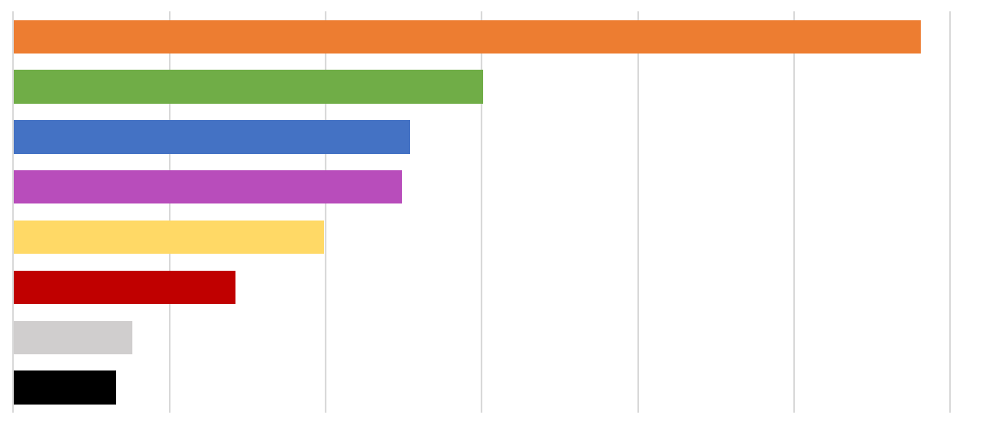
Example: “Wipe” animation for bar graphs

Slide 106


Example: “Wipe” animation for filling figures
2/3 of the US population

Slide 107
“Animating” your slides without animations
Create multiple copies of the same slide, but “hide” the parts you don’t want to be seen until the next slide
How to “Hide” slide components
  Text: Delete the text or make it the same color as the background
  Table: Make the text color the same as the background
  Figures: Using the “Crop” tool
Pro tip: On subsequent slides, color the “old” text in gray to add emphasis to the new content!

Slide 108
Slide design considerations
Basics (typeface, font, color palette, templates)
Tables, charts, figures
Adding emphasis
Animations/Transitions
Media (icons, images, video)
Slide navigation (silencing, links)

Slide 109

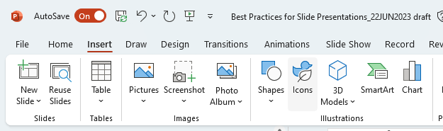

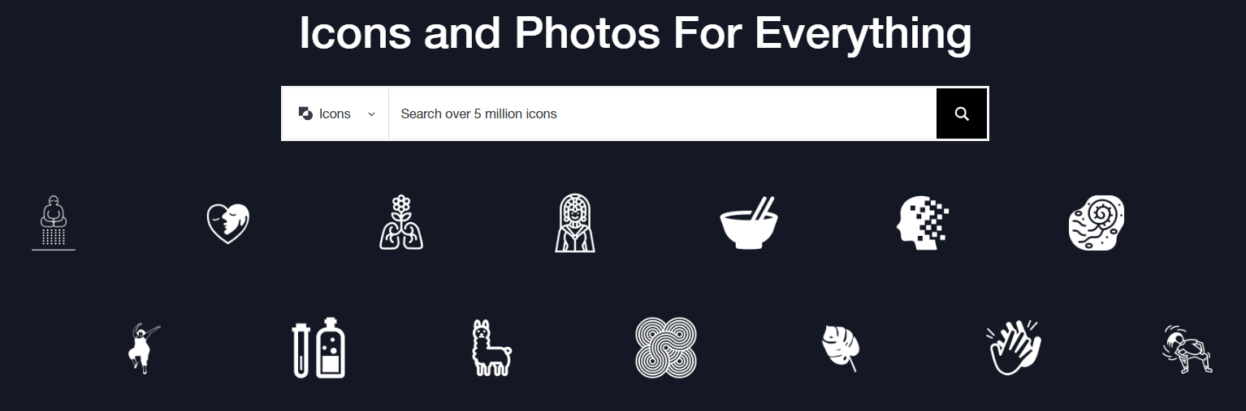


Icons, Images, Videos
Icons
Images/Figures
Videos
PowerPoint
The Noun Project
FlatIcon
Remember to credit all your sources!

Slide 110
Slide design considerations
Basics (typeface, font, color palette, templates)
Tables, charts, figures
Adding emphasis
Animations/Transitions
Media (icons, images, video)
Slide navigation (silencing, links)

Slide 111
Slide navigation
At ANY time during a presentation you can mute the screen with a “blank” slide
  Press W to cut to a blank WHITE slide
  Press B to cut to a blank BLACK slide

Slide 112
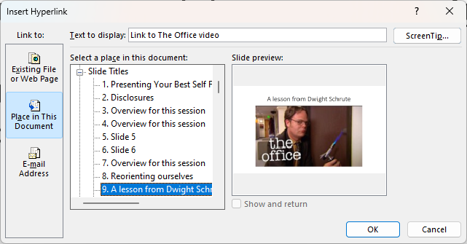
Slide navigation
At ANY time during a presentation you can mute the screen with a “blank” slide
  Press W to cut to a blank WHITE slide
  Press B to cut to a blank BLACK slide
Can create a link to ANY slide in the presentation
  Link to The Office video

Slide 113
Part 2 Summary
Typeface, font size and color, and template selection have all been proven to affect information transmission. Choose wisely.
Sometimes complex figures/tables must be displayed, but be deliberate about visually emphasizing their key point(s)
  Consider breaking up the figure/table or creating your own
You are responsible for making the content interesting, not your PowerPoint animations and transitions

Slide 114

Marie Kondo approach to presentations
“Does it spark joy?”

Slide 115
Questions to ask yourself
Why is this content in my presentation? | Audience needs to know it – “must-know” Audience needs to understand, but not know it – “foundational” It’s interesting…to you? To them?
Who am I showing this content to? | Peers? Learners? What level or levels? Experts?
What content do I show (or leave out?) | All of it – audience needs to see the ‘raw’ data A summary/synthesis of it – audience needs to get the gist
When do I show the content? | All at once or in pieces? Early or late in the talk? Before or after I ‘engage’ the audience about it?
How am I displaying the content? | Text? Images? Figures? Charts? Tables?

Slide 116
Questions to ask yourself
Why is this content in my presentation? | Audience needs to know it – “must-know” Audience needs to understand, but not know it – “foundational” It’s interesting…to you? To them?
Who am I showing this content to? | Peers? Learners? What level or levels? Experts?
What content do I show (or leave out?) | All of it – audience needs to see the ‘raw’ data A summary/synthesis of it – audience needs to get the gist
When do I show the content? | All at once or in pieces? Early or late in the talk? Before or after I ‘engage’ the audience about it?
How am I displaying the content? | Text? Images? Figures? Charts? Tables?

Slide 117
Questions to ask yourself
Why is this content in my presentation? | Audience needs to know it – “must-know” Audience needs to understand, but not know it – “foundational” It’s interesting…to you? To them?
Who am I showing this content to? | Peers? Learners? What level or levels? Experts?
What content do I show (or leave out?) | All of it – audience needs to see the ‘raw’ data A summary/synthesis of it – audience needs to get the gist
When do I show the content? | All at once or in pieces? Early or late in the talk? Before or after I ‘engage’ the audience about it?
How am I displaying the content? | Text? Images? Figures? Charts? Tables?

Slide 118
Questions to ask yourself
Why is this content in my presentation? | Audience needs to know it – “must-know” Audience needs to understand, but not know it – “foundational” It’s interesting…to you? To them?
Who am I showing this content to? | Peers? Learners? What level or levels? Experts?
What content do I show (or leave out?) | All of it – audience needs to see the ‘raw’ data A summary/synthesis of it – audience needs to get the gist
When do I show the content? | All at once or in pieces? Early or late in the talk? Before or after I ‘engage’ the audience about it?
How am I displaying the content? | Text? Images? Figures? Charts? Tables?

Slide 119
Questions to ask yourself
Why is this content in my presentation? | Audience needs to know it – “must-know” Audience needs to understand, but not know it – “foundational” It’s interesting…to you? To them?
Who am I showing this content to? | Peers? Learners? What level or levels? Experts?
What content do I show (or leave out?) | All of it – audience needs to see the ‘raw’ data A summary/synthesis of it – audience needs to get the gist
When do I show the content? | All at once or in pieces? Early or late in the talk? Before or after I ‘engage’ the audience about it?
How am I displaying the content? | Text? Images? Figures? Charts? Tables?

Slide 120
Questions to ask yourself
Why is this content in my presentation? | Audience needs to know it – “must-know” Audience needs to understand, but not know it – “foundational” It’s interesting…to you? To them?
Who am I showing this content to? | Peers? Learners? What level or levels? Experts?
What content do I show (or leave out?) | All of it – audience needs to see the ‘raw’ data A summary/synthesis of it – audience needs to get the gist
When do I show the content? | All at once or in pieces? Early or late in the talk? Before or after I ‘engage’ the audience about it?
How am I displaying the content? | Text? Images? Figures? Charts? Tables?

Slide 121
Questions to ask yourself
Why is this content in my presentation? | Audience needs to know it – “must-know” Audience needs to understand, but not know it – “foundational” It’s interesting…to you? To them?
Who am I showing this content to? | Peers? Learners? What level or levels? Experts?
What content do I show (or leave out?) | All of it – audience needs to see the ‘raw’ data A summary/synthesis of it – audience needs to get the gist
When do I show the content? | All at once or in pieces? Early or late in the talk? Before or after I ‘engage’ the audience about it?
How am I displaying the content? | Text? Images? Figures? Charts? Tables?

Slide 122
Take Home Points
When you are asked to deliver an educational session, always start your planning by asking…do I even need slides?
“Big picture” design considerations should always be aligned with your audience and educational objectives
Slides are visual aides that should adhere to principles of multimedia design that have been proven to enhance learning/retention

Slide 123
Where does the efficacy come from?
Receptor Targeted | Mechanism | Classic Example
D₂ antagonism | Block D₂ activity in mesolimbic and mesostriatal networks | Haloperidol
D₂ partial agonism | Dampen D₂ activity | Aripiprazole
D₂/5HT_{2A} antagonism | Modulation of glutamatergic/GABAergic neurons that regulate D₂ networks | Risperidone
D₂/5HT_{1A} partial agonism | Modulation of glutamatergic/GABAergic neurons that regulate D₂ networks | Brexpiprazole?
Notes:
Indirect modulation of dopaminergic networks allows for fine-tuning of D2 blockade, leading to fewer off-target motor side effects in nigrostriatal pathway.

Slide 124
Questions to ask yourself
Why is this content in my presentation? | Audience needs to know it – “must-know” Audience needs to understand, but not know it – “foundational” It’s interesting…to you? To them?
Who am I showing this content to? | Peers? Learners? What level or levels? Experts?
What content do I show (or leave out?) | All of it – audience needs to see the ‘raw’ data A summary/synthesis of it – audience needs to get the gist
When do I show the content? | All at once or in pieces? Early or late in the talk? Before or after I ‘engage’ the audience about it?
How am I displaying the content? | Text? Images? Figures? Charts? Tables?

Slide 125
Where does the efficacy come from?
Receptor Targeted | Mechanism | Classic Example
D₂ antagonism | Block D₂ activity in mesolimbic and mesostriatal networks | ?
D₂ partial agonism | Dampen D₂ activity | ?
D₂/5HT_{2A} antagonism | Modulation of glutamatergic/GABAergic neurons that regulate D₂ networks | ?
D₂/5HT_{1A} partial agonism | Modulation of glutamatergic/GABAergic neurons that regulate D₂ networks | ?
Notes:
Indirect modulation of dopaminergic networks allows for fine-tuning of D2 blockade, leading to fewer off-target motor side effects in nigrostriatal pathway.

Slide 126
Where does the efficacy come from?
Receptor Targeted | Mechanism | Classic Example
D₂ antagonism | Block D₂ activity in mesolimbic and mesostriatal networks | Haloperidol
D₂ partial agonism | Dampen D₂ activity | ?
D₂/5HT_{2A} antagonism | Modulation of glutamatergic/GABAergic neurons that regulate D₂ networks | ?
D₂/5HT_{1A} partial agonism | Modulation of glutamatergic/GABAergic neurons that regulate D₂ networks | ?
Notes:
Indirect modulation of dopaminergic networks allows for fine-tuning of D2 blockade, leading to fewer off-target motor side effects in nigrostriatal pathway.

Slide 127
Where does the efficacy come from?
Receptor Targeted | Mechanism | Classic Example
D₂ antagonism | Block D₂ activity in mesolimbic and mesostriatal networks | Haloperidol
D₂ partial agonism | Dampen D₂ activity | ?
D₂/5HT_{2A} antagonism | Modulation of glutamatergic/GABAergic neurons that regulate D₂ networks | ?
D₂/5HT_{1A} partial agonism | Modulation of glutamatergic/GABAergic neurons that regulate D₂ networks | ?
Notes:
Indirect modulation of dopaminergic networks allows for fine-tuning of D2 blockade, leading to fewer off-target motor side effects in nigrostriatal pathway.

Slide 128
Where does the efficacy come from?
Receptor Targeted | Mechanism | Classic Example
D₂ antagonism | Block D₂ activity in mesolimbic and mesostriatal networks | Haloperidol
D₂ partial agonism | Dampen D₂ activity | Aripiprazole
D₂/5HT_{2A} antagonism | Modulation of glutamatergic/GABAergic neurons that regulate D₂ networks | ?
D₂/5HT_{1A} partial agonism | Modulation of glutamatergic/GABAergic neurons that regulate D₂ networks | ?
Notes:
Indirect modulation of dopaminergic networks allows for fine-tuning of D2 blockade, leading to fewer off-target motor side effects in nigrostriatal pathway.

Slide 129
Where does the efficacy come from?
Receptor Targeted | Mechanism | Classic Example
D₂ antagonism | Block D₂ activity in mesolimbic and mesostriatal networks | Haloperidol
D₂ partial agonism | Dampen D₂ activity | Aripiprazole
D₂/5HT_{2A} antagonism | Modulation of glutamatergic/GABAergic neurons that regulate D₂ networks | ?
D₂/5HT_{1A} partial agonism | Modulation of glutamatergic/GABAergic neurons that regulate D₂ networks | ?
Notes:
Indirect modulation of dopaminergic networks allows for fine-tuning of D2 blockade, leading to fewer off-target motor side effects in nigrostriatal pathway.

Slide 130
Where does the efficacy come from?
Receptor Targeted | Mechanism | Classic Example
D₂ antagonism | Block D₂ activity in mesolimbic and mesostriatal networks | Haloperidol
D₂ partial agonism | Dampen D₂ activity | Aripiprazole
D₂/5HT_{2A} antagonism | Modulation of glutamatergic/GABAergic neurons that regulate D₂ networks | Risperidone
D₂/5HT_{1A} partial agonism | Modulation of glutamatergic/GABAergic neurons that regulate D₂ networks | ?
Notes:
Indirect modulation of dopaminergic networks allows for fine-tuning of D2 blockade, leading to fewer off-target motor side effects in nigrostriatal pathway.

Slide 131
Where does the efficacy come from?
Receptor Targeted | Mechanism | Classic Example
D₂ antagonism | Block D₂ activity in mesolimbic and mesostriatal networks | Haloperidol
D₂ partial agonism | Dampen D₂ activity | Aripiprazole
D₂/5HT_{2A} antagonism | Modulation of glutamatergic/GABAergic neurons that regulate D₂ networks | Risperidone
D₂/5HT_{1A} partial agonism | Modulation of glutamatergic/GABAergic neurons that regulate D₂ networks | ?
Notes:
Indirect modulation of dopaminergic networks allows for fine-tuning of D2 blockade, leading to fewer off-target motor side effects in nigrostriatal pathway.

Slide 132
Where does the efficacy come from?
Receptor Targeted | Mechanism | Classic Example
D₂ antagonism | Block D₂ activity in mesolimbic and mesostriatal networks | Haloperidol
D₂ partial agonism | Dampen D₂ activity | Aripiprazole
D₂/5HT_{2A} antagonism | Modulation of glutamatergic/GABAergic neurons that regulate D₂ networks | Risperidone
D₂/5HT_{1A} partial agonism | Modulation of glutamatergic/GABAergic neurons that regulate D₂ networks | Brexpiprazole
Notes:
Indirect modulation of dopaminergic networks allows for fine-tuning of D2 blockade, leading to fewer off-target motor side effects in nigrostriatal pathway.

Slide 133
Let’s practice!
We will split into 3 breakout groups. You will have 15 minutes to:
Elect both a spokesperson and a PowerPoint designer
Discuss the slide as a group using the provided questions
Design a slide or set of slides that aim to improve the learner experience

Slide 134
Practice 1

Slide 135
What is self-care?
Self-care has been defined as "a multidimensional, multifaceted process of purposeful engagement in strategies that promote healthy functioning and enhance well-being"
There are many forms self-care can take-- from getting enough sleep every night or stepping outside for a few minutes for some fresh air
Self-care is vital for building resilience toward those stressors in life that you can't eliminate: When you've taken steps to care for your mind and body, you'll be better equipped to live a healthy and happy life.
It's important to assess how you're caring for yourself in several different domains so you can ensure you're caring for your mind, body, and spirit.
Notes:
So, what is self-care? Essentially, the term describes a conscious act a person takes in order to promote their own physical, mental, and emotional health.
Unfortunately, however, many of us view self-care as a luxury, rather than a priority. Consequently, we’re left feeling overwhelmed, tired, and ill-equipped to handle life's inevitable challenges.
There are lots of forms of self-care, and so it’s important…

Slide 136
Questions to ask yourself
Why is this content in my presentation? | Audience needs to know it – “must-know” Audience needs to understand, but not know it – “foundational” It’s interesting…to you? To them?
Who am I showing this content to? | Peers? Learners? What level or levels? Experts?
What content do I show (or leave out?) | All of it – audience needs to see the ‘raw’ data A summary/synthesis of it – audience needs to get the gist
When do I show the content? | All at once or in pieces? Early or late in the talk? Before or after I ‘engage’ the audience about it?
How am I displaying the content? | Text? Images? Figures? Charts? Tables?

Slide 137
What is self-care?
Redesign this!
Self-care has been defined as "a multidimensional, multifaceted process of purposeful engagement in strategies that promote healthy functioning and enhance well-being"
There are many forms self-care can take-- from getting enough sleep every night or stepping outside for a few minutes for some fresh air
Self-care is vital for building resilience toward those stressors in life that you can't eliminate: When you've taken steps to care for your mind and body, you'll be better equipped to live a healthy and happy life.
It's important to assess how you're caring for yourself in several different domains so you can ensure you're caring for your mind, body, and spirit.
Notes:
So, what is self-care? Essentially, the term describes a conscious act a person takes in order to promote their own physical, mental, and emotional health.
Unfortunately, however, many of us view self-care as a luxury, rather than a priority. Consequently, we’re left feeling overwhelmed, tired, and ill-equipped to handle life's inevitable challenges.
There are lots of forms of self-care, and so it’s important…

Slide 138
Practice 2

Slide 139
Recognizing delirium
In one sample, 42% of psychiatry consultations for depression were actually hypoactive delirium
Test attention and orientation
  Spell “world” backward
  List months of the year or days of the week backwards
  Serial subtraction (i.e. serial 7s or 10s)
  Squeeze hand for letter A in “CASABLANCA”
Obtain info about pre-illness mental status, as there should be a significant change from baseline
CAM-ICU (very sensitive and highly specific if positive) and Nu-DESC (somewhat sensitive but highly specific even at score of 1)
The Montreal Cognitive Assessment (MoCA): a wider range of tasks & > sensitivity in identifying mild cognitive impairment than the MMSE.
Notes:
Recognizing delirium as well as a gauge to mark improvement.

Slide 140
Questions to ask yourself
Why is this content in my presentation? | Audience needs to know it – “must-know” Audience needs to understand, but not know it – “foundational” It’s interesting…to you? To them?
Who am I showing this content to? | Peers? Learners? What level or levels? Experts?
What content do I show (or leave out?) | All of it – audience needs to see the ‘raw’ data A summary/synthesis of it – audience needs to get the gist
When do I show the content? | All at once or in pieces? Early or late in the talk? Before or after I ‘engage’ the audience about it?
How am I displaying the content? | Text? Images? Figures? Charts? Tables?

Slide 141
Recognizing delirium
Redesign this!
In one sample, 42% of psychiatry consultations for depression were actually hypoactive delirium
Test attention and orientation
  Spell “world” backward
  List months of the year or days of the week backwards
  Serial subtraction (i.e. serial 7s or 10s)
  Squeeze hand for letter A in “CASABLANCA”
Obtain info about pre-illness mental status, as there should be a significant change from baseline
CAM-ICU (very sensitive and highly specific if positive) and Nu-DESC (somewhat sensitive but highly specific even at score of 1)
The Montreal Cognitive Assessment (MoCA): a wider range of tasks & > sensitivity in identifying mild cognitive impairment than the MMSE.
Notes:
Recognizing delirium as well as a gauge to mark improvement.

Slide 142
Practice 3

Slide 143

Expectancy Violation (“Test it out”)
What if your patient’s expectancy is hard to test?!?!?!?!
Find a way to rephrase/reconceptualize it so it IS testable!
  E.g., What if I get a serious illness because I touched a dirty pole?
    I can’t tolerate the uncertainty of not knowing for sure
  E.g., What if I go to hell for thinking about killing my child?
    I can’t tolerate the uncertainty of not knowing if I sinned
  E.g., What if I have a terrible illness that my doctors can’t detect?
    I won’t be able to go for more than a day without calling a doctor
  E.g., I just don’t like feeling anxious
    I can’t tolerate feeling anxious for more than X minutes
  E.g., I can’t tolerate disgust
    I will throw up in X minutes
  E.g., I can’t handle the picture being crooked; it just doesn’t feel right
    I will lose my mind after X hours of just not feeling right
Examples adapted from Abramowitz et al., 2019

Slide 144
Questions to ask yourself
Why is this content in my presentation? | Audience needs to know it – “must-know” Audience needs to understand, but not know it – “foundational” It’s interesting…to you? To them?
Who am I showing this content to? | Peers? Learners? What level or levels? Experts?
What content do I show (or leave out?) | All of it – audience needs to see the ‘raw’ data A summary/synthesis of it – audience needs to get the gist
When do I show the content? | All at once or in pieces? Early or late in the talk? Before or after I ‘engage’ the audience about it?
How am I displaying the content? | Text? Images? Figures? Charts? Tables?

Slide 145
Expectancy Violation (“Test it out”)
Redesign this!
What if your patient’s expectancy is hard to test?!?!?!?!
Find a way to rephrase/reconceptualize it so it IS testable!
  E.g., What if I get a serious illness because I touched a dirty pole?
    I can’t tolerate the uncertainty of not knowing for sure
  E.g., What if I go to hell for thinking about killing my child?
    I can’t tolerate the uncertainty of not knowing if I sinned
  E.g., What if I have a terrible illness that my doctors can’t detect?
    I won’t be able to go for more than a day without calling a doctor
  E.g., I just don’t like feeling anxious
    I can’t tolerate feeling anxious for more than X minutes
  E.g., I can’t tolerate disgust
    I will throw up in X minutes
  E.g., I can’t handle the picture being crooked; it just doesn’t feel right
    I will lose my mind after X hours of just not feeling right
Examples adapted from Abramowitz et al., 2019

