Slide 1
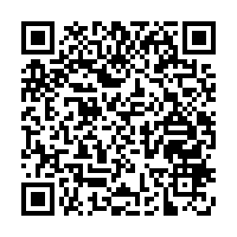
Conquer Your Inbox: Practical tips on e-mail management
09/20/2023
Michael Lucido, MD, PhD
David Thylur, MD
Join our PollEV:
Text mlucido to 22333
Go to PollEV.com/mlucido
Or scan the QR code

Slide 2
Disclosures
No disclosures

Slide 3
Goals/Outcomes
By the end of this seminar, we hope participants will be able to:
Contribute to a more reasonable e-mail culture
Develop an effective, personalized framework for e-mail management
Apply basic Outlook skills to improve day-to-day efficiency

Slide 4
Notes:
Poll Title: Do not modify the notes in this section to avoid tampering with the Poll Everywhere activity. More info at polleverywhere.com/support What do you hope to learn from today's seminar? https://www.polleverywhere.com/free_text_polls/EhccvsM4w9e58NgvrzQkP

Slide 5
The E-mail Problem
The average person working in an office setting receives >100 e-mails per day
Administrative and clinical updates and requests
Newsletters
Subscriptions (e.g. journals)
Listserv distributions
E-mails Work/Life
E-mail Overload = administrative burden
Interruption
Notes:
This perception of an individual to be unable to find, cope with or process his/her emails effectively was defined as the feeling of email overload.

Slide 6
Academic E-mail Culture
Perception of infinite accessibility → blurring work-life balance
Overreliance for communication → isolating, often inefficient, delays in decision-making
All the info, all at once → overwhelming, difficulty prioritizing/extracting info
Varying expectations → confusing

Slide 7
Notes:
Poll Title: Do not modify the notes in this section to avoid tampering with the Poll Everywhere activity. More info at polleverywhere.com/support What is your e-mail etiquette pet peeve? https://www.polleverywhere.com/free_text_polls/BNPuOM7XCw9JI2DrBiigi

Slide 8
Shifting a Culture With Etiquette
“To protect your inbox, you must protect other people’s inboxes.”
Compassionate e-mail culture begins with e-mail etiquette and standards
What does this look like?

Slide 9
Compassionate E-mail Culture
Appropriate use of e-mail for communication
Would a phone call, text message/Teams message, teleconference, or in-person conversation be better suited?
Do any of the recipients need to communicate with one another?
Concise, informative subject lines
Consider tagging subject lines to denote importance or expectation
“FYI:” when no reply is expected, “Action:” when some follow up action is expected, “Response:” if a response in expected
Clear expectations for response
Be explicit about your expectations for response (and if there is a deadline)
E.g. “No reply necessary” or “please respond at your earliest convenience”
Be explicit about what the assumption will be if there is no response by the deadline

Slide 10
Compassionate E-mail Culture
Direct, concise content
Not all e-mail needs exposition
Single word and single sentence responses may be appropriate and sufficient
Removal of extraneous elements
Do you need a salutation and signature line with every reply in a chain?
Respect for “business hours”
Sending an e-mail at 10PM sends an implicit message re: expectations, but it doesn’t mean you can’t or shouldn’t be working at that hour
Use the “delay send” feature when working outside of normal business hours

Slide 11
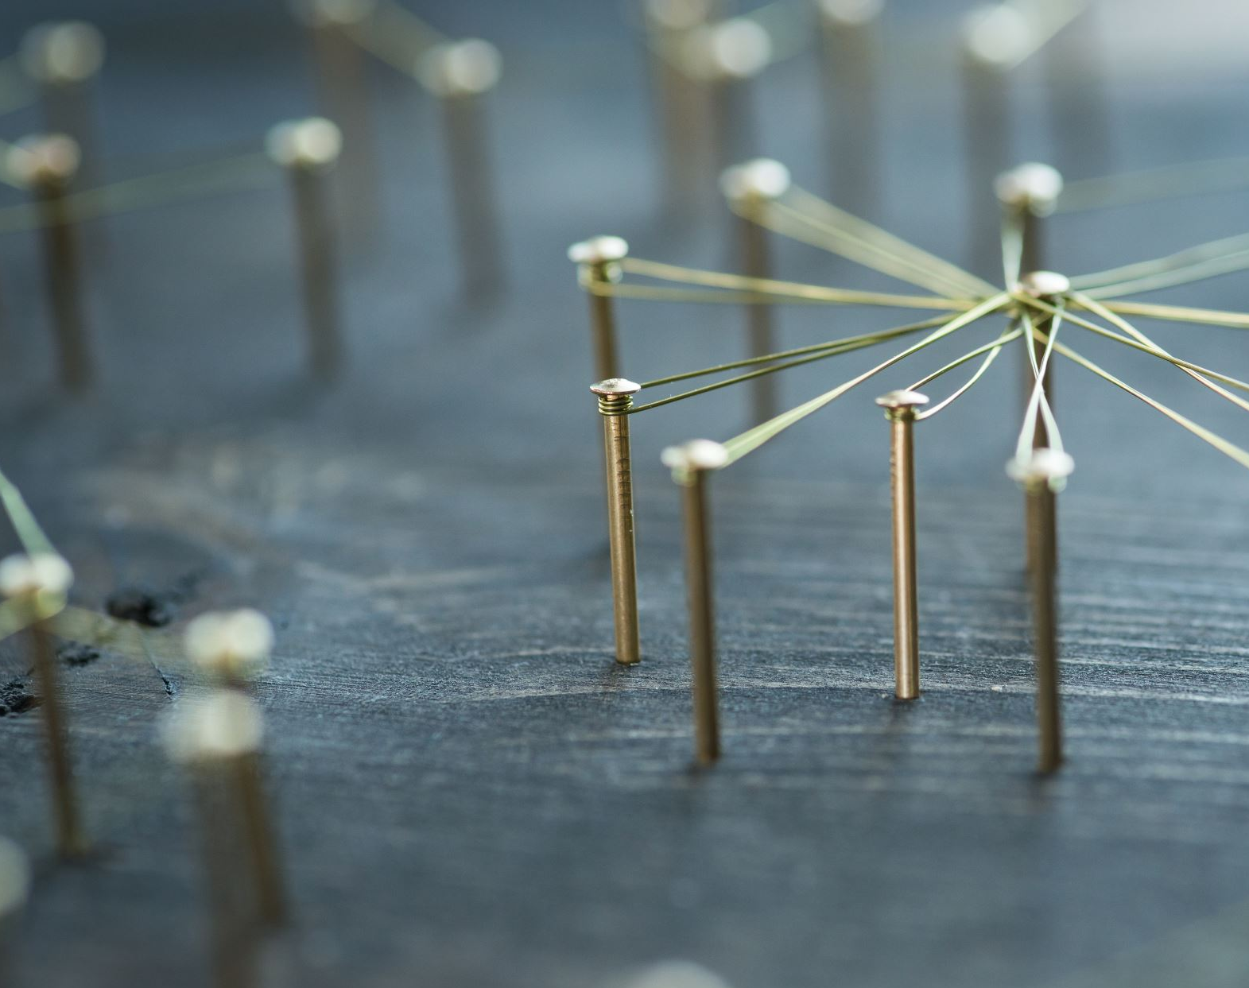
Discussion

Slide 12
The principles of email management
Develop a system that works for you
Time spent devising a system may save you more time in the long run
Remember the four D’s:
Do: Immediately handle emails or tasks that take less than 2 minutes
Defer: Make a plan to handle emails that need more time/attention
Delegate: Reassign emails that could be handled by someone else, if appropriate
Delete: Remove unnecessary emails

Slide 13
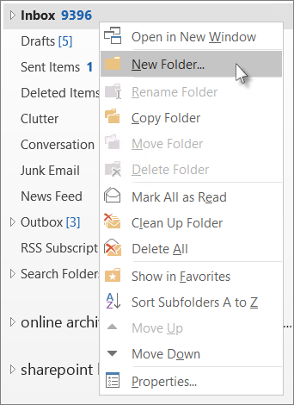
Outlook Skills
Folders
Used to organize emails into smaller, more manageable groupings
Examples could be using a folder named “R21” for all emails pertaining to an upcoming R21 grant application

Slide 14
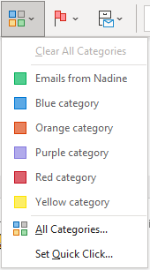
Outlook Skills
Categories
Used to identify similar types of emails
Ex: All lab members are in the “Research Lab” category are colored purple

Slide 15
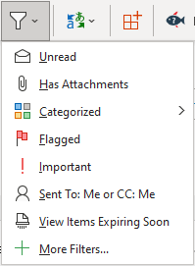
Outlook Skills
Filters
Allow you to only show emails that meet a certain criterion, such as a specific Category or Due Date

Slide 16
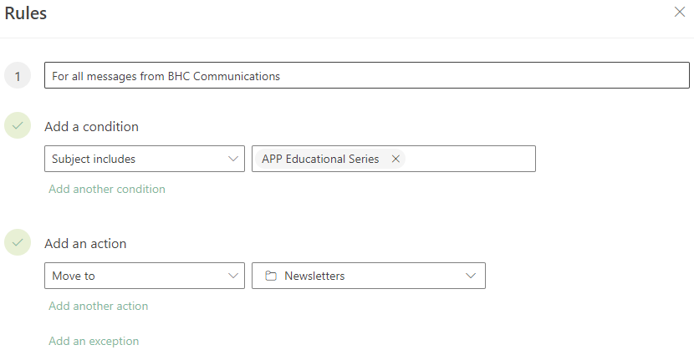
Outlook Skills
Rules
Useful for automatically sorting incoming emails

Slide 17
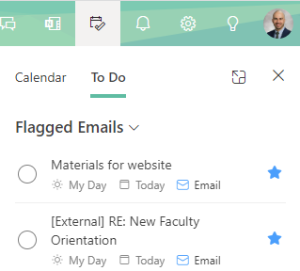
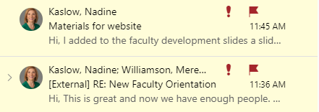
Outlook Skills
Tasks
Outlook has a built-in “to do” list. Click on the flag next to an email to add it to your tasks.
You can track what you need to take care of with the To-Do bar

Slide 18
Practice
Try the techniques listed in the tip sheet
See if you can apply each technique in a way that will be helpful for you
David and Mike will be available to help
We will use breakout rooms if needed

