Slide 1
Wellness
March 4, 2020
Mark Ackerman, PhD
Chanda Graves, PhD
Catherine Rice, PhD

Slide 2
What is Wellness?
A conscious and deliberate process of choices for a healthier and more satisfying lifestyle
A wellness approach is a lifestyle that supports healthy habits that have positive effects on quality of life

Slide 3
WELLNESS
8 Dimension Wellness Framework includes:
Physical
Social
Intellectual
Spiritual
Financial
Occupational
Emotional
Environment

Slide 4
7 Wellness Domains Key to Quality of Life
(Hettler, 1976; Renger et al., 2000)

Slide 5
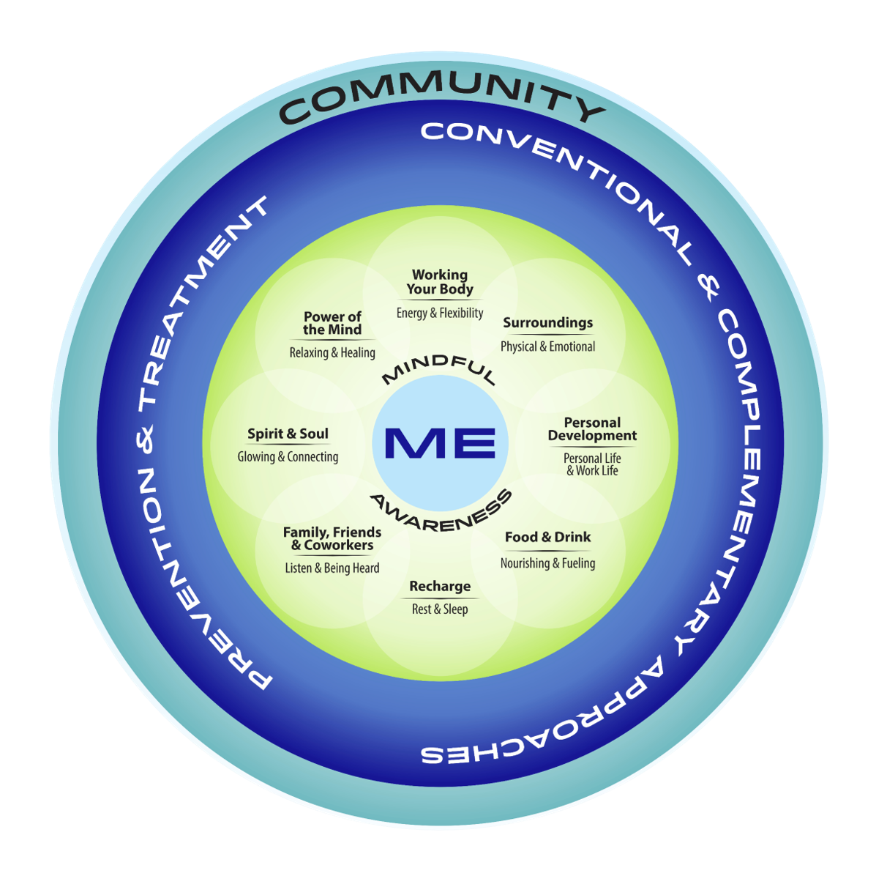

Slide 6
Why is wellness important?
Wellness is important for quality of life
Heart Disease and Cancer are the #1 and #2 causes of death and disability
Both these and other chronic diseases are linked to mental health conditions, e.g. depression, and reduced lifestyle quality

Slide 7
Why is wellness important?
The majority of chronic diseases can be prevented by lifestyle change
Healthy lifestyle can lower the risk of chronic disease by 50-60% despite genetic predisposition, e.g. exercise increases endorphins, relationships serve as stress buffers

Slide 8
Why is wellness important?
https://hellohealthy.com/wp-content/uploads/2015/05/why-wellness-is-so-important1.jpg

Slide 9
Why is wellness important?
https://www.managedcaremag.com/archives/2008/2/wellness-programs-no-longer-just-add

Slide 10
What wellness resources exist for faculty?
“Lifestyle is medicine”
Wellness promotion: regular exercise, good quality diet, moderate weight (BMI<25), if you smoke: quit, stress management, social support, spirituality
Consider: join the Emory gym, develop avocational interests, cultivate network of friends, engage in spiritual pursuits

Slide 11
What wellness resources exist for faculty?
Emory Faculty Benefits/General Health
Health Emory Connect Platform
Health Risk Assessment (HRA)
Diabetes Prevention Program (DPP)
Annual Prevention Exam
Colonoscopy or Cologuard Test

Slide 12
What wellness resources exist for faculty?
Emory Faculty Benefits/General Health
Blood Pressure Kiosks
Express Care Clinic (free)
Ergonomic Assistance
EVIP Line
Flu Vaccines
Occupational Injury Management

Slide 13
Physical Activity and Fitness Resources
Discounted pricing on Fitness Facilities
Walking
List of Walking Places
Walking tours lead by Emory’s Health and Wellness Team
Walking Groups
Biking
On campus bike rentals
Employee cycling network
Graduate and Undergraduate biking social groups

Slide 14
Physical Activity and Fitness Resources
Active Works
Groups to add more activity in your work day
Discounted Pricing for a Fitbit
Pre-recorded webinars or videos on topics related to exercise and physical fitness

Slide 15
Healthy Eating & Weight Resources
Operation Eat Right Nutritional Challenge
Better Choice Label - Emory Dining
Emory Farmer’s Market
Community Supported Agriculture (CSA)
Emory pick up

Slide 16
Healthy Eating & Weight Resources
Healthy Vending Machine Locations
Weight Watchers
Pre-recorded Webinars/Videos
Weight Management Listserv
Health Emory Connect for tracking

Slide 18
Stress/ Emotional Health Resources
Faculty Staff Assistance Program (FSAP)
Online Mental Health Screening
Counseling
Financial Wellness
Refresh from Stress
Pre-recorded Webinars/Videos
Meditation
Smoking Cessation
Website https://www.hr.emory.edu/eu/wellness/index.html

Slide 19
Work/Life Resources
Children and Family
Adult and Elder Care
Financial Programs
Workplace Flexibility
Transitioning to Retirement
Work life Resource Library
Website
https://www.hr.emory.edu/eu/work-life/index.html

Slide 20
What strategies do you recommend for avoiding burnout?
Make time for self-care
Use your vacation time
Learn to meditate
Seek support of colleagues and friends
Engage in hobbies
Develop a stress management plan
Volunteer in your community

Slide 21
What strategies do you recommend for avoiding burnout?
Increase autonomy whenever possible:
scheduling, session length, case mix, and flexible working hours
Set limits without guilt
Make healthy behaviors a priority
book time off, exercise, and relaxation
Attack perfectionism
accept limitations, fallibility
Myers, M. (2015). Burnout in Psychiatrists. Retrieved March 1, 2020 from https://www.psychcongress.com/blog/burnout-psychiatrists

Slide 22
What strategies do you recommend for avoiding burnout?
Embrace interpersonal support
Share feelings openly in a safe milieu with others
Learn and practice mindfulness meditation
Mentor younger colleagues and receive mentorship
Myers, M. (2015). Burnout in Psychiatrists. Retrieved March 1, 2020 from https://www.psychcongress.com/blog/burnout-psychiatrists

Slide 23
How can faculty integrate wellness into their personal and professional lives?
Create a culture of wellness
Prioritize wellness
Faculty Training in Mind Body Medicine
Start with smaller/easier changes

Slide 24
How Can Wellness Be Integrated?
Autism example

Slide 25
myLIFETM Wellness through being H.E.R.E.
H.E.R.E. LIVING | Social Wellness | Emotional Wellness | Intellectual Wellness | Physical Wellness | Spiritual Wellness | Environment-al Wellness | Financial Wellness
Healthy … | positive interactions with others. | emotional responses. | balance of intellectual interests with all areas of life. | balance of physical activity, sound nutrition, sleep, and relaxation. | integrity to one’s beliefs, values, and ethics; one’s identity. | relationships with people who foster positivity and support your personal goals. | understanding of personal finances.
Engaged… | into social relationships with feelings of belonging and inclusivity. | with activities that bring joy and help to cultivate an optimistic attitude. | in creative and stimulating mental activities. | with enjoyable activities that promote optimal health. | with others with similar or diverse spiritual identities and practices. | in fostering a climate of respect and gratitude. | LIFE experiences as a result of financial freedom to make choices.
Responsible and Safe… | decisions when interacting with others. | coping practices. | discussion of intellectual interests and curiosities. | environmental arrangements to protect oneself from injuries and harm. | discussions around beliefs, values, and ethics. | habits that promote a healthy environment. | ways to manage money and address financial needs before they are problems.
Empowered… | confidence to cultivate healthy relationships, share talents, and contribute to community. | abilities and confidence in taking ownership of one’s feelings, understanding emotions, and sharing with others. | ability and confidence to pursue learning new things and to see opportunities for growth in the challenges life brings. | ability and confidence to take control of own physical health and well-being. | to think about the meaning of life for oneself and to be tolerant of the beliefs of others. | ability and confidence to identify opportunities to contribute to sustainability efforts and public spaces. | to set realistic goals related to acquiring money, with step by step plans to reach those goals.
Bernhardt, J., Thomas, T., Reid, M., Lam, G., Bohlke, K., Cubells, J., Rice, C. (2019). myLIFETM On Campus 2019 Program Report. Atlanta, Georgia: myLIFETM Program, Emory Autism Center, Department of Psychiatry and Behavioral Sciences, Emory University School of Medicine. Atlanta, Georgia.

