Slide 1
Giving Feedback to Trainees: Challenges & Opportunities
October 3, 2018
William McDonald, MD
JB Fuqua Chair for Late-Life Depression
Vice-Chair for Education

Slide 2
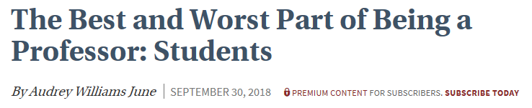
Chronicle of Higher Education

Slide 3
What is your philosophy for trainee development?
Milestones
First two years vs. the second two years
By the third year the resident should be formulating career goals and target their electives to meet those goals

Slide 4
How do you make clear expectations, discuss goals, monitor and track progress related to expectations and goals, and modify these as changes occur?
Residency Education Handbook (114 pages)
Each rotation has clearly defined goals, learning objectives, learning activities, evaluation methods
Residents should have a weekly meeting with their inpatient attending apart from rounding and should get a mid-rotation review
Outpatient psychotherapy supervisors/ adjunct faculty
Residents meet with the training directors twice a year

Slide 5
What are effective strategies for giving positive feedback, as well as feedback related to areas needing improvement?
Milestones emphasize that different learners can progress at different speeds on different educational levels
Only 68% of evaluations are completed by faculty
Areas of improvement
Most trainees respond to feedback
Evaluations should match performance
Specific feedback should include a path to improvement

Slide 6
How do you handle trainees who are not responsive to feedback?
Faculty forward concerns to Dr. Schwartz who gathers data and presents information to the bimonthly Clinical Competency Committee
Resident meets with two training directors and is given a summary of the meeting and a clear path to remediation

Slide 7
Giving Feedback to Trainees: Challenges & Opportunities
October 3, 2018
Mar Sanchez
Professor
Dept. of Psychiatry & Behavioral Sciences, SOM
and
Core Scientist
Yerkes National Primate Research Center

Slide 8
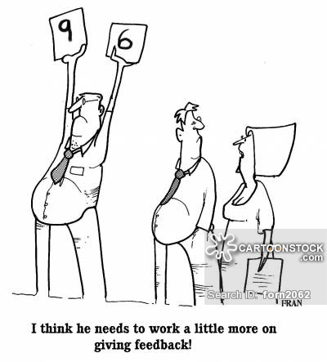
Giving Feedback to Trainees: Challenges & Opportunities

Slide 9
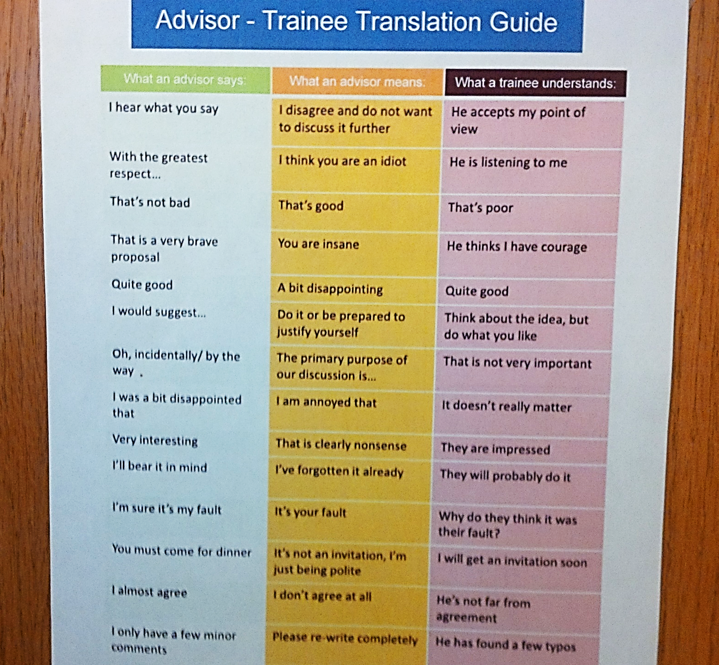
First: post this “Translation Guide” on your office door

Slide 10
What is your philosophy for trainee development?
The goal is for research trainees to develop:
Scientific knowledge & Technical research skills
Teaching & Service skills
Critical thinking
Communication skills (written, oral)
Professionalism
Leadership & management skills (manage lab –funding, regulations- & people).
Responsible conduct of research (ethics)
Independence (guide & support their research career; networking, presentations)

Slide 11
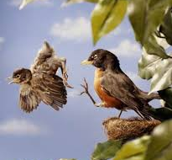
What is your philosophy for trainee development?
The goal is for research trainees to develop:
Scientific knowledge & Technical research skills
Teaching & Service skills
Critical thinking
Communication skills (written, oral)
Professionalism
Leadership & management skills (manage lab –funding, regulations- & people).
Responsible conduct of research (ethics)
Independence (guide & support their research career; networking, presentations)
“Just go!!”

Slide 12
What is your philosophy for trainee development?
“Guide, Advise, Advocate, Support”
The goal is for research trainees to develop:
Scientific knowledge & Technical research skills
Teaching & Service skills
Critical thinking
Communication skills (written, oral)
Professionalism
Leadership & management skills (manage lab –funding, regulations- & people).
Responsible conduct of research (ethics)
Independence (guide & support their research career; networking, presentations)
What makes it work?
Clear Communication & Honesty
Set clear expectations & Goals
Renegotiation as things develop and change (plasticity!!!)
Remember: there’s no one right way
No two mentor-mentee relationships are alike
Understand Limits & Boundaries
Be aware of field-specific (or PhD/MD) differences in expectations and obligations
Adapt to personality (e.g. independent), gender, race, cultural differences.

Slide 13
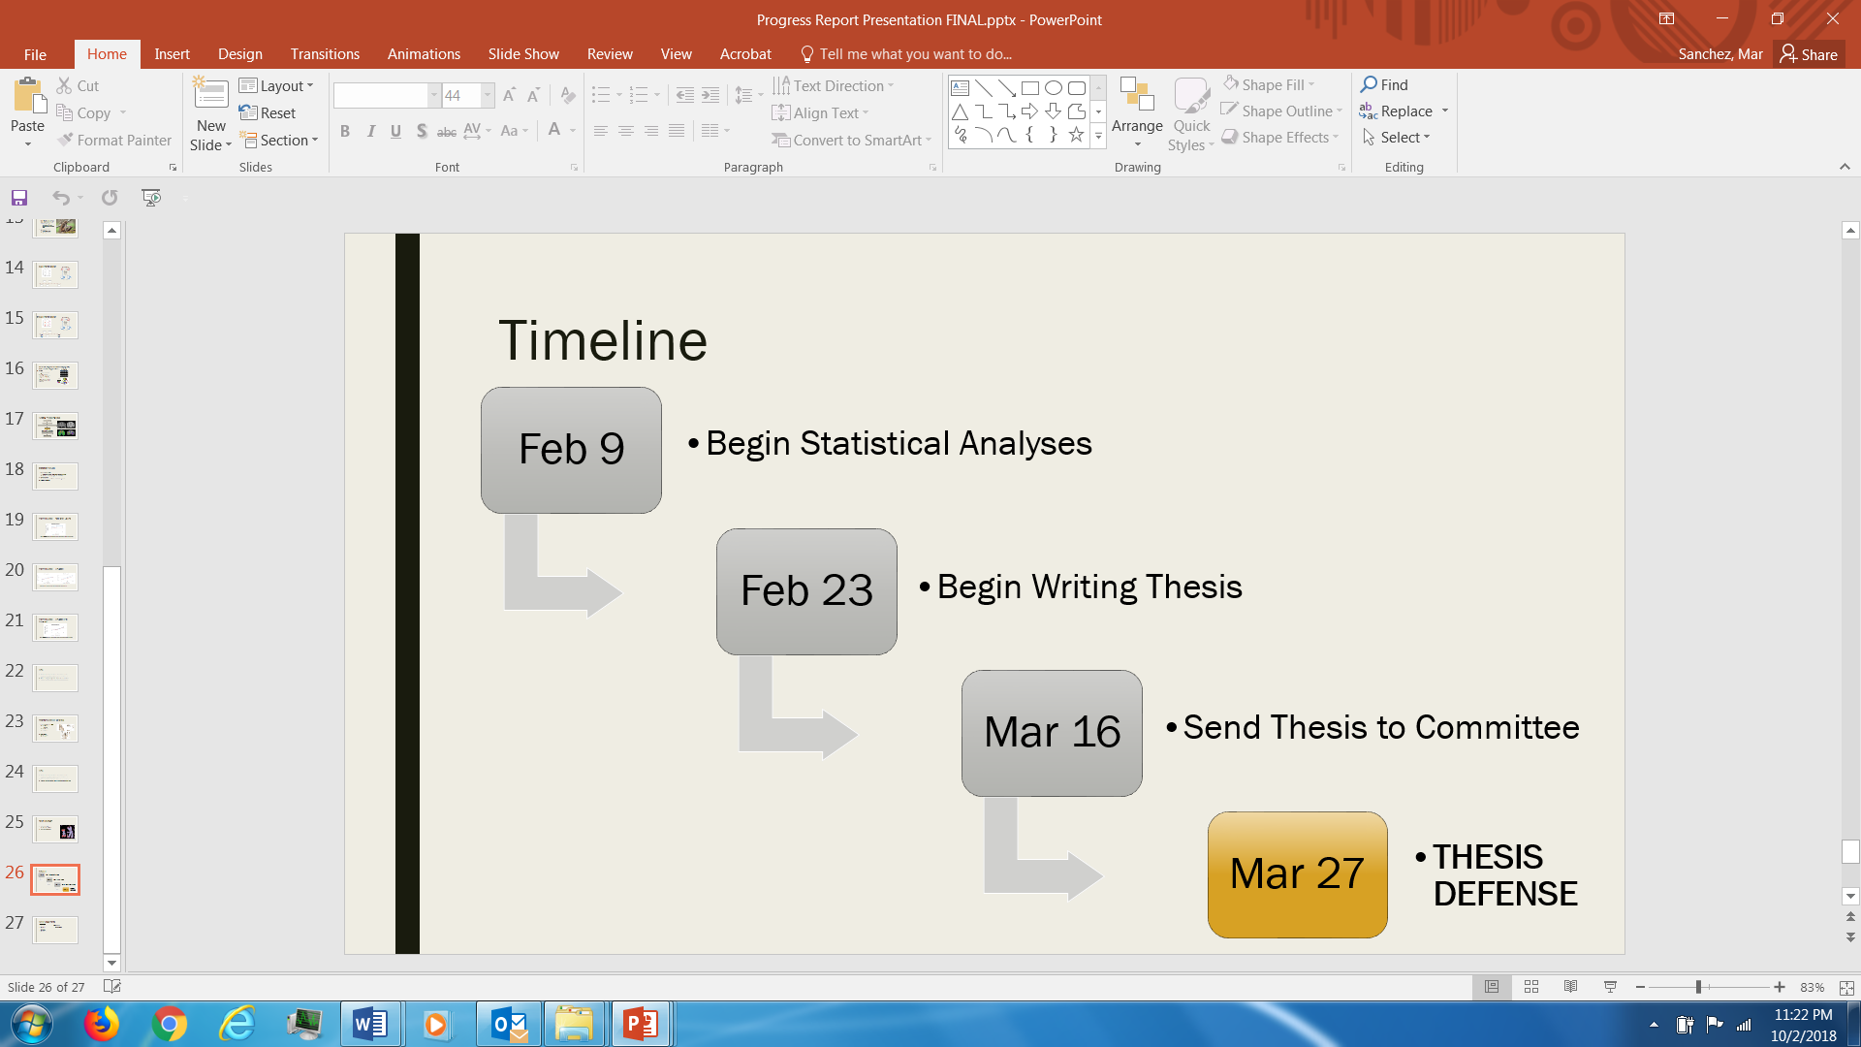
How do you make clear expectations, discuss goals, monitor and track progress related to expectations and goals, and modify these as changes occur?
Initial discussion of “the PLAN”
Weekly one-on-one meetings + Summary Table of Progress (per project & domain)!!!!!
Timelines & Milestones:
Weekly Lab meetings for project updates or Journal Club presentations (monthly: DataBLITZ).
Follow up on important meetings with summary email: always document goals/decisions/issues (per HR training).

Slide 14
What are effective strategies for giving positive feedback, as well as feedback related to areas needing improvement?
“Sandwich technique”:
Positive message first with personal wording……
(e.g. “These findings are so important”, “statistical analyses are really sophisticated”),
Then, tackle the criticism in a positive way
(e.g. use “and”, not “but”).
End with the “positive” impact.
(“this is going to take you to X/Y/Z”).

Slide 15
How do you handle trainees who are not responsive to feedback?
When issues arise:
Identify the source of the problem & discuss it honestly.
Offer alternative solutions & set up a timeline for changes to take place.
Evaluate progress frequently
If no progress….recruit a co-mentor, ask for advice (e.g. HR)
Accept failure: some people do NOT want to be mentored.
(Have a final meeting to discuss lack of progress and need to find a different mentor/program/field…or refer to Administration).

Slide 16
Recommended resources for Research Mentoring
Consider joining the ATLANTA SOCIETY OF MENTORS: www.atlantamentors.org
Consider joining Mentornet: www.mentornet.net
Interesting recent piece in Nature from a new faculty at Columbia Univ:
"The key to a happy lab life is in the manual“
www.nature.com.proxy.library.emory.edu/articles/d41586-018-06167-w
[I can email the PDF of the Lab Manual, which is published; see next slides]
https://www.nature.com/naturejobs/science/career_toolkit/mentoring

Slide 18
I can email the PDF of the manual,
Or give you their “Wiki” page.
Or the Twitter feeds with similar manuals

Slide 19
Giving Feedback to Trainees: Challenges & Opportunities
October 3, 2018
Nadine J. Kaslow, PhD, ABPP
Vice Chair for Faculty Development
Director of Psychology Postdoctoral Residency Training

Slide 20
What is your philosophy for trainee development?
Competency Benchmarks – competencies are consistent across development but performance expectations related to their essential components shift over the course of development
Trainees progress along a developmental trajectory and need different types of supervision/teaching based on their stage of development
Move from needing more support, guidance, and feedback to more autonomy

Slide 21
What is your philosophy for trainee development?
Foundational Competencies
Professionalism - professional values & attitudes, individual & cultural diversity, ethical legal standards and policy, reflective practice
Relational
Science

Slide 22
What is your philosophy for trainee development?
Functional Competencies
Application – Evidence-Based Practice, Assessment, Intervention, Consultation
Education – Teaching, Supervision
Systems – Interdisciplinary Systems, Management-Administration, Advocacy

Slide 23
How do you make clear expectations, discuss goals, monitor and track progress related to expectations and goals, and modify these as changes occur?
Postdoctoral Training Program Handbook
Clearly defined competencies, essential components, developmental expectations, and evaluation methods
Residents create an Individualized Development Plan with their supervisors, with whom they meet weekly
Individualized Development Plan is evaluated and revised every six months
Faculty review residents’ performance regularly and do 360 degree evaluation

Slide 24
What are effective strategies for giving positive feedback, as well as feedback related to areas needing improvement?
Articulate benchmarks expectations clearly, with attention to developmental level and make clear how feedback will be given
Directly observe trainee’s performance and use 360 degree evaluations
Give formative (ongoing) feedback that is specific, timely, and addresses both strengths and areas for development

Slide 25
What are effective strategies for giving positive feedback, as well as feedback related to areas needing improvement?
Plan and prioritize summative (end of rotation) feedback and ensure it is delivered in a safe environment
Listen to the trainee's self-evaluation
Take a balanced approach - Detail what the trainee does well and discuss opportunities for improvement with emphasis on specific, modifiable behaviors and be focused on the topics addressed
Have a plan for follow-up reassessment

Slide 26
How do you handle trainees who are not responsive to feedback?
Difficult conversations
Ethical imperative
Personal and contextual barriers
Practice
Remediation Plans
Address lack of responsiveness to feedback as a problem associated with one or more competencies (e.g., professionalism, supervision)

