Slide 1

SERVICE PORTFOLIO
FACULTY DEVELOPMENT COMMITTEE
January 6, 2021
Marianne Celano, PhD, ABPP
ANDREW FURMAN, MD
Julie Kable, PhD
NADINE KASLOW, PhD, ABPP

Slide 2
Objectives
Describe service
Present the relevant guidelines
Detail the Service Portfolio
Describe ways to gain valuable experiences for the Service Portfolio
Offer advice for creating a strong Service Portfolio

Slide 3
Service
Service is not synonymous with outstanding patient care
Service is distinct from Teaching- only overlap is program director, which is both
Service means going above and beyond
More faculty go up on Service than Teaching

Slide 4
Elements of Service
Evidence of your skill and knowledge (who you see, why your service is special, and awards that you may have received)
Humanistic concern for patients and families (public advocacy)
Collegiality and the innovation application of techniques and knowledge (modifications, changes, improvements, manuals, etc)
Citizenship (committee work, conference organization, peer review (manuscripts and grants)
Letters from people who have seen the benefits of your action

Slide 5

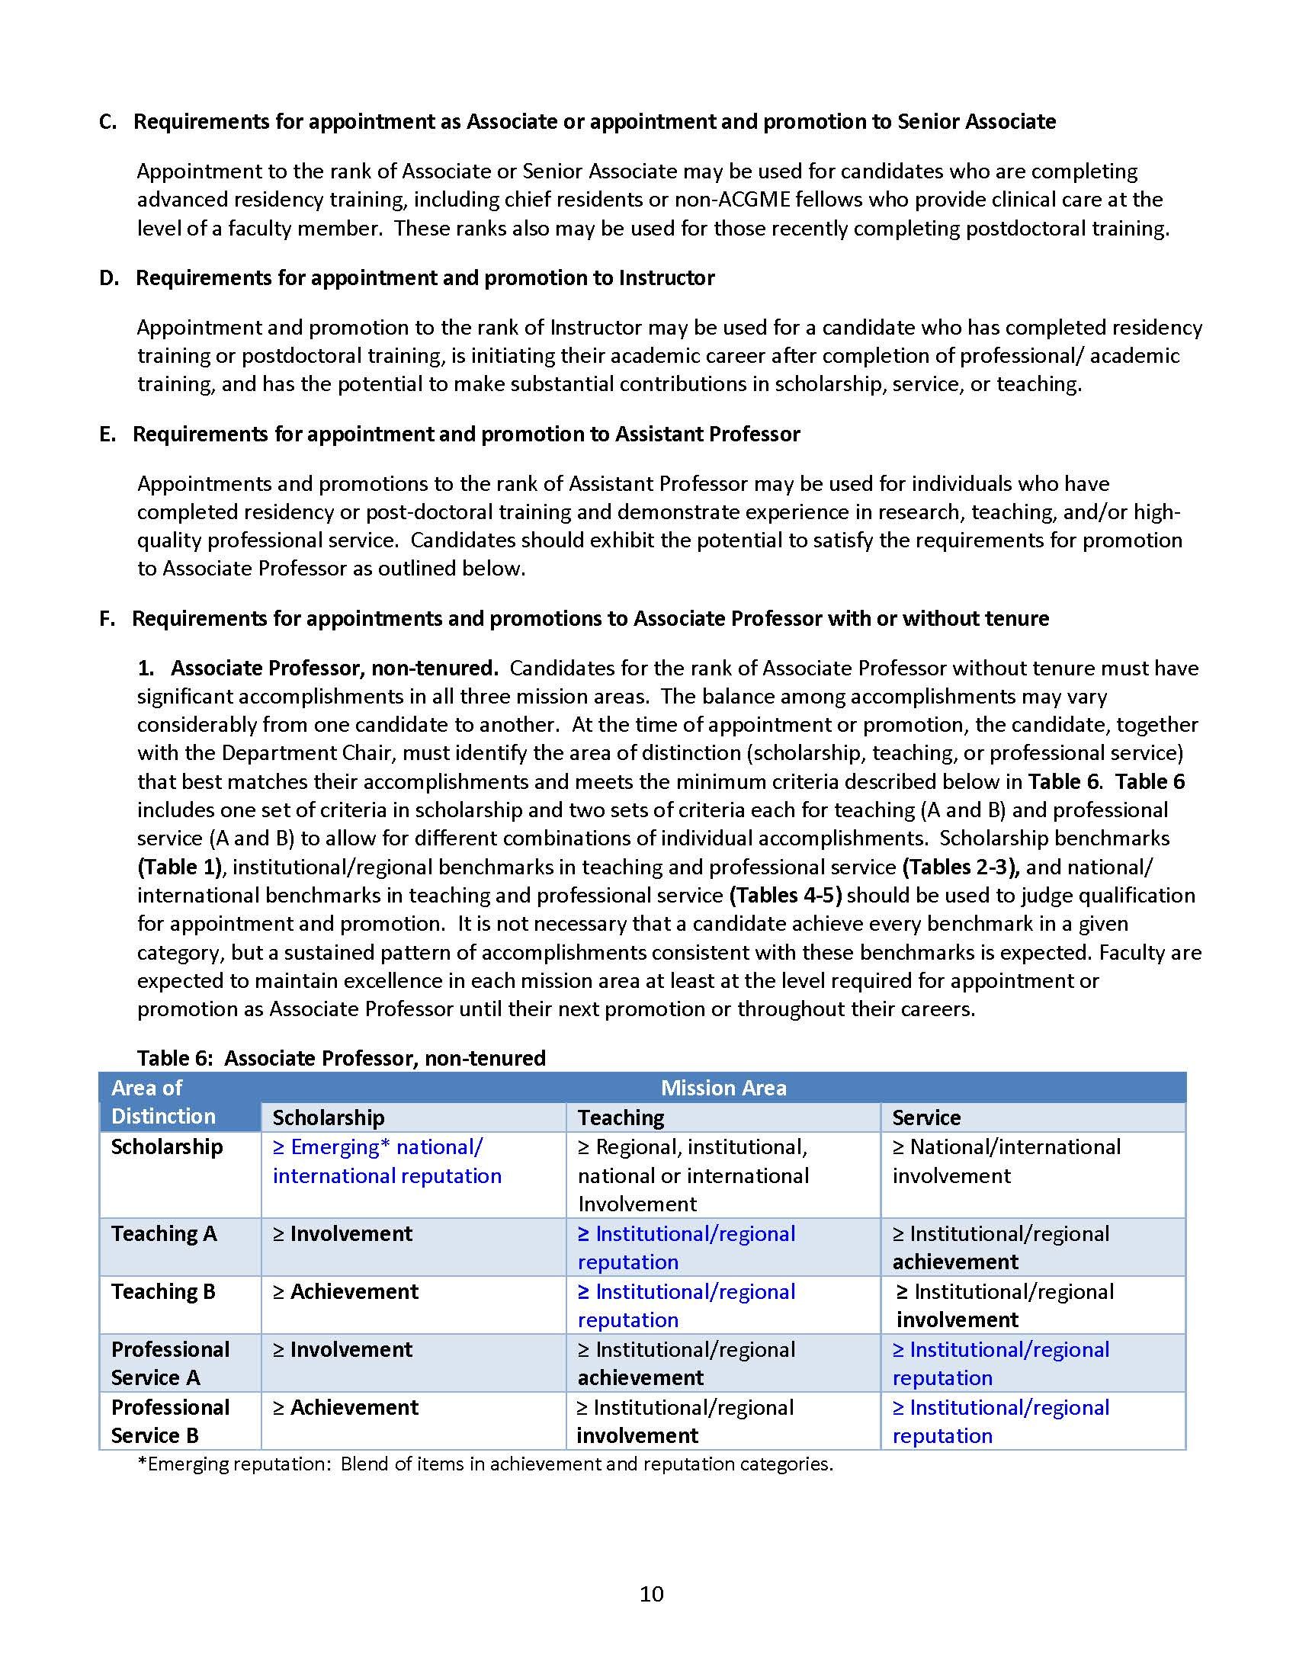
Promotion Guidelines

Slide 6
Promotion Guidelines

Slide 7

Service-Related Guidelines – Institutional/Regional: Table 3

Slide 8
Service-Related Guidelines – Institutional/Regional: Table 3

Slide 9
Service-Related Guidelines – National/
International: Table 5

Slide 10
Service-Related Guidelines – National/
International: Table 5

Slide 11
Service Portfolio: Format
Ensure your CV and Service Portfolio are the same by copying the information from the CV to the Service Portfolio and then adding detail
Follow the guidelines exactly
  Chronological order – oldest to newest
Use this as your opportunity to explain unique or exceptional roles – definitions of roles differ across departments and institutions
Remember you have 10 pages
Attachments
  Consider 4-5 letters of support - Have letters be only 1 page to maximize their impact
  Reports showing impact

Slide 12
Service Portfolio: Components
Current Administrative/Clinical Appointments
Clinical Service Contributions
Society Memberships
Committee Memberships
Peer Review Activities (grants, manuscripts, conference abstracts)
Editorships and Editorial Boards
Organization of Conferences
Consultantships/Advisory Boards
Service-Related Honors and Awards
Community Outreach (local charities, community clinics, religious or service organizations, media appearances)
Attachments

Slide 13
Component: Current Appointments
Current Administrative/Clinical Appointments (your title, location, and brief description of the role)
  Director, Division of X
    In this role I oversee X. I directly supervise X. I interact with X and Y to ensure X.
  You may add in recently held positions that are particularly noteworthy under a “Previously held” category
    Previously held: Interim X, 10/17-12/19

Slide 14
Component: Clinical Service Contributions
Clinical Service Contributions (patient care responsibilities, new programs created, impact for department/school)
  Service Z
    Created the Z service and serve as the A.
    This service offers B,C, and D interventions to E patients from around the region.
    This service has seen #patients since Y date.
  Service Q
    See E, F, and G patients
    Provide H services
    Have received quality metrics ….

Slide 15
Component: Society Memberships
Society Memberships (office held if any, Society, year(s))
  American Psychiatric Association/American Psychological Association
    Member, xxxx-present
    Office, years. I was elected in a competitive process by the members of X society to a three year term of office.
  Society X
    Member, xxxx-present
    Fellow X, xxxx-present. This recognition is based on M and N.

Slide 16
Component: Committee Memberships
a) National and International [office held if any, committee year(s)] | Member, Nominations Committee, 2007-09 (Elected) Founder and Chair, Fellowship Program Directors Committee, 2017-present
b) Regional and State [office held if any, committee, year(s)] | Vice President, Georgia Psychological/Psychiatric Physicians Association, 2014-2019
c) Institutional [office held if any, committee, year(s)] | Program Director, X Fellowship, 2015-present Member, Emory University School of Medicine Faculty Development Advisory Committee, February 2017-present President, Emory University Senate, 2020-present (Elected)

Slide 17
Component: Peer Review Activities
Grants i. National ii. Regional iii. Institutional | Ad Hoc Review, NIH Study Section, Neurosciences, xxxx-present Member, University Research Committee, 2012-2015
b) Manuscripts* | Ad Hoc Reviewer, Journal X, 2018-present Ad Hoc Review, Journal Y, 2015-2019
Conference Abstracts i. National ii. Regional iii. Institutional | Conference Abstracts means you reviewed abstracts for a meeting. It isn’t asking for abstracts you had accepted.
*Non-predatory journals, impact factor is considered | http://sco.library.emory.edu/open-access-publishing/index.html

Slide 18
Component: Editorships and Editorial Boards
Editorships and Editorial Boards | Editorial board*, Lancet Psychiatry, 2020-present Senior Section Head, New England Journal of Medicine, 2020-present
*Non-predatory journals, impact factor is considered | http://sco.library.emory.edu/open-access-publishing/index.html

Slide 19
Component: Organization of Conferences
Session/conference you organized or sessions you served as Chair – list administrative position or session as chair for each conference
  a. National and International
    Program Committee, X Scientific Sessions, 2015-2018. As leadership team member for X, I served on the program committee for the full meeting. X manages a one day session during each meeting and members are also included on other panels as appropriate
  b. Regional
    Scientific Sessions Chair, GPA/GPPA, 2015-2020, Responsible for all aspects of X Annual Meeting for two years
    Moderator, X Panel, X Annual Meeting, xxxx-present: Selected panelists, reviewed and graded submissions, mentored presenters and moderated session
  c. Institutional

Slide 20
Component: Consultantships/Advisory Boards
Consultantships (title, company or agency, year(s))
  Skyland Trails
    Board member, Description of organization and roles/responsibilities, xxxx-present

Slide 21
Component: Service Related Honors and Awards
Award/Honor (name, year, short explanation of award will be helpful to reviewers)
  Department of Psychiatry and Behavioral Sciences Award for Distinguished Service, 2018 – This award was in recognition for my leadership and involvement with program X, which provides services to frontline healthcare workers during the pandemic.

Slide 22
Component: Community Outreach
Local Charities, Community Clinics, Religious or Service Organizations, Media Appearances (title, organization, year(s))
  CNN, health updates, xxxx-present
  Volunteer, Habitat for Humanity, xxxx-present

Slide 23
Component: Attachments
Attachments
  4-5 letters of support from colleagues or societies – 1 page to maximize their impact
  Letters must be on official stationery, signed, and in your portfolio
    Select letters from the following types of individuals (not external referees):
      Non-Emory faculty with whom you’ve served on regional/national committees
      Emory faculty from a different department who can attest to the growth and excellence of your clinical program
      Journal editors who comment on your service as a reviewer or editorial board member
      Leaders of community/patient advocacy groups to describe your unique contributions

Slide 24
Component: Attachments
Attachments
  Report showing impact to your service line/program of your effort on projects, for example increased the number of patients seen/regional reach of the program, ….

Slide 25
HOW CAN I GAIN VALUABLE EXPERIENCES FOR MY SERVICE PORTFOLIO?
Serve on committees
  Departmental
  Institutional (e.g., IRB)
  Regional
  National
  International
Review manuscripts submitted for publication (ad hoc, editorial board)
Develop/lead clinical program that attracts patients regionally
Lead accredited training program (counts in education too)
Advise community/patient advocacy groups

Slide 26
HOW CAN I GAIN VALUABLE EXPERIENCES FOR MY SERVICE PORTFOLIO
Build/direct programs
Engage in committee work
Assume administrative roles
Be active/taking leadership roles in professional societies/organizations outside of the institution is very important, and necessary for promotion toa associate professor (regional) or professor (national/international) if area of distinction is Service

Slide 27
WHAT IS YOUR ADVICE FOR CREATING A STRONG SERVICE PORTFOLIO?
Start early
Identify your clinical niche and develop a clinical program
  Collect data on patient care (number served/year, from where, outcomes)
Ask your mentor or senior faculty members in your specialty how you can:
  Get involved in relevant regional and national committees
  Review manuscripts or conference program submissions
Identify an opportunity for quality improvement in patient care, assemble a team to fix it
Document all community outreach and service activities
Save emails in which faculty or patients thank you for your clinical service

Slide 28
WHAT IS YOUR ADVICE FOR CREATING A STRONG SERVICE PORTFOLIO?
Differentiate Service from Teaching and Scholarship
  Remember Program Directors/Associate Program Directors do both
    Include administrative functions under Service
    Include teaching, supervising, mentoring, thesis committees under Teaching
  Place moderating a panel under Service, whereas giving a lecture is Teaching, and lecturing related to your research is Scholarship
Remember, list item in only one place – No double dipping

Slide 29

QUESTIONS AND ANSWERS

