Slide 1
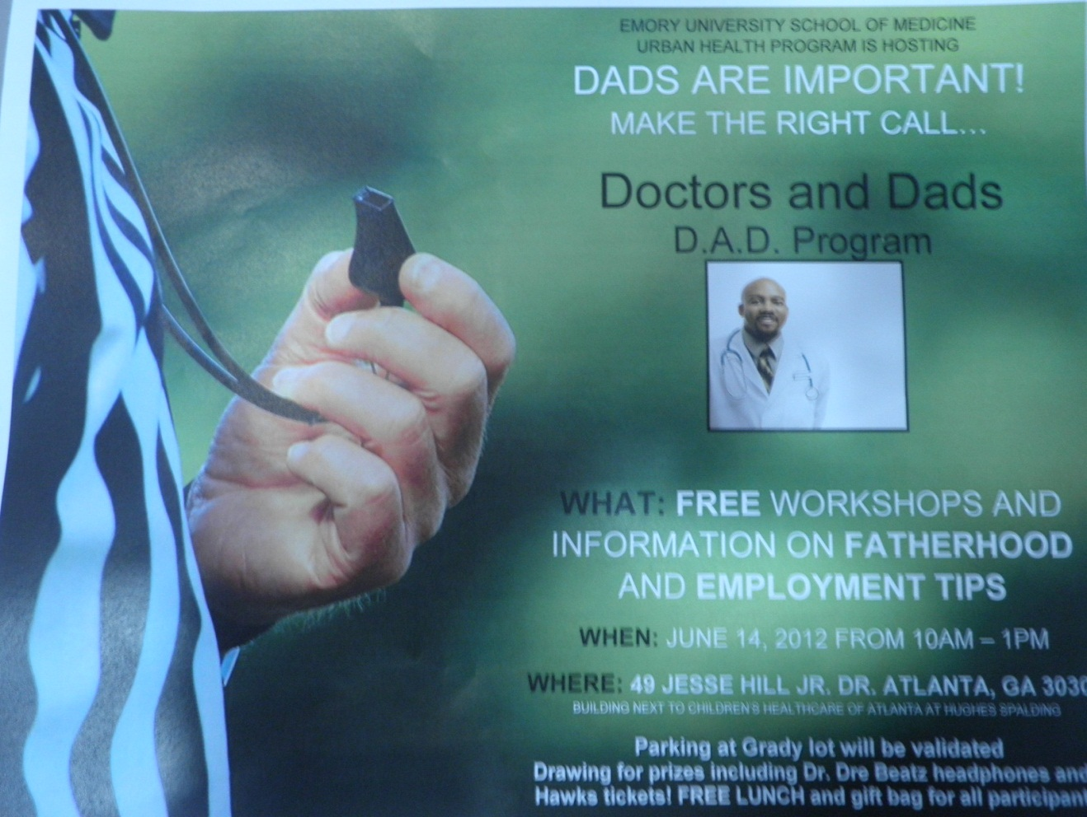
Doctors and Dads (D.A.D)
Dads are Important!
Emory University Department of Pediatrics Urban Health Program
June 14, 2012

Slide 2
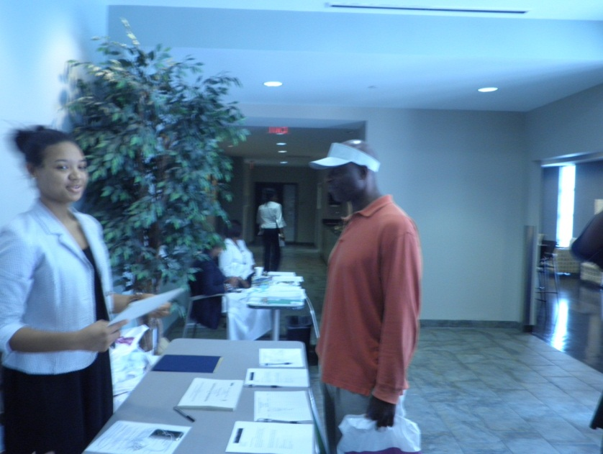
Rationale for Program
Involved fathers can have a huge impact on a child’s life. Emory’s Urban Health Program sponsored a workshop to honor and inform fathers whose children receive Pediatric Primary Care at Children’s Healthcare of Atlanta. The program was held in June, the week before Father’s Day.
Volunteer Leigh Johnson assists at the Registration table. Every father received a gift bag with handouts and fun freebies from Children’s Healthcare.

Slide 3
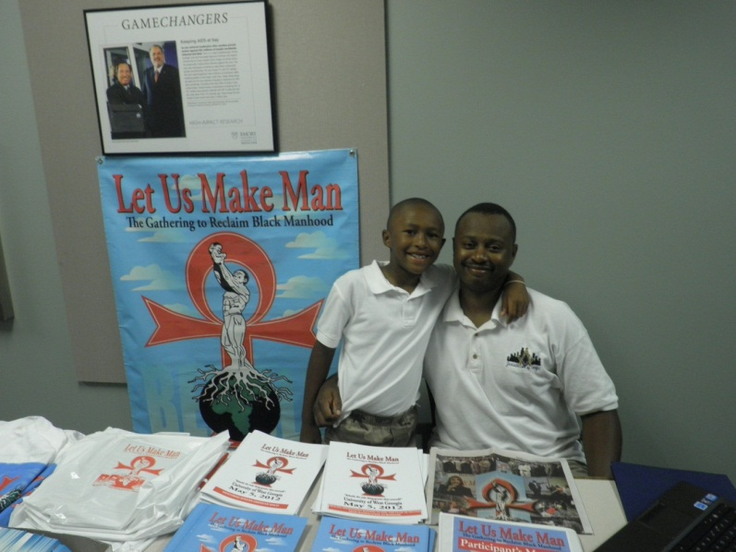
Exhibitors
Two exhibitors representing Fatherhood programs were present, in addition to the hospital chaplain:
* Let Us Make Man
* We Dare to Care
(Comprehensive Men’s Health Initiative)
Let Us Make Man exhibitor
Doug Evans poses with his son

Slide 4
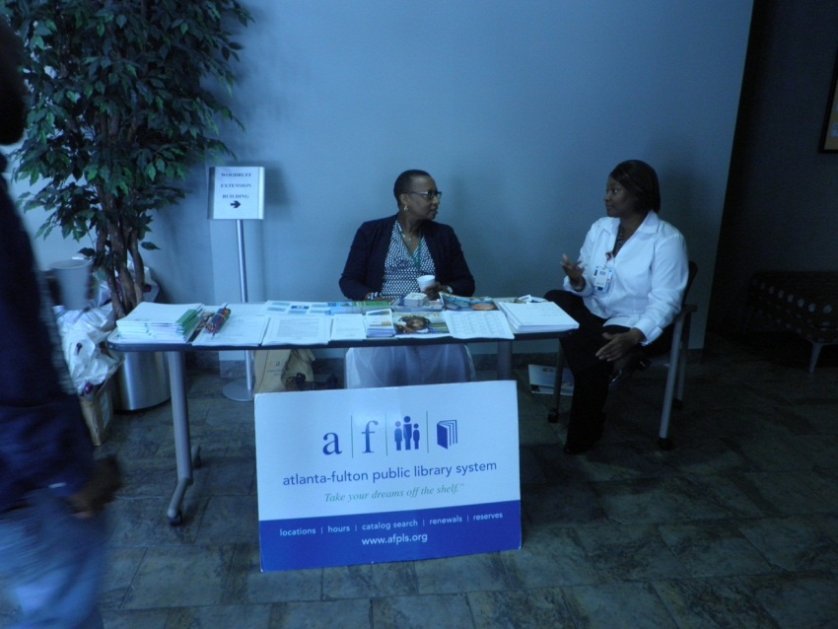
Atlanta Fulton County Library
Reading with children is an a great activity that fathers can do to promote learning skills. The Atlanta-Fulton Public Library provided library card registration onsite. Fathers were provided with a book list of great books with father-child themes!

Slide 5
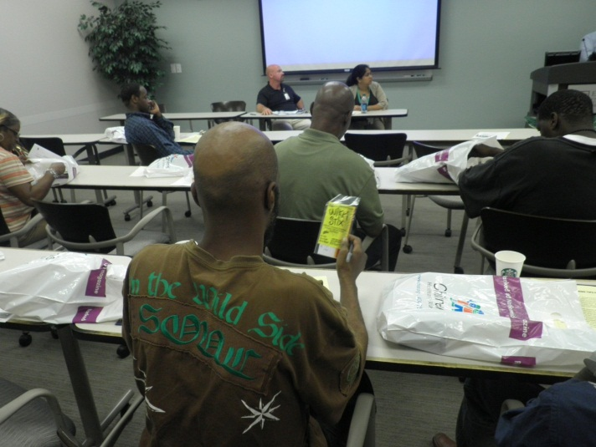
Facilitating Fathers’ Full Involvement
Payal Kapoor spoke about how attorneys with the Health Law Partnership (HeLP) can help fathers with legal barriers to participate more fully in their children’s lives.
Fathers participate in the workshops.
Mark Lee from the Georgia Fatherhood Program acknowledged that most fathers want to provide financial support for their children and discussed how his organization tries to help overcome barriers to employment.

Slide 6
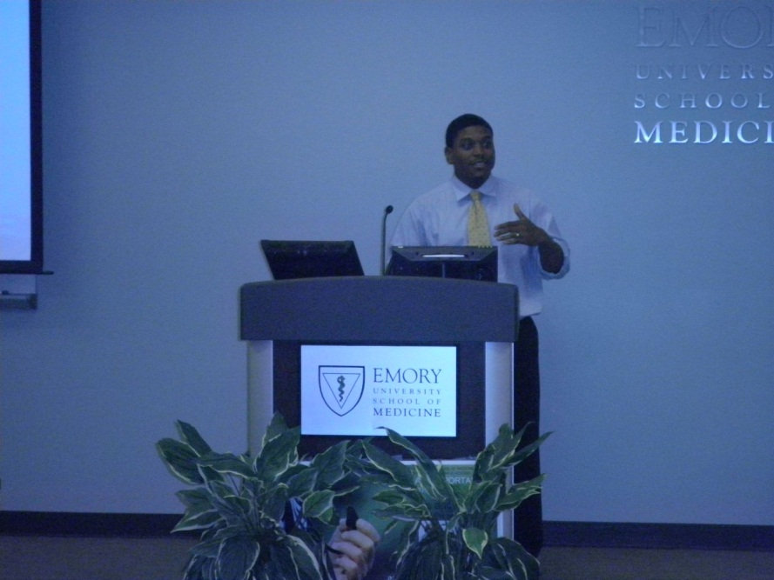
Teach Me, Dad!
Dr. Jason Thomas, Morehouse pediatric resident, provided insightful information as a doctor and father. He focused on how to find teachable moments during everyday activities to build children’s characters and knowledge base.
Dr. Ann Hazzard, Emory psychologist, talked about hands-on activities than are fun to do with children of different ages. Handouts covered educational websites , math games and rhymes, and fun low-cost recreational activities for families.

Slide 7
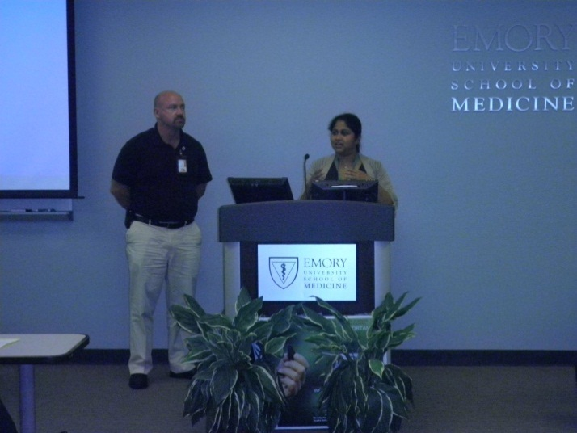
Positive Discipline That Works
Psychologist Uma Dorn and social worker Rob Magbee discussed how important it is to praise your child often and why alternatives to spanking are often most effective in improving children's behavior.
Just What the Doctor Ordered
Dr. Lynn Gardner (Emory) discussed helpful information for fathers to provide when they are bringing children in for their medical appointments. Dr. Kevin Mason (Morehouse) spoke about his own experiences as an adoptive father and the importance of open communication with children, including discussing challenging topics such as responsible sexual decision-making.

Slide 8
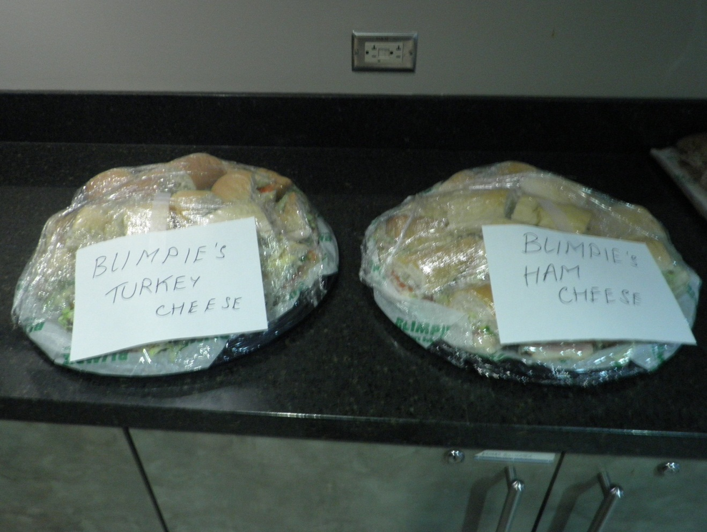
Lunch Break!
Presenters and workshop participants networked informally over lunch. Thanks to Blimpies for donating two deli sandwich trays.

Slide 9
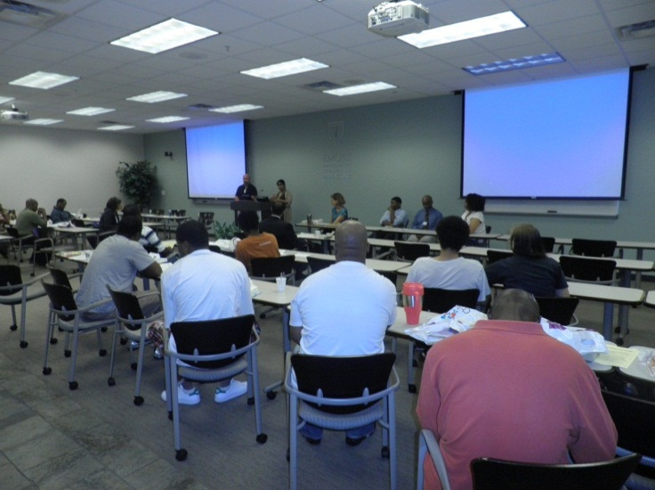
Employment Tips
Employment specialists with two agencies discussed the services their organizations provide, including job training, interviewing and resume tips, and job referrals:
* Adrianna Watkins & Rashida Carter
Goodwill of North Georgia
* Randy White
Atlanta Urban League/Salvation Army
A panelist shares his own experience of unemployment , noting that the stress of joblessness can lead to mental health problems for men.

Slide 10
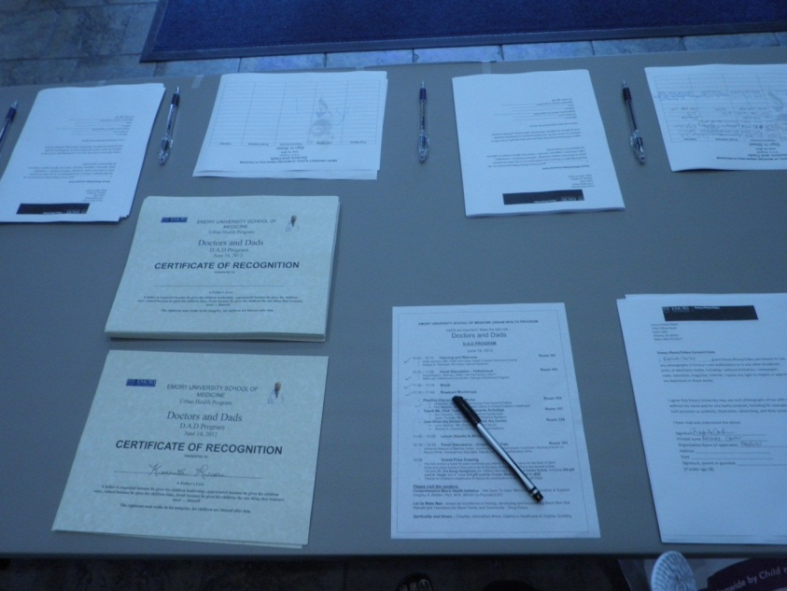
Workshop Closing
Author, Gerry L. White, led the fathers in a rousing group recitation of fatherhood pledge of
caring, commitment and consistency entitled
Honoring "YOU" A New Father, which emphasized those values. Then each father received a Certificate of Recognition for attending the D.A. D. program.
Certificates of Recognition, ready for pick-up!

Slide 11
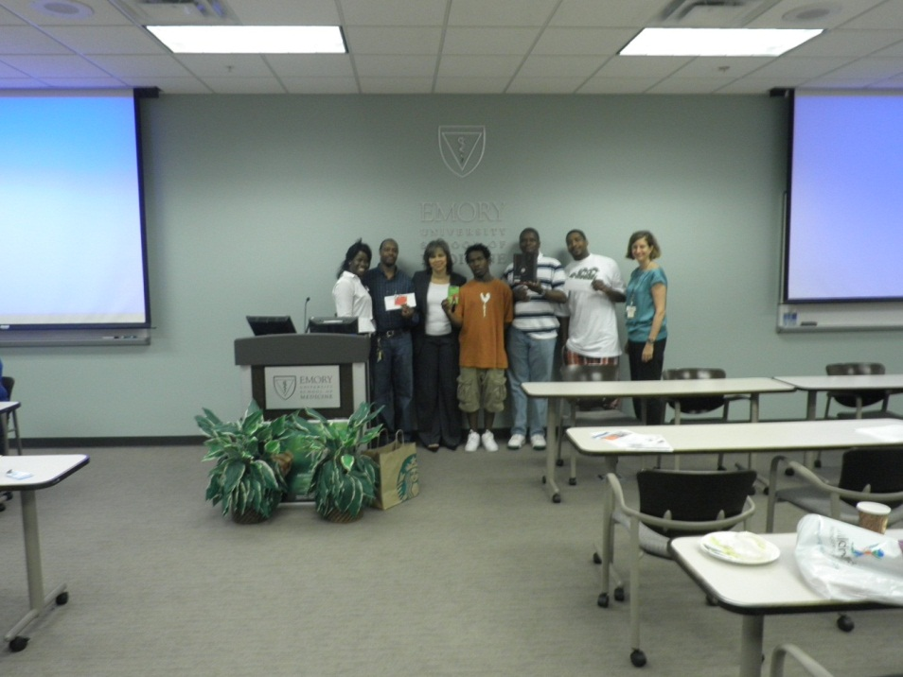
Children are Winners when Fathers are Part of Their Lives!
Dr. Veda Johnson, Executive Director of the Urban Health Program, congratulates the winners of the door prizes.

Slide 12
Special Thanks to
*Urban Health Program staff, especially Katilia Harden (Behavioral Health Coordinator), who planned the program after conducting a needs assessment with fathers.
*Sondra Brooks and Children’s Healthcare of Atlanta at Hughes Spalding
*Other prize donors (Dr. William Bennett, Atlanta Hawks)
*All of the volunteers!

