Slide 1
NHSN Respiratory Tract Infection Pilot Surveillance Activity: Training 101
Dr. Scott Fridkin, and Joseph Kellogg, MPH:
GA Emerging Infections Program and Emory University

Slide 2
What is the activity?
CDC’s NHSN is planning to add a surveillance module for “Respiratory Tract Infections (RTI)” in nursing homes
CDC is asking the GA Emerging Infections Program and 5 other sites to work with nursing homes
To hear from nursing homes how to best perform any such surveillance activity
To get feedback on how the forms, tools, and training material can be improved

Slide 3
Project Overview for LTCF
Before the project
RTI Surveillance
Post project
Step 1
Step 2
Step 3
Step 4
Step 5
Step 6
Step 7
Identify a Project Lead in each LTCF
LTCFs Complete Training with CDC/EIP
EIP Team/LTCF conduct retrospective review of COVID-19 cases (optional)
Appendix G
Post Pilot Survey and Process of Care Form (optional)
Appendix F
Appendix I
EIP Team transfers data to CDC
Data Analysis
&
Receive results from CDC via EIP Team
LTCF collects data prospectively using the RTI prospective event form for approximately 3-6 months
Appendix A RTI Prospective Form
Appendix C Denominator Form

Slide 4
Rough Timeline of Project
Sep. 2021
Sept 14, 15, 16
Participate in Trainings run by Emory/GA EIP
Jan 2022
Oct 2021
Dec 2021
Sept 23 soft rollout of surveillance
option to continue past Jan
Nov 2021
Submit forms
Submit forms
Submit Forms
EIP staff data entry
Virtual calls with Emory/GA EIP on policies
start surveillance
Weekly office hours
Weekly office hours
Weekly office hours

Slide 5
Training Objectives
At the end of the training, you should be able to
Explain the approach to the NHSN RTI Pilot Surveillance (how to track, what to track, what to report)
Be able to access instruction manual and forms for surveillance
Be able to correctly abstract and report the required data elements for the forms
Identify steps you need to take to successfully submit surveillance data to GA EIP partners
Find a second training time to run through some case studies

Slide 6
Overview of approach to RTI surveillance in NHs
For 3 months starting Oct 1
Incorporate normal processes of work to track residents needing further review for RTI (RTI Triggers)
RTI Triggers include 5 indicators in three groupings: clinical change, testing, antibiotic starts
1 RTI form per RTI
(1) New RTI sign or Symptom
Laboratory/imaging report
(2) Lab (Blood, urine, sputum) test results
SBAR or Clinical Change
(4) Clinician diagnosed RTI
(3) CXR imaging
Antibiotic Starts
(4) For RTI or Pneumonia
(5) Antiviral for possible flu
Add names to list as these results come in
Add names to list as these results come in
Update list weekly for all residents with each RTI trigger
Track daily and maintain list of residents
* (number) reflects RTI trigger number in form instructions

Slide 7
RTI Triggers
Hierarchy for Available Triggers:
New Respiratory Tract Infection (RTI) Signs or Symptoms (New or Worsening).
Laboratory Result indicating possible RTI
Imaging Result indicating possible RTI
Clinical Diagnoses of a RTI
Antibiotic use for indication of RTI
Antiviral use for possible RTI

Slide 8
Overview of approach to RTI surveillance in NHs
For 3 months starting Oct 1
Incorporate normal processes of work to track residents needing further review for RTI (RTI Triggers)
RTI Triggers include 5 indicators in three groupings: clinical change, testing, antibiotic starts
Exactly How you do this is up to you; but need an ongoing list of resident names and dates of each “Trigger” event you are aware of. Some residents will have more than one trigger event.
1 RTI form per RTI
(1) New RTI sign or Symptom
Laboratory/imaging report
(2) Lab (Blood, urine, sputum) test results
SBAR or Clinical Change
(4) Clinician diagnosed RTI
(3) CXR imaging
Antibiotic Starts
(4) For RTI or Pneumonia
(5) Antiviral for possible flu
Add names to list as these results come in
Add names to list as these results come in
Update list weekly for all residents with each RTI trigger
Track daily and maintain list of residents
* (number) reflects RTI trigger number in form instructions

Slide 9
Overview of Information Needed for each Resident with RTI
-2 | -1 | 1 | 2 | 3 | 4 | 5 | 6 | 7 | 8
1 RTI form per RTI
The high priority RTI Trigger is the “event date” for reporting
CDC asks for clinical information for 7 day “Surveillance Window”
Attribution – where was the resident, type of resident at event date
Vital Signs during surveillance window
Signs/symptoms, lab testing, imaging (CXR) in surveillance window
Mental status and functional status changes in surveillance window
Treatment during surveillance window
Apply a standard definition for the RTI
PNA vs. LRTI vs. ILI vs. SARS-CoV-2
Vaccination status of resident (anytime)
Outcome
Transfer within 7 days
Died within 30 days
Update list weekly for all residents with each RTI trigger

Slide 10
Operational Manual
All forms and Instructions Sent via Email with PDFS with filenames outlined below
Also, can be found by clicking here
Please let us know if you have trouble getting access – users must be manually added by Joe
RTI Event Forms
Appendix A RTI Prospective Event form
Appendix B Table of Instructions for RTI Prospective Event Form
Appendix E Definitions, Tables and Algorithims
Census Forms
Appendix C Denominator form
Appendix D Instructions for Denominator Form

Slide 11
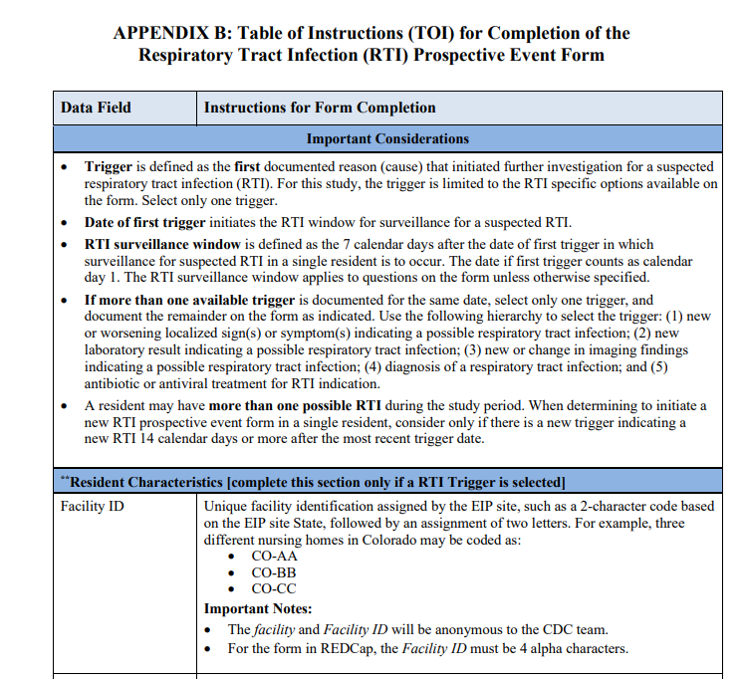
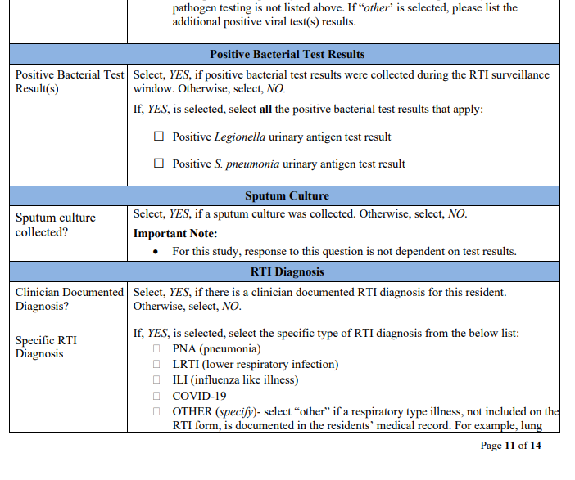
Operational Manual
All forms and Instructions Sent via Email with PDFS with filenames outlined below
Also, can be found by clicking here
Please let us know if you have trouble getting access – users must be manually added by Joe
RTI Event Forms
Appendix A RTI Prospective Event form
Appendix B Table of Instructions for RTI Prospective Event Form
Appendix E Definitions, Tables and Algorithims
Census Forms
Appendix C Denominator form
Appendix D Instructions for Denominator Form

Slide 12
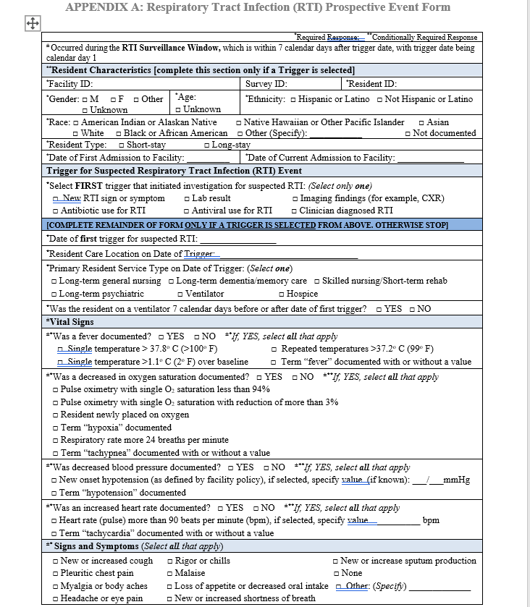
Operational Manual
All forms and Instructions Sent via Email with PDFS with filenames outlined below
Also, can be found by clicking here
Please let us know if you have trouble getting access – users must be manually added by Joe
RTI Event Forms
Appendix A RTI Prospective Event form
Appendix B Table of Instructions for RTI Prospective Event Form
Appendix E Definitions, Tables and Algorithims
Census Forms
Appendix C Denominator form
Appendix D Instructions for Denominator Form

Slide 13
Check Access to Documentation
Have you received the PDFs and have access
+/or do you have the link sent by Joe bookmarked and opened now

Slide 14
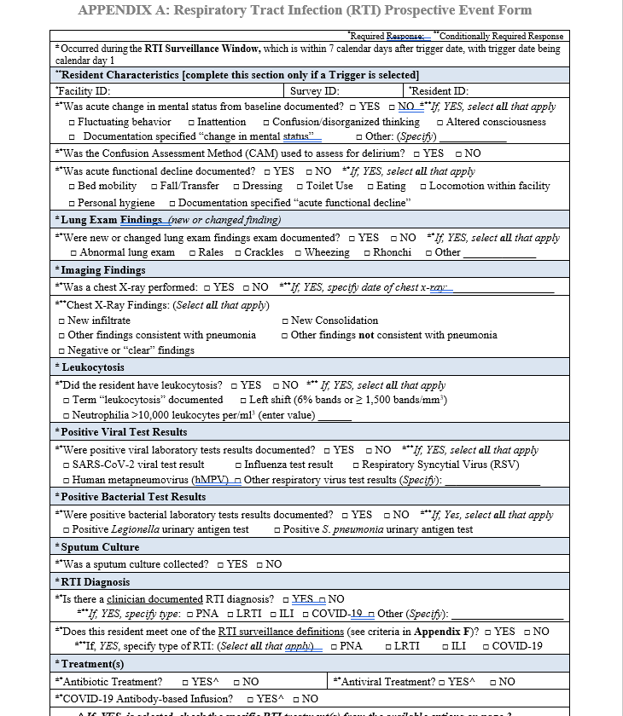
Respiratory Tract Infection Prospective Event Form

Slide 15
Respiratory Tract Infection: “Triggers”

Slide 16
RTI Triggers
Trigger: First documented reason (cause) that initiated further investigation for a suspected respiratory tract infection.
Date of first trigger: initiates the RTI window for surveillance for a suspected RTI.
RTI surveillance window: the 7 calendar days after the date of first trigger in which surveillance for suspected RTI in a single resident is to occur. The date if first trigger counts as calendar day 1.

Slide 17
Knowledge Check
Mr. Jones had a cough on 8/23/2021. On 8/24/2021 a CXR was ordered for suspected RTI.
8/23/2021
Surveillance Window: 8/23-8/30

Slide 18
RTI Triggers
Hierarchy for Available Triggers:
New Respiratory Tract Infection (RTI) Signs or Symptoms (New or Worsening).
Laboratory Result indicating possible RTI
Imaging Result indicating possible RTI
Clinical Diagnoses of a RTI
Antibiotic use for indication of RTI
Antiviral use for possible RTI

Slide 19
Knowledge Check
Mr. Jones had a cough on 8/23/2021. On 8/23/2021 a CXR was ordered for suspected RTI.
8/23/2021
Hierarchy for Available Triggers:
New Respiratory Tract Infection (RTI) Signs or Symptoms (New or Worsening).
Laboratory Result indicating possible RTI
Imaging Result indicating possible RTI
Clinical Diagnoses of a RTI
Antibiotic use for indication of RTI
Antiviral use for possible RTI

Slide 20
Respiratory Tract Infection: Resident Characteristics

Slide 21
Resident Characteristics
Complete only if you have identified a RTI trigger
Facility ID: Assigned by EIP site and anonymous to CDC team
Survey ID: Will be automatically generated so can leave blank
Short-stay residents have been in the facility for 100 days or less
Long-stay residents have been in the facility for greater than 100 days

Slide 22
ID Naming Conventions
List Facility Names and 2-character ID
Resident ID Rules
Facility Name | Facility ID
A.G. Rhodes Cobb | GAAG
Sandy Springs | GASS
Appling | GAAP
Townsend Park | GATP
Christian City | GACC
Lilburn | GAPL
Northside Gwinnett ECC | GANG

Slide 23
ID Naming Conventions
Resident ID will be listed as the 2-digit facility ID, followed by first 3 letters of last name, first 3 letters of first name, and year of birth
Joseph Kellogg is a resident at Sandy Springs and was born in 1992
GASSKELJOS1992 would be his Resident ID

Slide 24
Respiratory Tract Infection: Event Information

Slide 25
RTI Event Information
Enter location where resident was residing on trigger date (e.g., west unit)
Select single best primary service type on date of trigger (yes, hospice is included)
Ventilator includes all residents with a device to assist or control respiration continuously (not CPAP)

Slide 26
Respiratory Tract Infection: Vital Signs

Slide 27
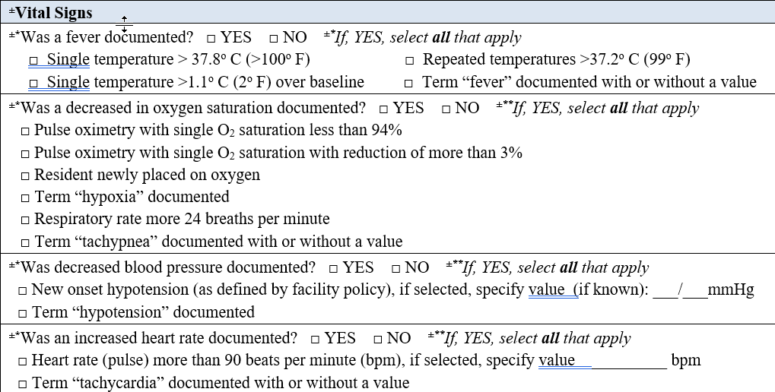
Vital Signs

Slide 28
Knowledge Check
Mr. Johnson had SOB on 8/23/2021.
On 8/23/2021 their vitals are documented as temperature of 99°F, BP 101/90, HR 89 and O2 saturation of 93%
On 8/24/2021 he also had a temperature of 99°F

Slide 29
Respiratory Tract Infection: Signs and Symptoms

Slide 30
Respiratory Tract Infection Signs and Symptoms
Select all signs and/or symptoms that occurred during the RTI surveillance window

Slide 31
Signs and Symptoms: Acute Change in Mental Status from Baseline
Try to look for common ways change in mental status is characterized (e.g., confusion, inattention) but you can always write in the other box
The Confusion Assessment Method (CAM) is a tool used to formally assess for delirium.
Please document if this tool was used.
The facility leader does not need to perform the CAM

Slide 32
Signs and Symptoms: Acute Change in Functional Status
Note: this is different from the McGeer Criteria

Slide 33
Knowledge Check
RTI trigger of SOB was identified on 8/23/2021
On 8/24/2021 the resident was noted to have a fall and was noted to be “confused and agitated”.
agitated

Slide 34
Respiratory Tract Infection: Lung Exam and Imaging

Slide 35
Lung Exam and Imaging
For evidence of pneumonia or a new infiltrate by imaging, only one imaging study is needed.
To be considered as positive for pneumonia, findings are to be new/acute; excluding results related to chronic or other conditions (for example, heart failure).

Slide 36
Respiratory Tract Infection: Leukocytosis

Slide 37
Leukocytosis
Leukocytosis = elevated white blood cell count
Criteria is slightly different from McGeer criteria

Slide 38
Knowledge Check
RTI trigger of SOB was identified on 8/23/2021
On 8/25/2021 the resident was noted have “leukocytosis” documented in the chart. WBC count was noted to be 9,800 wbc

Slide 39
Respiratory Tract Infection: Viral and Bacterial Results

Slide 40
Positive Viral Test Results and Sputum Culture

Slide 41
Respiratory Tract Infection: RTI Diagnosis

Slide 42
Respiratory Tract Infection Diagnosis
E
Select Clinician Documented RTI diagnosis if it appears in the chart
The facility leader will determine if a resident meets a RTI surveillance definition (Appendix E)

Slide 43
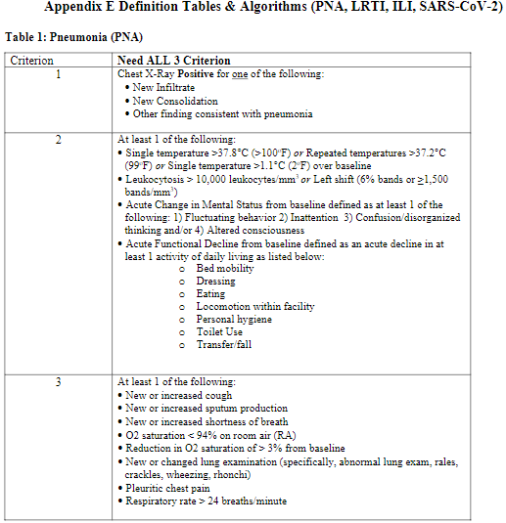
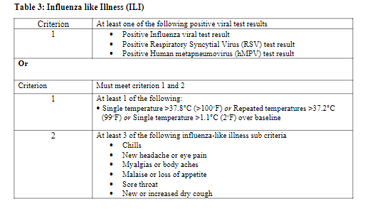
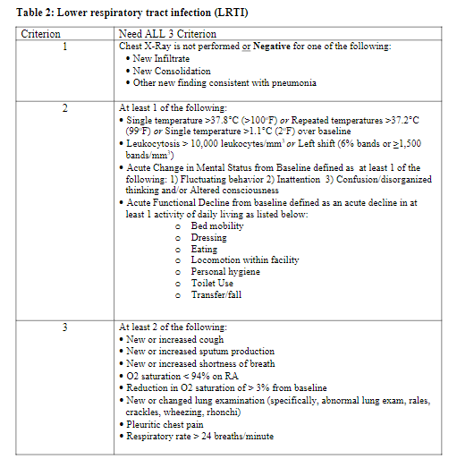
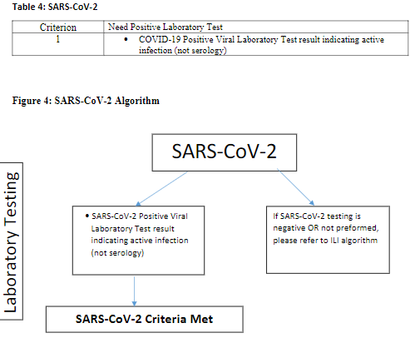
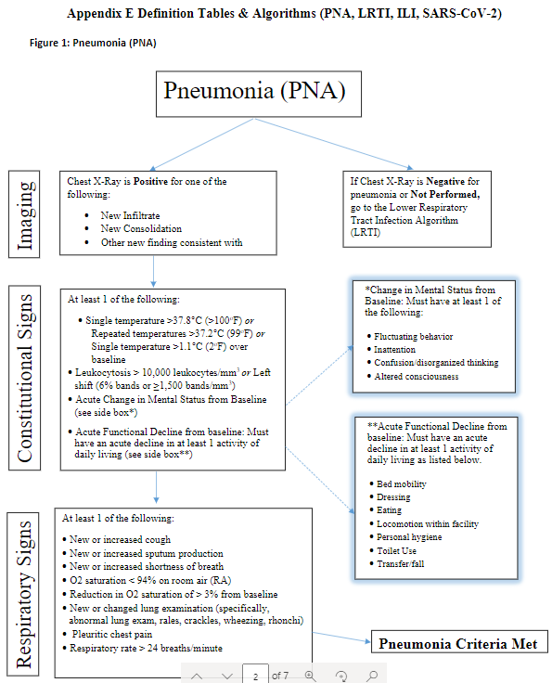
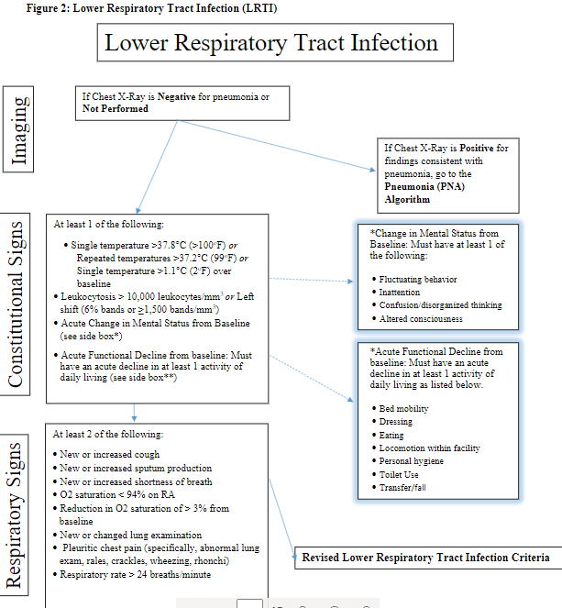
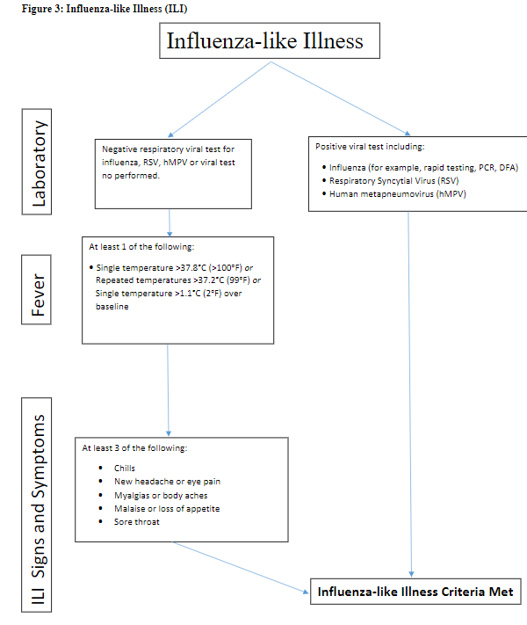
The facility leader will determine if a resident meets a RTI surveillance definition (Use Appendix E as a Guide to Determine Which RTI)
PNA
LRTI
ILI
SARS-CoV-2

Slide 44
Respiratory Tract Infection: Treatment

Slide 45
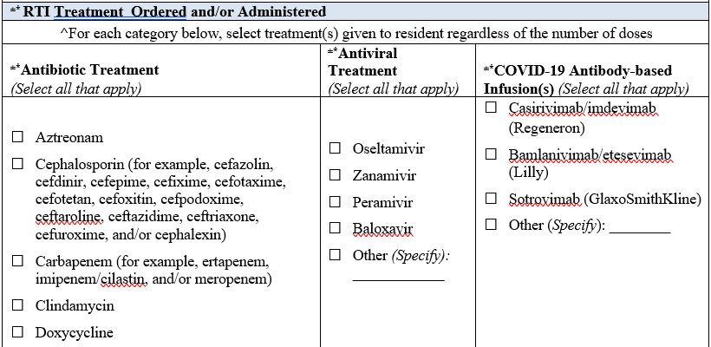
Treatment and Treatment Options
Include antibiotic and/or antivirals ordered or given for indication of RTI, regardless of how many doses the resident received.

Slide 46
Vaccination Status

Slide 47
Additional Respiratory Tract Infection Outcomes

Slide 48
Key Points
14-day rule on repeat infections. A resident may have multiple RTIs
Fill out a new RTI prospective event form in the same resident if there is a new trigger indicating a new RTI ≥14 calendar days after previous trigger date.
7-day “Surveillance Window”
For most clinical information of an event, look at entire 7 day period after Trigger event (8 days total, including day of trigger). Exceptions include outcome (Death)
30-day outcome rule
For death outcome, need to wait for about a month after each trigger event to document alive/dead
Transfer Rule
A patient is considered transferred to hospital if they are admitted for at least one night (overnight stay)
as an outcome this means “transferred=yes” if occurred during 7-day surveillance window
For an antibiotic start, new starts occurring during acute care admissions (of at least one night) are NOT eligible for an RTI form
For antibiotic starts to be a “Trigger” the start must be while a resident, or during a visit to an outpatient or acute care facility WITHOUT an overnight admission at that facility

Slide 49
Review Proposed Facility and Resident ID
Facility ID Resident ID
Facility ID (4 characters)
First 3 last name
First 3 first name
Year of birth
Facility | Facility ID
A.G. RHODES COBB | GAAG
SANDY SPRINGS | GASS
Christian City | GACC
Appling | GAAP
Townsend Park | GATP
Pruitt Lilburn | GAPL
Resident ID example
G | A | A | G | F | R | I | S | C | O | 1 | 9 | 6 | 4

Slide 50
Reasonable Weekly Approach for Oct 1 start
Week | Line List RTI trigger event | RTI Form start (7-day window) | RTI outcome (30-day window) | Track beds, vents | Review and Submit to GA EIP | Review and Submit to EIP
1 | √ (daily) |  |  | Sum weekly*
2 | √ (daily) | Only If events in last week |  | Sum weekly*
3 | √ (daily) | Only If events in last week |  | Sum weekly*
4 | √ (daily) | Only If events in last week |  | Sum weekly*
5 | √ (daily) | Only If events in last week |  | Sum weekly*
6 | √ (daily) | Only If events in last week | Record outcomes weeks 1-2 | Sum weekly*
7 | √ (daily) | Only If events in last week |  | Sum weekly*
8 | √ (daily) | Only If events in last week | Record outcomes weeks 3-4 | Sum weekly* | Submit Oct Denominator form* | Submit October cases**
9 | √ (daily) | Only If events in last week |  | Sum weekly*
10 | √ (daily) | Only If events in last week | Record outcomes weeks 5-6 | Sum weekly*
11 | √ (daily) | Only If events in last week |  | Sum weekly*
12 | √ (daily) | Only If events in last week | Record outcomes weeks 7-8 | Sum weekly* | Submit Nov Denominator form* | Submit November cases**
13 |  | Only If events in last week
14 |  |  | Record outcomes weeks 9-10
15
16 |  |  | Record outcomes weeks 11-12 |  | Submit Dec Denominator form* | Submit December cases**
*Denominator data can be assimilated daily, weekly or monthly (if automated), and submitted once per month
**Submission can be scan and email or fedex TBD

Slide 51
Next up
Initial Questions about form or instructions
Break?
Case study video (9 min)
Review denominator form and instructions (6 min)

Slide 52
Operational Manual
All forms and Instructions Sent via Email with PDFS with filenames outlined below
Also, can be found by clicking here
Please let us know if you have trouble getting access – users must be manually added by Joe
RTI Event Forms
Appendix A RTI Prospective Event form
Appendix B Table of Instructions for RTI Prospective Event Form
Appendix E Definitions, Tables and Algorithims
Census Forms
Appendix C Denominator form
Appendix D Instructions for Denominator Form

Slide 53
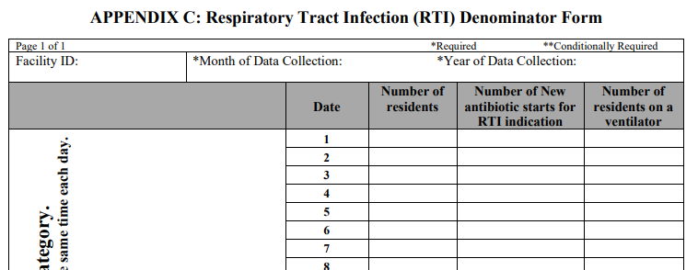
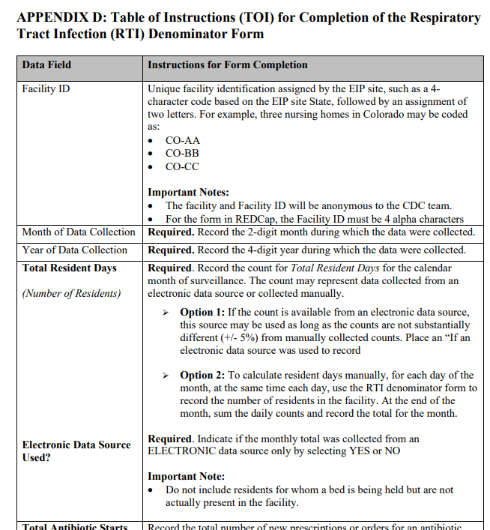
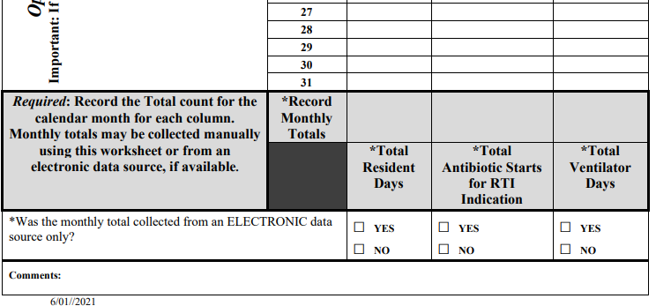
RTI Surveillance Denominator Form
Appendix D – Denominator Instructions
Appendix C – Denominator Form
Worksheet if needed
Totals for each month required

Slide 54
Total Resident Days: Manual Example
At 10:00 am each day:
8/1 = 30 residents
8/2 = 32 residents
8/3 = 31 residents
8/4 = 35 residents
8/5 – 32 residents
8/6 = 31 residents
8/7 = 30 residents
Daily Resident Count
“at the same time each day”
record number of residents in facility
Monthly Sum – at end of month sum daily counts and record
30
32
31
35
32
31
30
221

Slide 55
Total Resident Days: Electronic Capture Example
X
Daily Resident Count
“at the same time each day”
record number of residents in facility
Monthly Sum – at end of month sum daily counts and record
221

Slide 56
Key Points – New Antibiotic Starts
New starts in facility only –
New start = Started while the resident is receiving care by the facility, either by physicians in the facility or by outside physicians who see the resident in an outpatient clinic or emergency department.
Exclude antibiotic starts by another healthcare facility prior to the resident’s admission
Exclude antibiotic started during a transfer to acute care-even if resident originated in your facility and was re-admitted to nursing home after > 1 day interval (i.e., an overnight admission to acute care)
Capture new antibiotic orders, regardless of number of doses or days of therapy, or if course not completed

Slide 57
Denominator Form: Antibiotic Starts for RTI
To calculate the number of new antibiotics starts for RTI.
Daily
“at the same time each day”
record number of new antibiotic starts
Does not include starts during hospital admission (even if transferred for only 1 day/overnight stay)
Working solution – time of day could be morning report/rounds/check in for previous day
Can use own “work sheet” if more reliable

Slide 58
Example – August
Mr. B was started Keflex for pneumonia on 8/1 for 5 days.
Mr. S was stated on ciprofloxacin on 8/4 for suspected LRTI but he went to the hospital on 8/5.
Ms. J is on nitrofurantoin for UTI prophylaxis daily upon NH admission (8/6) from hospital
30
1
32
31
35
1
32
31
0
30
Total = 2 Antibiotic Starts

Slide 59
Example – September
Mr. was admitted to the NH on 9/1 after 3-day August hospitalization for PNA, started on Azithromycin in ED for LRTI for 5 days.
Mr. S a NH resident went to the ER on 9/3 for SOB and was started on ciprofloxacin and send back to the facility in evening of 9/3.
30
0
32
31
1
35
32
31
30
Total = 1 Antibiotic Starts

Slide 60
Ventilator Days
At the end of the month, sum the daily counts and record the total for the month.

Slide 61
Submission of Data
Week | Line List RTI trigger event | RTI Form start (7-day window) | RTI outcome (30-day window) | Track beds, vents | Review and Submit to GA EIP | Review and Submit to EIP
1 | √ (daily) |  |  | Sum weekly*
2 | √ (daily) | Only If events in last week |  | Sum weekly*
3 | √ (daily) | Only If events in last week |  | Sum weekly*
4 | √ (daily) | Only If events in last week |  | Sum weekly*
5 | √ (daily) | Only If events in last week |  | Sum weekly*
6 | √ (daily) | Only If events in last week | Record outcomes weeks 1-2 | Sum weekly*
7 | √ (daily) | Only If events in last week |  | Sum weekly*
8 | √ (daily) | Only If events in last week | Record outcomes weeks 3-4 | Sum weekly* | Submit Oct Denominator form* | Submit October cases**
9 | √ (daily) | Only If events in last week |  | Sum weekly*
10 | √ (daily) | Only If events in last week | Record outcomes weeks 5-6 | Sum weekly*
11 | √ (daily) | Only If events in last week |  | Sum weekly*
12 | √ (daily) | Only If events in last week | Record outcomes weeks 7-8 | Sum weekly* | Submit Nov Denominator form* | Submit November cases**
13 |  | Only If events in last week
14 |  |  | Record outcomes weeks 9-10
15
16 |  |  | Record outcomes weeks 11-12 |  | Submit Dec Denominator form* | Submit December cases**
Starting end of 2nd month, submit monthly
Options include Scanning Forms and Submit Electronically
Via Email – we can review how to encrypt an email if desired
Nearby manual Pick up
Other ideas or concerns
*Denominator data can be assimilated daily, weekly or monthly (if automated), and submitted once per month
**Submission can be scan and email or fedex TBD

Slide 62
Questions
Can you explain the approach to the NHSN RTI Pilot Surveillance (how to track, what to track, what to report)
Did you access instruction manual and forms for surveillance
Do you think you can correctly abstract and report the required data elements for the forms
Do you know steps you need to take to successfully submit forms to GA EIP partners
Have we found a second training time to run through some case studies
This Photo by Unknown Author is licensed under CC BY

