Slide 1
Office for Clinical Research (OCR) A Year in Transition
DOM Ease of Research Town Hall
February 7, 2025

Slide 2
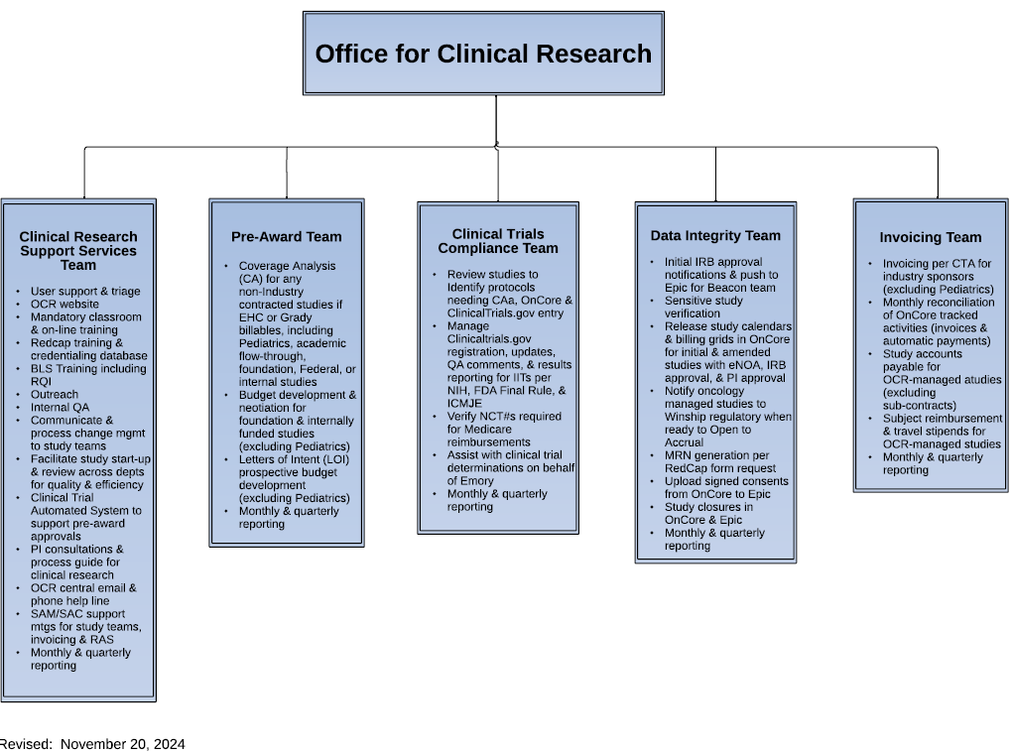

Slide 3
OCR Clinical Research Support Services Team

Slide 4
Clinical Research Support Services (CRSS) Team Overview
To support Investigators' research initiatives, management, and close-out of clinical studies by educating the clinical research team, supporting the research teams' needs, and offering consultative services.
To provide concierge support will ease the burden on research initiatives, transfers, and closeouts.
To partner with Emory ORA, Emory Healthcare, Schools and Departments, Emory Affiliates, and Subjects.

Slide 5
Clinical Research Education, Training, and Consultations
Mandatory clinical research training for investigators and their study team
AHA Basic Life Support/CPR Training
Investigator Consultations
Departmental Trainings
OnCore/Epic Training, now OnCore Superusers and EHI Digital Research Informatics

Slide 6
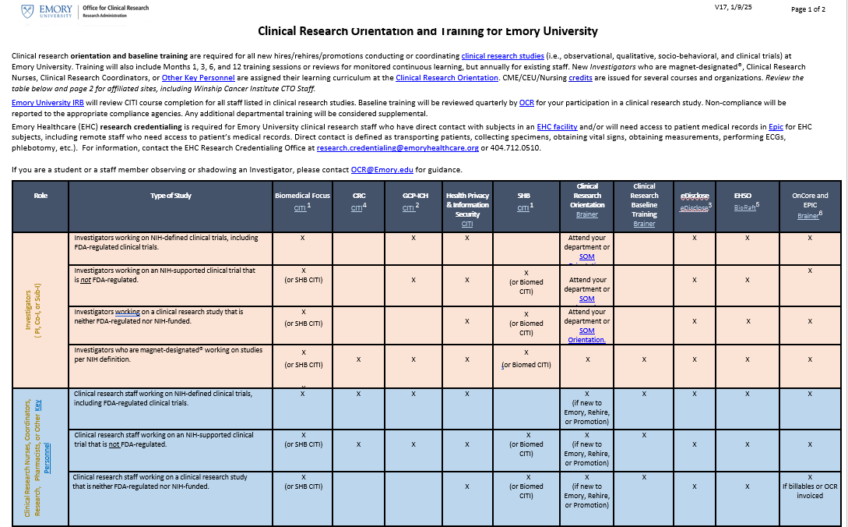
https://ocr.emory.edu/guidelines/guidelines.html

Slide 7
CRSS Metrics
Between FY 24 and FY 25, we have increased by 1 to 5% in each area.

Slide 8
Research Navigation Collaboration with
DSMB/DSMP Searching for new members to join. Sign up here.
Rapid Response Team (RRTs) Streamline and facilitate the Pre-Award approval process for NIH and/or other Federally Funded Network Studies needing fast-track approvals. View criteria and documents here.
Investigator Dashboard (to be replaced by Insight) View the Rack Card here.

Slide 9
CRSS Team Process Improvements
IN PROCESS
Improved mandatory required training for study teams due to # of inexperienced hired clinical research staff.
UPCOMING
Increasing the # of Investigator consultations. Work with ORA to provide additional resources to increase volume.
Introducing Post-Award approval efficiency for budget and financial management. The departments of Pediatrics, Human Genetics, and Infectious Disease are being piloted to determine the process before approaching all departments. This will ensure that all parties involved follow the Post-Award process.

Slide 10
OCR PreAward Team & OnCore

Slide 11
Emory PreAward Division Variations
Woodruff Industry Sponsored Clinical Trials (WISC) PreAward
(Est. February 2024)
Industry Contracted Studies
Develops Coverage Analysis (CA)
Develops, negotiates, analyzes industry budgets
Finalizes industry clinical trial contracts
Office for Clinical Research (OCR) PreAward
Federal, Foundation, Academic Flow Through, Internal, Unfunded, & All Pediatric Studies
Develops Coverage Analysis (CA)
Develops, negotiates, analyzes NON-industry, NON-federal budgets
Develops prospective budgets for Letter of Intent (LOI)
Office for Clinical Research (OCR)
Clinical Trial Compliance PreAward
All Clinical Trials (CT) NOT requiring WISC/OCR PreAward
CT review, processing & subject tracking only for OnCore reporting
Review of IRB-approved studies to ensure research billing compliance
Confirm CT determinations
CT.gov compliance for Emory Investigator Initiated (IITs) research

Slide 12
OCR PreAward Turn Around Metrics April 2024 through January 2025
Submission volume has fluctuated yet turn around metrics remains <30 days (<20weekdays) for CA and budget development.

Slide 13
OCR PreAward Backlog Resolution March 2024 through January 2025
Every effort is applied to keep studies from sitting in OCR PreAward queue. Not only has the volume of active studies >100 days decreased but so has >30 days.

Slide 14
OCR PreAward Process Improvements
IN PROCESS
Improvement to Coverage Analysis (CA) TAT pilot; Saving time and $
Moving OnCore Build/Entry to after CA & Budget finalization.
Establishment of Research Informatics (RI), who manages OnCore.
Development of Non-Industry Working Group to improve fixed or limited budget development, negotiations and/or analysis.
UPCOMING
Implementation of Insight
Pilot AI Pilot project to improve CA development process

Slide 15
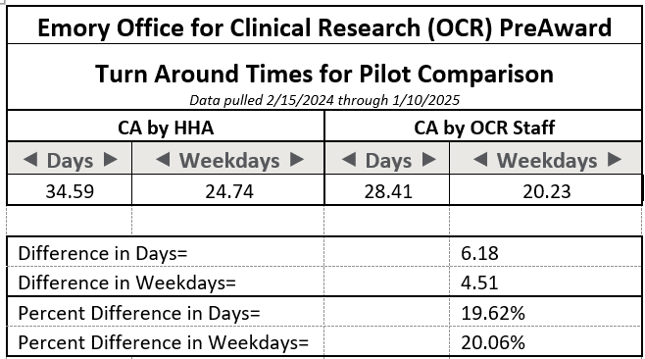
Coverage Analysis (CA) HHA vs. OCR Pilot Project
Completing the CA within OCR is ~20% faster, saving ~$73,000.

Slide 16
Research Informatics (RI) & OnCore CTMS Build/Entry
Research Informatics is a newly created department to manage OnCore CTMS
RI manages OnCore data, reporting and BOS Build of the CA & Budget in OnCore
Advarra Business Operation Services (BOS) is an outsourced vendor specializing in OnCore calendar, CA migration, and budget builds within OnCore
In an effort to obtain swifter activation & amendment updates, the OnCore build has been moved after CA & budget finalization
OCR PreAward
Finalizes CA & Budget
I
R
B
C
O
N
T
R
A
C
T
I
N
G
R
E
S
E
A
R
C
H
A
D
M
I
N
Research Informatics
OnCore Build/Data entry of Final CA & Budget
OCR Data Integrity
Releases OnCore, Pushes to & Activates in EPIC
OPEN TO ACCRUAL

Slide 17
How does OnCore Optimization Impact Study Teams?
OnCore Optimization Effective January 21, 2025
PI/Designee sign-off within OnCore post-BOS OnCore build & RI QA.
Provides the PI & study team the opportunity to review the OnCore build prior to activation.
Track SAEs in subject console.
Track protocol & subject deviations in CRA console (optional).
Improved billing compliance on front & back end.
Identify both sponsor & insurance billables upfront for clinical trials.
Billing department (CTBD) efficiency in EPIC once charges occur.
Dedicated OnCore team – Research Informatics (RI).
Focused on optimizing the OnCore system to provide efficient & transparent subject tracking, & research billing compliance.
RI ServiceNow Support: https://login.emory.edu/idp/profile/SAML2/Redirect/SSO?execution=e1s1

Slide 18
Non-Industry Budgets
Due to the need for standardization, OCR has implemented a non-industry budget working group.
Brings together study teams, PIs, & financial leadership
Identify non-industry budget concerns:
Effort, administrative costs, overhead
Understand current University policies effecting these costs
Goal is to develop guidance to provide as a resource to those developing, negotiating, & analyzing budgets
Provide transparency to investigators and financial staff
Provide budgets based upon actual costs
Decrease budget deficits--identify deficits upfront for cost-sharing needs
Increase TAT

Slide 19
What Is Coming?
Insight
Streamlines all research and innovation processes in a single Cloud-based, highly configurable and secure end-to-end system.
Artificial intelligence (AI)
Upcoming pilot to focus on utilizing AI for CA development, to potentially decrease development time.

Slide 20
OCR Clinical Trials Compliance Team

Slide 21
Clinical Trials Compliance Team Overview
Assists with ensuring accurate clinical trial determinations (NIH, ACT, ICMJE, etc.) for clinical trials conducted at Emory
Actively reviews protocols reviewed by Emory’s IRB to ensure both research billing compliance, as well as ClinicalTrials.gov compliance
Manages all clinical trial activation and subject tracking studies & their set up within OnCore

Slide 22
Clinical Trials Compliance Team Overview
Ensures compliance per for the FDA regulations & the NIH Policy relating to ClinicalTrials.gov for Emory
Manages all Emory investigator-initiated research, including Sponsor-investigator clinical trials, on behalf of Emory for all non-Oncology studies in CT.gov, to include:
Registering the study utilizing the protocol and NIH grant (if applicable)
Updating the record per protocol amendments
Making necessary timeline updates to reflect the current status of the study & outcome measures
Addressing NIH QA review comments
Managing the results reporting process in collaboration with the PI & study teams

Slide 23
Clinical Trials Compliance FY24 Metrics
Total IRB-approved Studies Reviewed = 451
EHC Billables: 22 studies not submitted for a Coverage Analysis prior to enrollment/IRB approval
Non-EHC Billables: 49 studies not submitted to OCR for activation in OnCore
OnCore review for NCT numbers required for billing compliance for all studies per CMS: 393
As of September 1, 2024, Emory was listed as sponsor in clinicaltrials.gov for 1,326 total studies (305 active studies) and 11 study records currently suspended (due to COVID-19 or other reasons)
ClinicalTrials.gov inquiries for problem updates *non-Oncology*: 1,080
OCR initiated study registration for 48 studies, updated 448 study records,
addressed 50 QA Review Comments, updated records for 73
amendments, and entered results for 43 studies.
% of Clinical Trials registered prior to 1st subject enrolled: 98% (47/48)
% of Results reported before deadline: 88% (38/43)

Slide 24
OCR Clinical Trials Compliance Team Process Improvements
IN PROCESS
Improvements for aligning with OnCore and Epic needs for ClinicalTrials.gov tracking of NCT#s for studies for CMS requirements
UPCOMING
Transition from ERMS management and tracking of ClinicalTrials.gov study records into a new system developed specifically to ensure more efficient management and adherence to ClinicalTrials.gov deadlines, etc.
Use of Insight Humans module from Insight implementation includes ClinicalTrials.gov-specific questions for Emory investigator-initiated studies

Slide 25
Data Integration and Integrity Team

Slide 26
Data Integrity Team Overview
Assists with ensuring accurate clinical trial activation for clinical trials and non-clinical trials with EHC billables conducted at Emory.
Initial activation and amendments.
Verifies all clinical trials have eIRB approval & eNOA for compliance.

Slide 27
Data Integrity Team Overview
Ensures study activation & linking to the EPIC system for billing compliance & patient safety.
Manages all Emory Redcap requests for medical record numbers for subject entry into OnCore linking to the EPIC system for subject safety.
Managing the process in collaboration with the EPIC team, PI & study teams.

Slide 28
Data Integrity Team Overview
Daily push of studies through interface for updated information on clinical trials in OnCore.
Ensures compliance for the informed consent documents.
Reviews the document for accuracy; uploads the document into the subject medical record in EPIC for patient safety.
Ensure that studies are closed in the OnCore system when closed in the eIRB.
Confirming all subjects are off study.

Slide 29
Data Integrity Team FY 24 Metrics
Total Initial Studies activated in OnCore and EPIC = 391
Initial eIRB approval studies pushed to EPIC = 347
Medical Records generated through Redcap = 2,098
Reviewed and uploaded from OnCore to EPIC
-Signed Informed Consent Documents (ICD) = 5,289
Calendars released in OnCore new and amended/revised and then released in EPIC = 725
Billing grids released in OnCore new and amended/revised and then released in EPIC = 2,040 (many studies have more than one billing grid)

Slide 30
OCR Data Integrity Team Process Improvements
IN PROCESS
Improvements for aligning with OnCore and Epic using new task lists.
UPCOMING
Transition from OnBase management and tracking of Clinical Trials to OnCore study task list records to ensure more efficient management, adherence & transparency for studies in the pipeline.
Use of Insight Humans module from Insight implementation to help with workflow processes.

Slide 31
OCR Invoicing Team

Slide 32
OCR Invoicing Management Attributes
Industry
Sponsored/Funded
CLINICAL TRIAL
Human subjects research in which people, data or samples of tissue are studied to understand health and disease
Includes studies with two funding sources
Non-Industry
Sponsored/Funded
CLINICAL TRIAL
Includes:
Industry
Sponsored/Funded
CLINICAL RESEARCH
Non-Industry
Sponsored/Funded
CLINICAL RESEARCH
Must meet NIH/FDA definition of a clinical trial
OCR manages ALL of the above
with/without PRA
Non-Invoiceables payments
Milestones payments
OCR manages ALL of the above
with/without PRA
Non-Invoiceables payments
Milestones payments
Hybrid/Double Award
Federal/Non-Federal
Evaluate case-by-case
OCR to contact RAS
PI Initiated
Foundation
Federal
Managed ONLY if:
Invoice required by sponsor for CPT coded items/services
Managed ONLY if:
Invoice required by sponsor for CPT coded items/services
Includes:
PI Initiated
Foundation
Federal
Who will manage?
Preference:
One dept to manage acct vs. across depts
OCR does NOT generate/pay invoices for subawards
OCR does NOT generate/pay invoices for subawards
OCR does NOT generate/pay invoices for subawards
OCR does NOT generate/pay invoices for subawards
OCR does NOT generate/pay invoices for subawards
Office for Clinical Research

Slide 33
OCR Invoicing Processes (Industry sponsored or funded)
Monthly Study Reconciliation:
Generate invoices for start-up costs, pass-through items, milestones & research activities with EHC billables tracked in OnCore
Itemize/match monies received for activities paid automatically based upon completion of sponsor milestones per the CTA to activities tracked in OnCore
CRF completion
Queries
Monitoring visits
Process payments to external vendors, patient stipends & travel reimbursements
Generate monthly study status reports for industry-funded clinical trials & research

Slide 34
Invoicing Metrics
FY2024
Active studies: 1,190
Active Research Participants with Invoicing Activity: 2,880
Research Visits Reviewed: 14,992
As of August 31, 2024
Outstanding Invoices: $2,494,366
Outstanding Automatic Payments: $61,192
Payments Received & Reconciled: $41,989,054
Payments Received Not Reconciled: $2,022,124
Study Expenses Paid: $1,544,309

Slide 35
OCR Invoicing Team Process Improvements
In PROCESS
OnCore replaced ERMS (Emory Research Management System) in Fall 2022 for protocol management and subject tracking. Optimization in January 2025 transitioned sponsor invoicing to OnCore.
UPCOMING
Insight implementation will replace most Emory systems used to improve research administration, efficiency, compliance, & transparency. One stop shopping…

