Slide 1
Maintenance of Certification, part IV
Practice Assessment
Getting credit for local practice improvement
Nathan Spell, MD
Chief Quality Officer, EUH
Vice Chair for Quality and Clinical Effectiveness, Dept. of Medicine

Slide 2
MOC Requirements*
Requirement | Frequency
Pass a secure exam (worth 20 points) | Every 10 years, after year 6 of cycle
Do some activity to earn points | Every 2 years
Accumulate 100 points, which must include Practice assessment (at least 20 points) Medical knowledge (at least 20 points) Patient safety (may be included in one of above) Practice survey (voice of patient) (may be included in one of above) | Every 5 years
And pay a lot of money for the pleasure of doing MOC | ongoing
* Under re-evaluation by ABIM and subject to modification

Slide 3
MOC Practice Assessment Needed
Don't have local data
Have local data sources
ABIM PIM
AQI Pathway
Self-directed or Completed project ABIM PIM
(predefined measures)
Emory Medicine as Portfolio Sponsor
(EHC, TEC, Grady, VA measures)
Order through
abim.org
ABIM-approved
materials from other
professional societies
or registries
On-line application
and submit data at
abim.org. May
propose own
measure for ABIM
approval.*
Local approval by
sponsoring institution
(not yet at Emory)
* Requires processing time

Slide 4
Self-directed or Completed Project
Self-directed Project
Completed Project
Prospective
Baseline data <12 mos. old
Retrospective
Project completed w/in last 24 months
Data on at least 25 patients
Data for at least 3 measures from ABIM Measures Library
Can propose your own metric for improvement if one of these is not appropriate for your situation
Can be done as a group

Slide 5
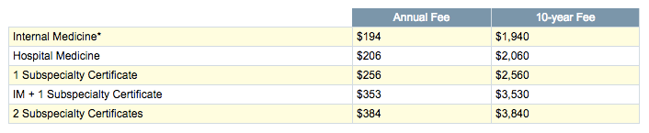
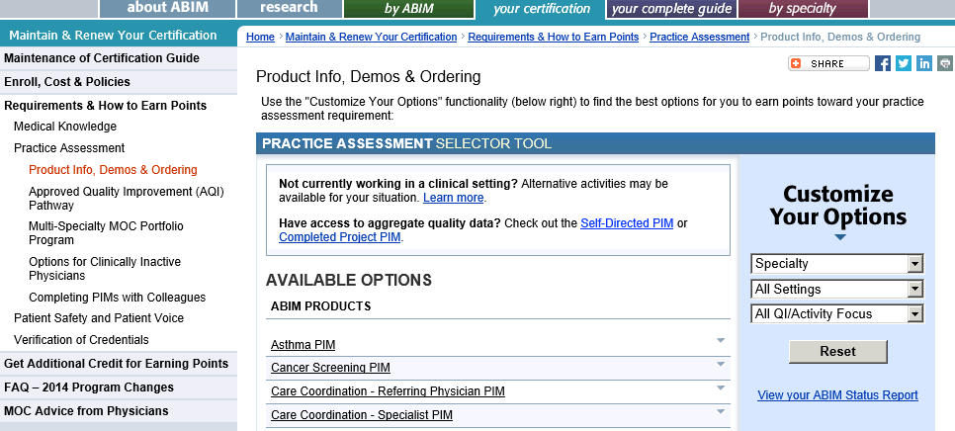
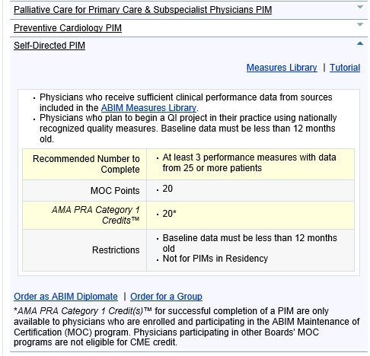
Instructions
Enroll in MOC and pay fees, if not yet done
Select Practice Assessment
  Self-directed or Completed project PIM
Order for yourself or a group
  If Group, one person initiates
  Will need to name participants, with ABIM #’s
  Each participant must be enrolled in MOC

Slide 6
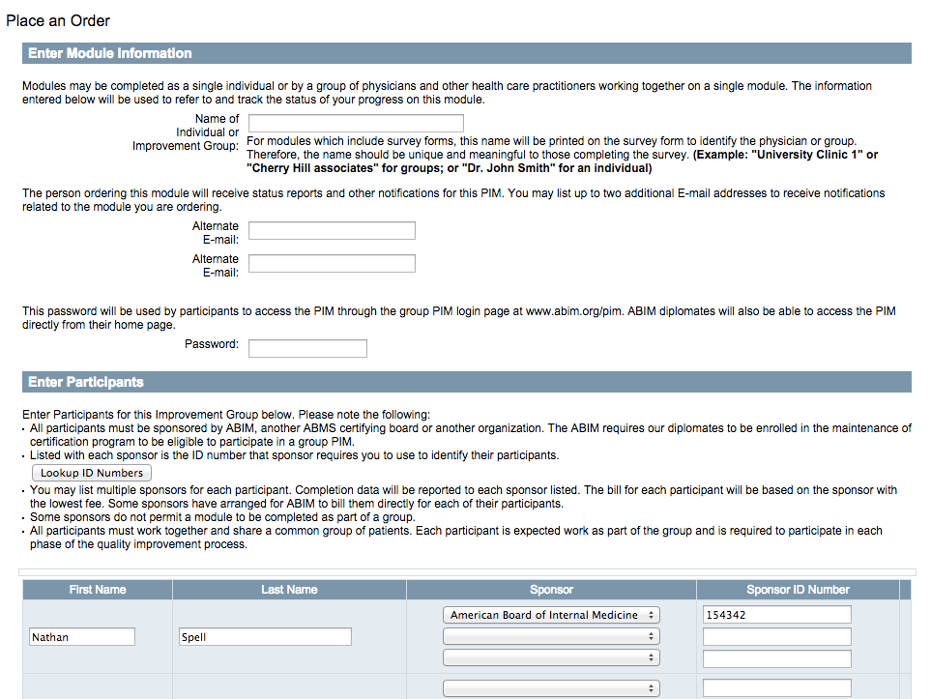
Instructions, continued
Enter info to initiate the module
Select 3 quality measures from the Measures Library on which you have local data or are able to gather by review of patient charts.
Choose a measure to improve and reassess after improvement (option to propose your own measure, too)

Slide 7
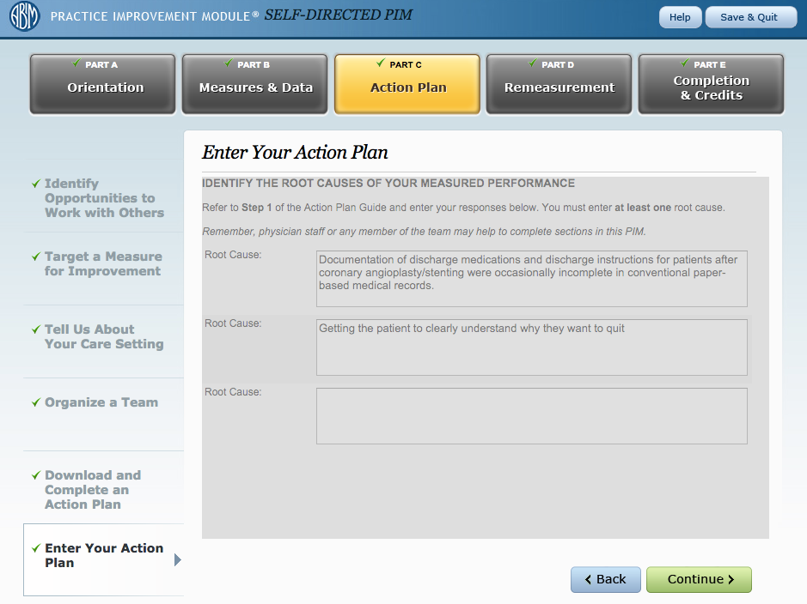
Instructions, continued
7. If doing as a group, each member will have to log in, enter data, describe the process, and describe/attest to his or her personal involvement in the work.

Slide 8
In the end . . .
Earn 20 points toward MOC and satisfy the Practice Assessment requirement
Earn 20 credits of CME

