Slide 1

Office of SVPR
Resources For New Faculty
Kimberly Eck, MPH, PhD
Sr. Associate Vice President for Research, Emory University

Slide 2


Finding Funding
Funding Resources & Opportunities
https://research.emory.edu/funding/index.html
Get Started with Grant Forward:
https://www.grantforward.com/index
https://research.emory.edu/_includes/documents/grantforwardquickguide.pdf
Funding Fridays (join the email list):
https://visitor.constantcontact.com/manage/optin/ea?v=001y1UJ-rXujfIVDSE5-FF6PVxl-xHvggKOqzPi4BXaWg0kT2Om-64vRSrEi5ekjA7IZXkBYcYM3G62VPlmzcADObDjRnJyeoth
University-wide internal funding opps

Slide 3
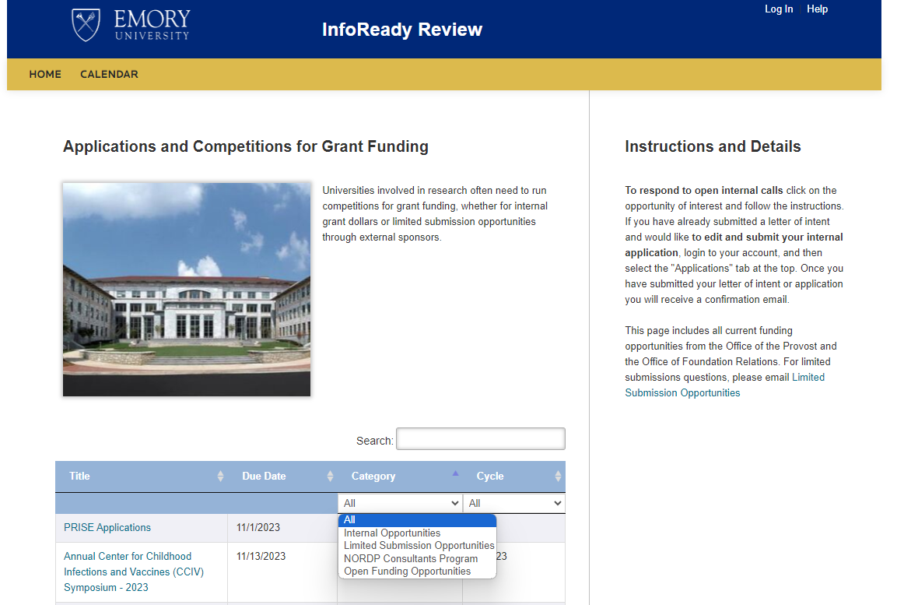
Limited Competitions & Internal Funding
Limited competitions
Many but not all internal funding opportunities
Website: https://emory.infoready4.com/
Examples of Internal Programs:
URC Program
Seeds from Office of SVPR
SOM I3

Slide 4
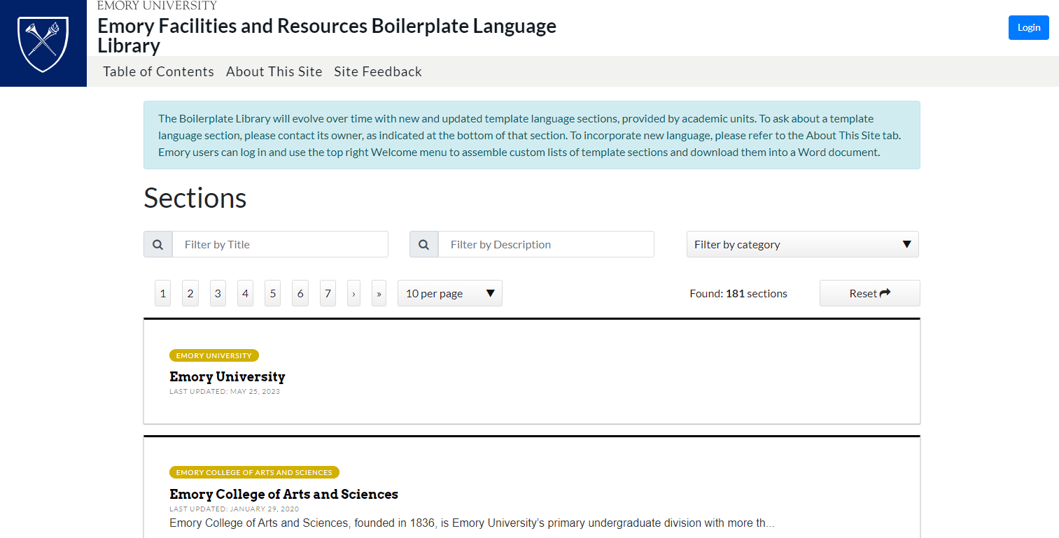
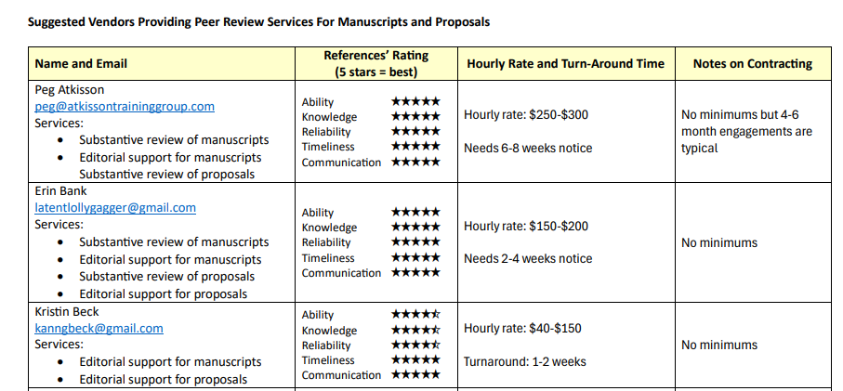
Proposal Development Resources (Self-Service)
Website: https://boilerplate.emory.edu/
Descriptions of:
Universities
Schools
Departments (some)
Core facilities
Healthcare
… and more
Website: Vendor List
Suggest vendors that can provide editing and review for manuscripts and proposals

Slide 5


More Proposal Development Resources (Optional)
Guidance on the agency
For abstracts: Review
For full proposals: Typically, comprehensive support
Mega Grants ($10M)
Comprehensive support tailored to the team and proposal
Contact us as soon as possible
Training Grant Support
Support for institutional training grants
Including completing those tables!
And evaluation design!

Slide 6

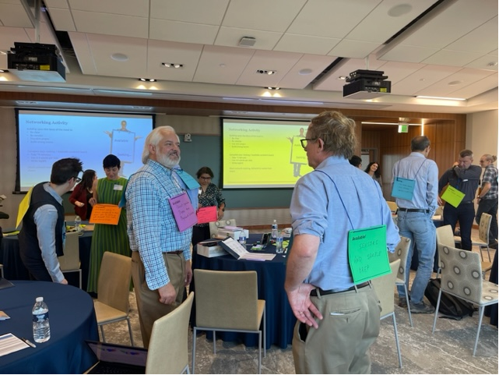
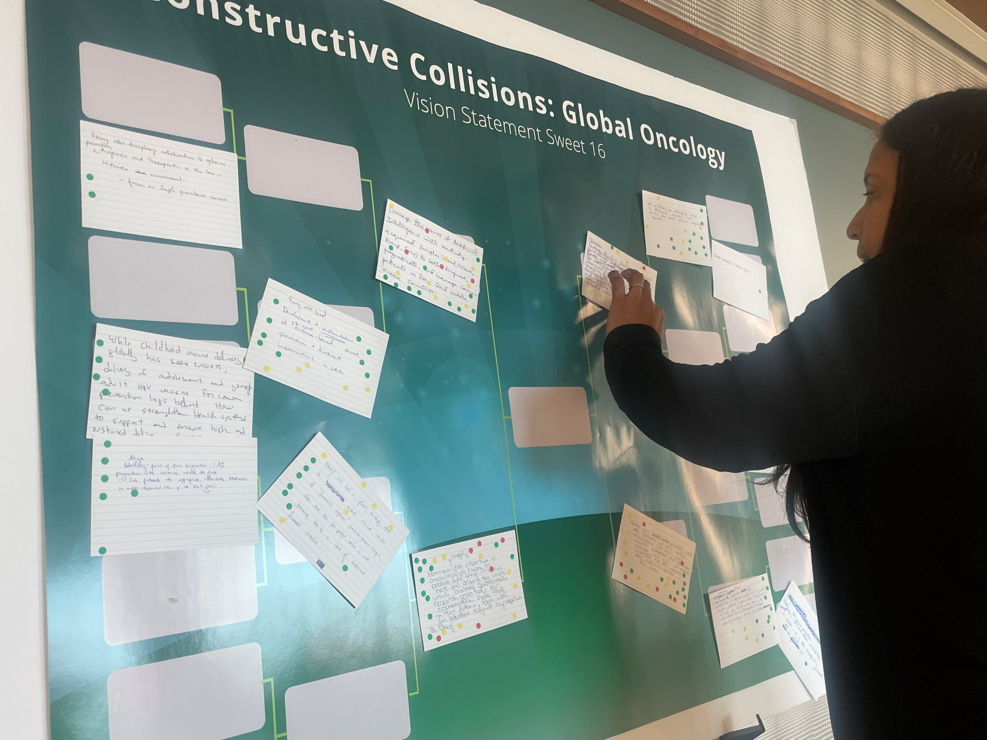
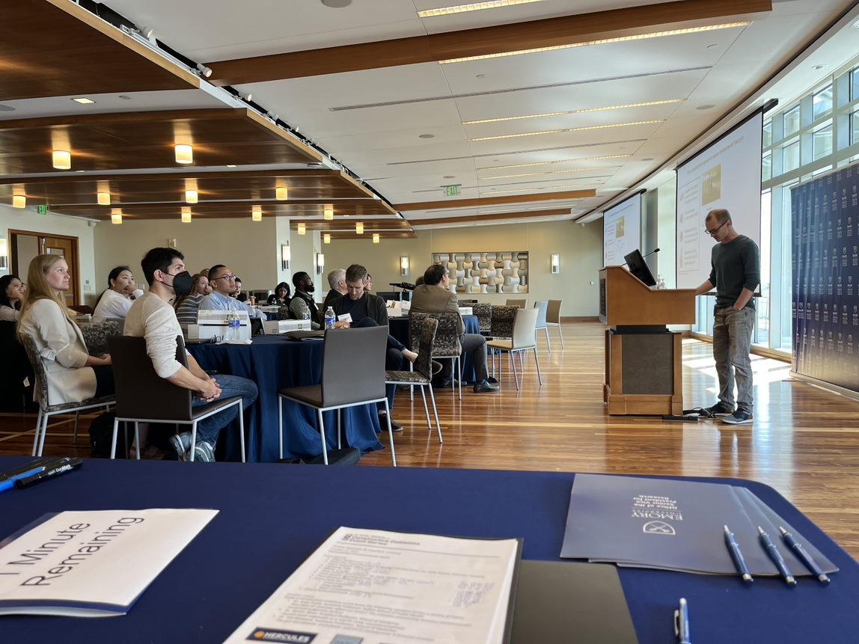
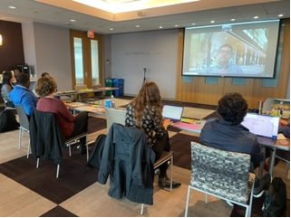
Constructive Collision Events
Previous Constructive Collisions
Spring 2024
AI.Humanity New Hires (Jan)
  Planned with Office of the Provost
Teaming for Diverse Funders (Jan)
  In conjunction with SVPR Seed
DOD Congressionally Directed Medical Research Programs (CDMRP) (March)
Women’s Health (April)
  WH Initiative on Women’s Health
Fall 2024
Advancing Health Equity & Diagnostic Technologies (Nov)
  NSF Engine Planning Grant
Humanities x Health Sciences (Dec)
  Planned with Center for Healthcare History and Policy

Slide 7
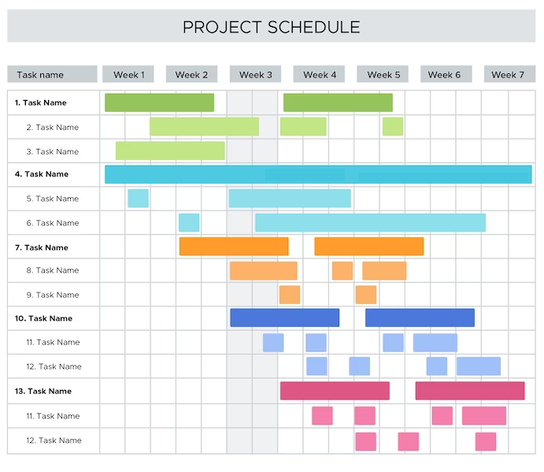
SVPR Project Management and Evaluation Service Center
https://research.emory.edu/research-development/pm-and-evaluation.html
Project management and evaluation services are available through the service center
Post-award service for Emory investigators
May also be supported with institutional funding
Fill temporary or part-time gaps in project management
Conduct evaluation projects with limited scope or budget
Should NOT replace traditional mechanisms of securing PM and Eval services, e.g. hiring dedicated PM for large project or hiring external evaluator.

Slide 8



Sometime in 2025: Use SciENcv To Format NIH Personnel Documents
SciENcv helps you create and manage documents in support of grant applications with participating agencies
Biosketches and Current and Pending Support for proposals and RPPRs submitted on or after Date TBD must use the new Common Form and be produced using SciENcv
The easiest way to populate your SciENcv biosketch is through an ORCID iD: https://guides.libraries.emory.edu/c.php?g=1052178&p=7640122
Go to SciENcv and initiate the creation of a biographical sketch. Then select ORCiD as your external data source.
Step-by-step guide with screenshots: https://www.ncbi.nlm.nih.gov/books/NBK154494/
Stay tuned for additional communications and resources … at https://rcra.emory.edu/research-security/sciencv.html
NOT-OD-24-163 for details

Slide 9
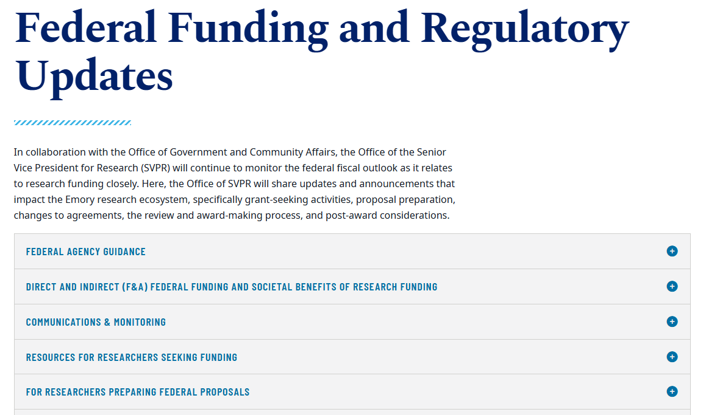
Federal Updates
Factual updates impacting Emory’s research ecosystem are maintained here:
https://research.emory.edu/federalupdates/index.html
Limited direct emails but will have links in Funding Fridays
Current advice for researchers
  Submit proposals
  Spend on awards

Slide 10
Questions?
keck@emory.edu

