Slide 1

Uhi’s plan-Engaging you
UHI faculty, staff and student leaders welcome you.
We want to involve you in a UHI project for summer and beyond.
Have engaged project teams that can work flexibly.
Let’s share a virtual dinner and build our community.
www.urbanhealthinitiative.emory.edu for meeting information

Slide 2
Our Mission
UHI provides health disparities education and advocacy, builds collaborative partnerships and develops best practice models with underserved communities and those who work with them in Metropolitan Atlanta in order to advance equity in health and well-being.

Slide 3
Learn MORE ABOUT US
http://bit.ly/2f9Enyn
Notes:
Please view the linked video to hear from our founder & director, Dr. Charles Moore. http://bit.ly/2f9Enyn

Slide 4
UHI Leaders
Charles Moore, MD: Director
Jada Bussey-Jones, MD: Co-Director
Amy Webb Girard, PhD: Co-Director
Carolyn Aidman, PhD: Associate Director
Brittany Evans, MHA: Assistant Director
Joan Wilson, MS: Assistant Director
Bill Sexson, MD: Senior Advisor
Carlos del Rio, MD: Senior Advisor
Nadine Kaslow, PhD: Senior Advisor
Notes:
Our leadership board is filled with professional from many fields allowing us insight into many aspects of community health.

Slide 5
INTERESTED IN JOINING A UHI PROJECT?
Learn about UHI active projects through presentation and team breakout calls. Meet project coordinators.
Sign up and participate in project breakout calls tonight.
Contact: Blessing Falade, blessing.o.falade@emory.edu
Notes:
To join UHI, we ask you first send us your resume or CV and a statement expressing interest in a particular project (or projects!) and your relevant experience. The statement does NOT need to be formal cover letter. A paragraph in email is perfect!
We will then schedule an interview with you to see what project will best fit your interest and skills.
Then, we will ask you to send us a headshot and bio, proof of CITI certification (social, or behavioral, either is fine), and sign-off on Emory release forms (i.e. photo release, volunteer, etc.).

Slide 6

Walk with a doc
GOAL: To provide a no cost walking program for anyone interested in living a healthier lifestyle. Talk with medical professionals outside the office.
Volunteers Needed: Project coordinator and team members
Upcoming Plans:
  Promote Walk with a Doc activities to healthcare professionals who are interested in physical activity while sharing healthy ideas.
  Promote events to community members who would like the opportunity to talk with health care professionals in a casual environment.
Contact: Dr. Charles Moore, cemoore@emory.edu

Slide 7

Tobacco use prevention & Cessation
GOAL: To provide Grady Hospital patients, employees, and Atlanta community members with information and advice about the dangers of smoking and vaping.
Volunteers Needed: Team members
Upcoming Plans:
  Collect and share information and strategies for tobacco use resistance.
  Promote success in quitting therapies via smoking cessation classes.
  Help evaluate success and needs for programs, ongoing.
Contact: Dr. Charles Moore, cemoore@emory.edu

Slide 8
Health Careers Collaborative
GOAL: To engage students to graduate from high school through project-based learning with a focus on science and health care related issues by modeling a diverse range of health-related career pathways and empowering students to identify the most pressing health needs in their community and engage students in community-based health promotion activities.
Volunteers Needed: Students and Professionals in the following fields: Public Health, Medicine, Allied Health, and Physician Assistants.
Upcoming Plans:
  Develop virtual learning activities and tutoring sessions for our partner schools
  Hold end of the year debriefs with volunteers and school leaders
Contact: Brittany Evans, brittany.evans@emory.edu

Slide 9

Program: RYSE
(DIVERSITY, Equity, & Inclusion—Department of Medicine)
GOAL: Our program has been designed to facilitate mentorship and networking; and enhance academic and research agendas. This initiative specifically targets historically underrepresented minority healthcare professionals with a specific emphasis on faculty in academic health sciences. This program will enhance peer mentoring and sense of community among URM faculty members and learners; develop/enhance leadership and career development skills identified by participants; encourage meaningful discussions about the experience of navigating academic health sciences as a URM faculty members and learners; and contribute to efforts to create a more diverse and inclusive environment.
Volunteer Needs:
  TBD; Most of our programming has been postponed due to the unprecedented impact of COVID-19.
  Upcoming—On-site volunteering at GA-GEAR: Community Health Fair
Upcoming Plans:
  Professional Development and Networking Event: Physician Wellness
  GA-GEAR: Community Health Fair
Contact: John-Otis Blanding, jobland@emory.edu, Karastin Hughes, Karastin.hughes@emory.edu

Slide 10
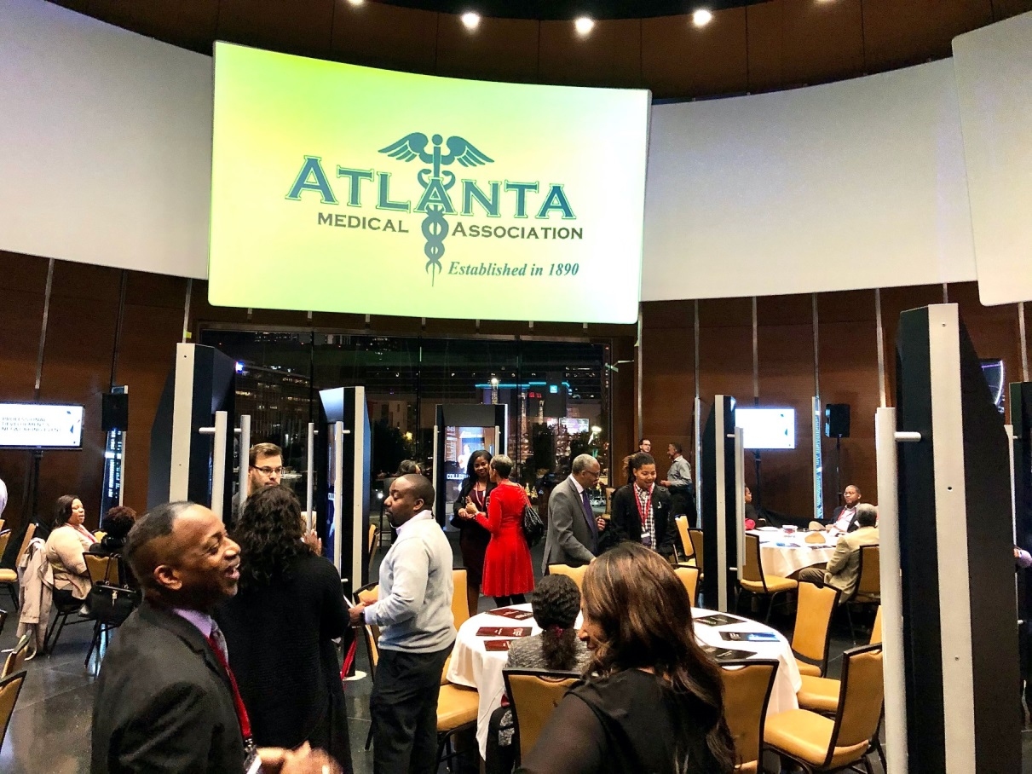

minority professional development & NETWORKING EVENT
“The Impact of Alzheimer’s Disease on Your Role as a Caregiver and Physician”
PROGRAM: RYSE CONT.

Slide 11
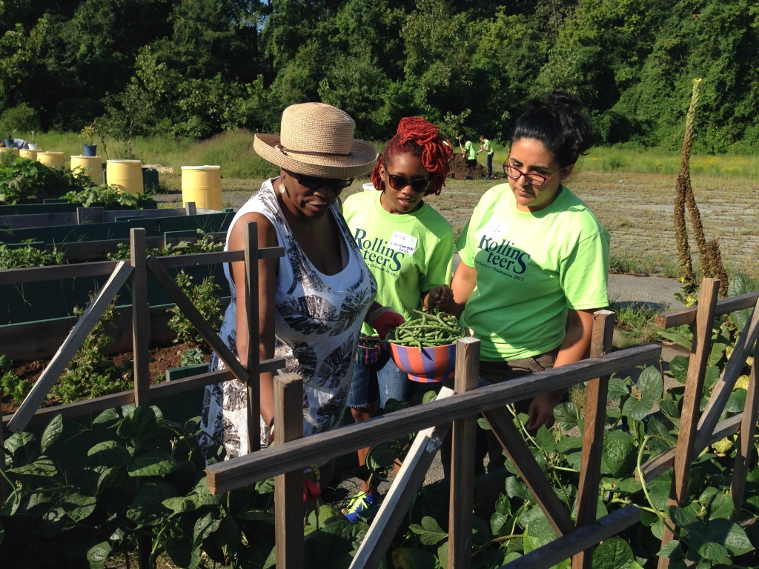
Food Access Programs
Community Teaching Gardens
  Gardening Workshops for Community Members
  Harvest is provided free to community members
Read-to-Me Program (R2M)
  Combining Literacy and Garden-related STEM education
  Hand’s on Activities to reinforce learning
Urban Farmer Entrepreneur Program
  Agriculture / Business Skills / Leadership Skills
  Focus on Recruitment of Women & Girls
Contact: Joan Wilson, joan.wilson@emory.edu

Slide 12

UHI Advocacy Core
Goal, learn to advocate for issues of equity
Volunteer Needs:
  Project Coordinator- Assist in the development of a Laney Graduate School course on Interprofessional Education and Social Determinates of Health course
  Project Coordinator- Assist with Ethics and Advocacy webinar, Primary Care Advocacy Collaborations, Civility Discussions
Contact: Joan Wilson, joan.wilson@emory.edu
Dr. Bill Sexson, wsexson@emory.edu

Slide 13
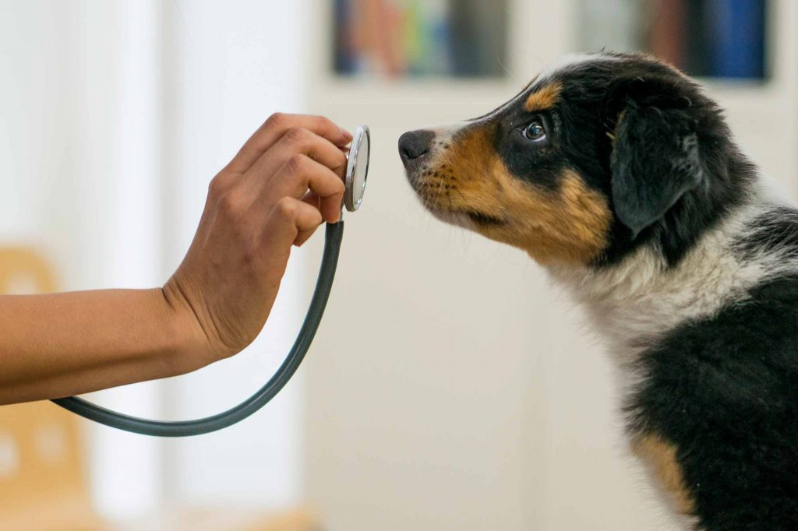
Cancer Detecting dogs
GOAL: To seek ways in helping low resourced patients have greater access to diagnostic cancer testing. Cancer sniffing dogs are the newest generation of service dogs and a resource we strive to bring to the patients and medical team at Grady Hospital.
Volunteer Needs: Students and professionals that share interest in being part of a team working towards the development of new research methods that can change the future.
Upcoming Plans:
  IRB Approval, Grant writing, Marketing
Contact: Taqiyya Alford, taqiyya.alford@emory.edu

Slide 14
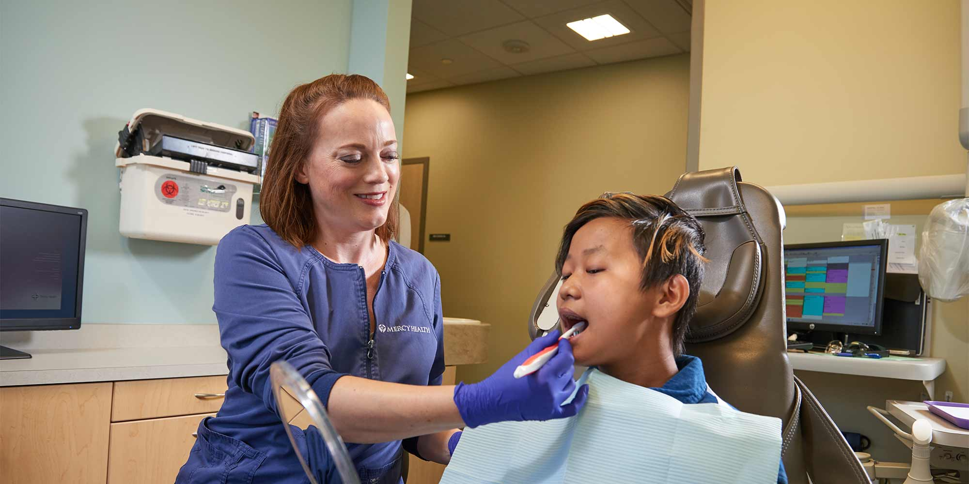
Dental Diversion
GOAL: To divert patients from using the Grady Emergency Department for dental-related concerns; To increase the number of Atlantans with a dental home by maximizing the presence of the HEALing Community Center’s highly skilled dental team in the community
Volunteer Needs: Hollis Innovation Academy Team Lead
Upcoming Plans:
  Outreach at Hollis Innovation, including content development for parents and teachers
  Train Grady Primary Care providers on conducting oral health screenings during primary care exams
Contact: Grace Buchloh, gracebuchloh@gmail.com

Slide 15

Healthy Pregnancy Spacing
GOAL: To develop and disseminate information related to healthy pregnancy spacing to women of reproductive age in Atlanta.
Volunteer Needs: Social Media Manager, Lead Media Content Developer
Upcoming Plans:
  Add information on healthy pregnancy spacing to UHI website
  Host focus group with expectant and postpartum women to assess response to media and gain new ideas for media content
  Media content development
Contact: Penelope Strid, pen.strid@gmail.com
Photo from World Vision

Slide 16

Atlanta doula connect
GOAL: To provide opportunities and community support in maternal and child healthcare, empowerment, career development, and support for women, especially during the pregnancy and labor and delivery
Volunteer Needs: Team members for promotion, monitoring and evaluation
Upcoming Plans:
  Continue developing Atlanta Doula Connect a Volunteer Labor Support Program
  Partner with Georgia Tech App Development Team, the ObsTECHtrics
  for Atlanta Doula Connect App
Contact: Sandra Manhan, sandramanhan13@gmail.com

Slide 17
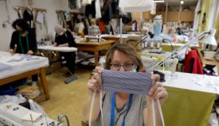
Emory safety manual
GOAL: To develop curriculum for an online course providing students, staff, faculty from Emory and other universities and community partners with helpful information on how to stay safe.
Volunteer Needs:
  IT Member- who likes IT and course development to update the Safety Manual course on Canvas, pilot test, and implement throughout Emory and other sites.
  Evaluator Member- must have skills and interest in continued evaluation to see how the Safety Manual is being received, understood, along with being able to make quality improvements, e.g., COVID-19, as they appear.
Contact: Chryston Jones, cjjone3@emory.edu

Slide 18
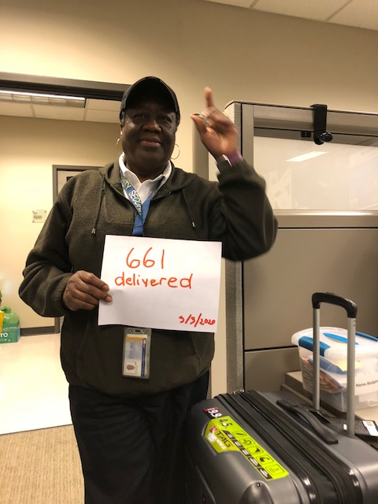
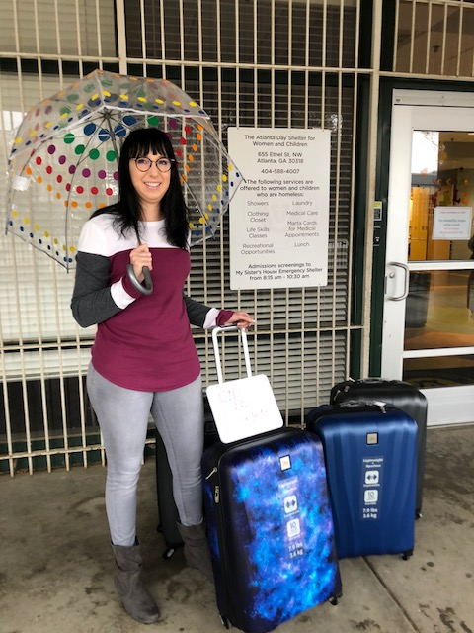
Rolling Suitcase Drive
GOAL: To provide rolling suitcases to homeless individuals with limited transportation, to improve secured mobility of their possessions. To date there have been 661 suitcases delivered!
Volunteer Needs: Members needed to assist with promoting the rolling suitcase drive, develop PR material, community outreach with faith congregations, restaurants, other organizations. Plan evaluation, keep website up-to-date, write articles.
Upcoming Plans:
  Investigate if suitcases improve mobility
  Update media content
  Planning for after COVID-19
Contact: LyTina Brown, lytina.brown@gmail.com

Slide 19

Operations team
GOAL: Maintain communication and coordinate across projects by scheduling/attending meetings, detect operational gaps and inconsistencies, propose operational improvements, develop tool to track programs progress and develop reports as needed.
Volunteers Needed: Marketing Assistant, Administrative Assistant (student or professional interested in gaining experience in management)
Upcoming Plans:
  Expand partnerships and sponsors
  Increase awareness of UHI and participate in outreach activities
  Recruit future volunteers
  Develop additional projects
Contact: Taqiyya Alford, taqiyya.alford@emory.edu; Blessing Falade, blessing.o.falade@emory.edu

Slide 20

Questions? Ask in Chat Box

Slide 21
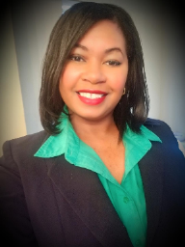
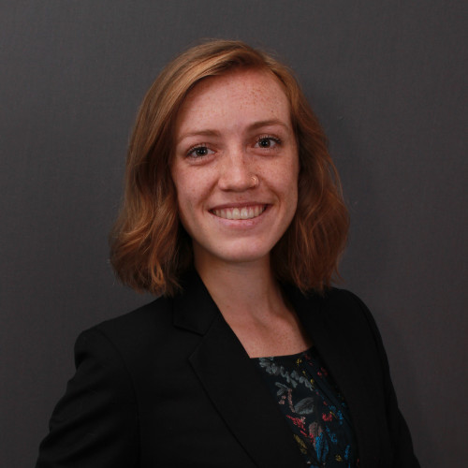
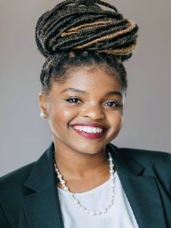
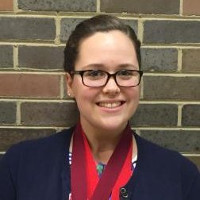
UHI fellows designation AWARD
Taqiyya Alford
  UHI Operations and Cancer Detecting Dogs
Grace Buchloh
  Dental Diversion and Access to Dental Care
Blessing Falade
  UHI Volunteer Coordinator
Penelope Strid
  UHI Operations and Healthy Pregnancy Spacing
  Coordinator

Slide 22


Please complete our Post-Meeting Survey Available at: https://www.surveymonkey.com/r/55BYWV5

Slide 23
Breaking bread together to build community
Get your dinner or snack.
Dial in to your favorite project team breakout meetings and share:
  Contact information
  Interests and skills team has and needs
  Set summer calendar, plan to work virtually
  Take action items and get started
Meeting facilitator will create record and send to all, confirming first meeting.
Adjourn

